Slide 1
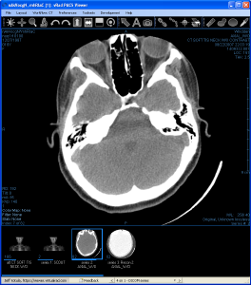
Strategies for 24/7/365 SaaS Jeff Kotula Principal Software Engineer jeff.kotula@vrad.com

Slide 2
Agenda
The System and Environment
Challenges
General Approach, Rules of Thumb
Hardware
System Design
Downtime
Peopleware

Slide 3
Virtual Radiologic
(vRad)
Teleradiology
jeff.kotula@vrad.com

Slide 4
Teleradiology
Attending doctor determines that a scan is needed
Broken limbs, car accident, falls, stroke evaluation, GSW, internal bleeding…
Patient is scanned (XRay, CT, MR, PET, etc.)
Hospital, imaging center, mobile scanner
Images are sent to the vRad PACS system in Minneapolis via VPN
PACS – Picture Archiving and Communication System
Order information is gathered from radiology technician via the web
RIS – Radiology Information System
Radiologists access and review orders (RIS) and images (PACS) from home
vRad radiologists online 24/7/365
Radiologist report is sent back to attending doctor or facility
Faxing is still the gold standard
But doing more with mobile devices
Attending doctor evaluates report and determines treatment

Slide 5
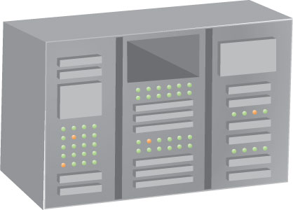
Teleradiology
Auto-route images to radiologists on the basis of subspecialty, demand/capacity, etc.
Optimizes use of subspecialty radiologists and report turnaround in environment of fluctuating volumes
Neuroradiologist
Hospital 1
Neuroradiologist
Hospital 2
MSK radiologist
vRad Data Center / PACS / Order Management
Pediatric radiologist
Hospital 3
Body radiologist
Hospital 4
General radiologist
Imaging Departments

Slide 6
Teleradiology
Growing demand:
Declining radiologist population, aging patient population
Radiologist specialties (neuro, MSK, pediatrics, etc.)
High number of small hospitals and practices
vRad staffs over 200 radiologists
Scattered throughout US, some in Europe and Asia
Work at home! Small subset work on-site at client locations
10 hr shifts, 7 days on, 7 off
Data from 7400+ unique sending devices – scanners, other PACS systems
7 million studies annually, one-day record of over 20,000
500 TB of transitory imaging data per year, and growing
Long-term archive offered as well
Average less than 20 minute turnarounds for emergent studies
Telephone calls for most critical findings – e.g. stroke
Accuracy of 99.6%
vRad provides both diagnostic and technology services

Slide 7
vRad
A wide variety of technologies
VPNs to communicate with sending devices
https to communicate with radiologists and hospital personnel
Web services
ASP web pages, AJAX
ClickOnce Windows Forms applications
Silverlight applications
SQL database, distributed memory caching
Mobile apps (iPhone/iPad)
Windows services, utility programs, etc.
HL7 messaging
Primarily use Microsoft tools
C#, .Net
Javascript
Smattering of other tools and languages
Engineering, DB, QA departments
Hardware infrastructure department

Slide 8
RIS
Order information
Patient identification, symptoms, requested services
This information is subject to regulatory rules
HIPAA, JHACO
Report text and addendums
Manages faxing back to clients
Other distributions (web, mobile and HL7)
Used as the basis for client billing
Also drives billing reimbursement processes
Medicare/Medicaid
Auditability is important

Slide 9
PACS
Supports ingest of image data into our system
Allows review, quantification of images by radiologists
For image transfer and formatting, DICOM is the industry standard
Digital Imaging and Communications in Medicine
It is a very weak standard:
It is not rigorously defined
Most vendors don’t hesitate to violate it
Tool to promote lock-in for their systems
PACS software is considered a class 2 medical device
Class 1: minimal potential for harm
Class 3: implantable devices, life-sustaining
Food and Drug Administration (FDA) oversight
Adds some necessary layers and reviews to our processes
Heavily automated regression testing
Each release requires a full run of all tests
Release every 1.5 months or so

Slide 10
Basic vRad Workflow
6. File report
7. Distribute report
RIS
4. Read case
Hospital
3. Full order info
Radiologist
2. Initiate order
5. View images
1. Images
PACS

Slide 11
Challenges
jeff.kotula@vrad.com

Slide 12
Challenges in our Environment
Testing environment
Can’t duplicate production load
Production performance is difficult to gauge
DB deadlocking, race conditions
No maintenance windows
Busiest during usual off-hours
But also busy during normal working hours too
Hampers updates, maintenance tasks (e.g. DB re-indexing)
Sloppy data
DICOM, HL7
User provided (patient information)
Inaccurate – sometimes with good reason
Incomplete
Duplicate data

Slide 13
Challenges in our Environment
No “natural” data partitioning/archiving by time
All past data needs to be available all the time
Generally don’t delete data
Errors resulting in delayed or degraded
patient care are not tolerable

Slide 14
General Approach
Rules of Thumb
Failure is a unifying principle in the design of things
-- Henry Petroski
jeff.kotula@vrad.com

Slide 15
General Approach
Redundancy
Internet connections and routers
Phone lines
DB clusters
Application servers
Software
Logs, logs, and more logs
Most investigation occurs after the event
But knowing what you need to gather before you need it is difficult
Example: transmission information
Manual backup process for every automated process
People must plug holes resulting from:
Anomalous input
Software error
Component failures
Example: orphan studies

Slide 16
Rules of Thumb
Simplicity
Facilitates design, implementation, and troubleshooting
Example: stateless web servers
Ownership
All components have specific owners
Departments, teams, individuals
You break it, you fix it
Design all components/features to expect failures and errors
Try to achieve perfect operation
But build for fault tolerance
Exception handling
Retry logic

Slide 17
Hardware
jeff.kotula@vrad.com

Slide 18
Hardware
Content switches
Cisco ACE
Load-balancing router
DNS names map to sets of identical application servers
Uniform application servers
Standard blades from Dell
Identical software
Browser or web service requests
ris.virtualrad.com
ACE
App1
App2
App3
AppN

Slide 19
Hardware
Database servers
Big, powerful
Clustered
Mirrored for patching
SANs
Isilon
AMS
Evaluating Nexsan and Permabit as well
No really good solutions yet
They often do too much
Assume different archiving models
Serve for both DB and image storage

Slide 20
Hardware
Tier 1+ data center
Multiple internet connections
Multiple providers
Multiple phone connections for faxing
Multiple providers

Slide 21
System Design
jeff.kotula@vrad.com

Slide 22
System Design
Client apps
Firewall
https
Browsers
Services
Web pages
Web services
Database
Three-tier architecture
Middle-tier is sometimes skipped over by apps living completely behind the firewall
Client apps include ClickOnce and Silverlight apps
Databases are MS/SQL Server
Session state
Web apps: DB
Client and service apps: in local RAM

Slide 23
System Design
Web services/servers are stateless, web apps use DB for state
Every page or WS request is independent
Can go to any server
Enables cookie-cutter servers; easy scaling
Robust/adaptive load balancing via the Cisco ACE routers
App servers can be pulled in and out of the pool at will
Browser or web service requests
ris.virtualrad.com
ACE
App1
App2
App3
AppN

Slide 24
System Design
Cookie cutter servers and load-balancing switches:
If a server crashes it is automatically removed from the content switch
Instantaneous switch reconfiguration to add or remove servers
Servers can be updated independently from each other
OS upgrades
Software upgrades
Debugging instrumentation
Port probe and the content switch
ACE can watch specific ports for heartbeat signals
By turning off the heartbeat the server is removed from the pool
Brings a server partially off-line
Very important in cases where you must have server-side state (i.e. DICOM)
Existing connections can work to completion
But new connections will not be made
Enables controlled, staged shutdown of individual servers

Slide 25
System Design
Databases
Multiple database server clusters
Key catalogs are distributed
Maintenance
Fault tolerance
Catalogs can quickly be bootstrapped from source code
Enables emergency business continuity
Also important for testing
All SQL is source-controlled alongside corresponding middle-tier code
Almost no data is deleted
Regulatory and legal reasons
Partitioning is used for truly transitory data
(This isn’t common though…)
Tables are typically scoped and indexed by time and a key status code
Studies: Transmitting, End Transmitting, Deleted, Merged, Retransmitting…

Slide 26
System Design
Applications
Three main variations:
Server-side state: ASP apps
Client-side state: ClickOnce and Silverlight apps
Service applications (daemons)
Server-side state applications
Keep state in DB so the servers themselves are stateless
ACE supports fault tolerance in the event of server failures
Naturally robust in the presence of brief connectivity outages
The Internet is not reliable

Slide 27
System Design
Client-side state applications
ClickOnce and Silverlight are self-updating
Just post a new version and it is downloaded upon next launch
We do not support multiple versions of an app in the field simultaneously
APIs and file formats always move forward
Reduced compatibility concerns
Apps are designed to recover gracefully from web-service failures
In most cases, actions can simply be tried again
Recovers easily from most transitory connectivity failures

Slide 28
Opinion Sidebar
Developing for ASP/AJAX vs. ClickOnce/Silverlight
Complexity in ASP arises from lack of client-side state and control
Development is easier, and more reliable with client-side applications
Recovery from errors is generally easier too – more options than 404 errors
Better user experience

Slide 29
System Design
Service applications
Generally autonomous
No direct human interaction
Automatically restarted
Usually just an infinite service loop:
Look for work to do, then execute
Two main techniques for work discovery:
Polling
Look for work queued up in DB tables
Remove it when completed
Messages/events
MSMQ: Only on a single machine (cross machine was not reliable)
Web service calls

Slide 30
Opinion Sidebar
Polling beats messaging
Simpler: lots of extra code for message packaging, distillation, routing
More reliable
Easier/better/faster error recovery
Only disadvantage: polling introduces a small lag

Slide 31
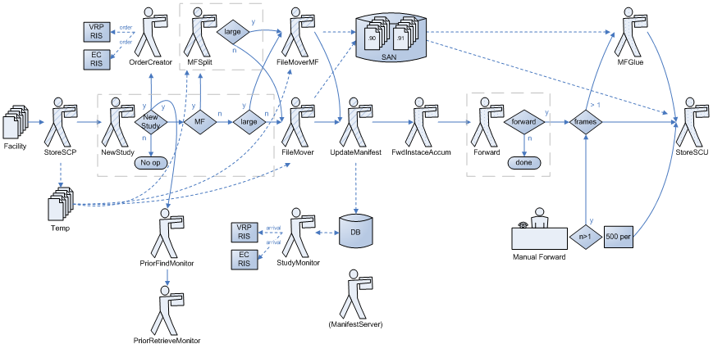
System Design
Example: The Image Bucket-Brigade

Slide 32
System Design
The Ownership Problem
With replicated identical servers, sometimes need to identify “owners” for certain key data
PACS: Studies
RIS: Cases (report data)
Need to ensure:
Consistent update
Modification restricted to a certain user/service
Transactions do not suffice
Long-lasting ownership
Operations often not bracketed in a useful way
Other users need to see transitional changes made by the owner
Ownership identified by:
Additional field in record identifying current owner
Modifying this needs to be atomic and correct in the presence of race conditions
Or a special table mapping unique identifier (GUID) to a specific user/owner
Automatically released after a period of inactivity
(Accounts for owners who crash or get lost along the way)

Slide 33
Observation Sidebar
The pattern:
Algorithm: When this occurs, do that
But what happens when this doesn’t occur?
How can we recover?
What will be the downstream effects?
Very fractal – pattern applied at all levels of granularity
Subsystems
Applications
Queries
Code

Slide 34
System Design
Logging and Monitoring
Differing points of view regarding production problems
Operations: Give me a workaround
Manual tool
Reboot/reset server/service/DB
Remove a server from the pool
Do something! Quick!
Engineering: Figure out what is happening and fix it
Explore
Analyze
Context is important
Slow

Slide 35
System Design
Logging and Monitoring
Standard monitoring tools help operations
Systems
CPU/Memory
Disk space
Networks
Connectivity
Load
Software
CPU/Memory
Performance counters
DB
Page faults
Deadlocks
(Not as useful because they are too expensive…)
All fine, but rather weak and passive

Slide 36
System Design
Logging and Monitoring
ProcessDoctor
Monitoring framework and utility
App teams create dynamic plugins
Deployed on all backend servers
Monitors specific conditions
MSMQ queue sizes
Ping important services
CPU load – trending
Performance counter trends
Send email, raise alarms as necessary
False positives considered harmful
Dynamic process management
Restart stopped/stalled services
Pause services e.g. during upgrades of other systems

Slide 37
System Design
Logging and Monitoring
Much of our activity occurs after normal business hours
Troubleshooting is usually retrospective
Operations has already worked around the issue in some way
Standard monitoring tools aren’t especially helpful
Tend to discard data too frequently
Not the right level of detail
We emphasize logging tools for troubleshooting
Both to diagnose technical problems
And to audit patient information
Who viewed what, when?
Mechanisms:
File-based logging
DB-based logging
LogMiner

Slide 38
System Design
Logging and Monitoring
File-based logging
Most general and powerful technique
Implemented in a set of utility classes
Log messages can be rerouted at run-time:
Files
User interfaces
Debug output window
Bit-bucket
Logging levels can be controlled at run-time
Config files
Registry
All logging functions support standard Console.Writeline() formatting:
Log.Warning(“Exception during image ingest: {0}”, StringUtils.FormatException(ex));

Slide 39
Opinion Sidebar
Not Invented Here
Lots of truth to that, however:
3rdparty tools are always more complex than what you really need
Learning curve is often steep
You do not have control!
Often end up wrapping them in a simpler API anyway
Because simplicity is Good and control is Good, use 3rdparty components only when they offer significant functions:
That you need
That would take a long time to build
That don’t add business value in and of themselves – they are not your core expertise
In my experience it’s usually faster, easier, more reliable to build simple things yourself than to integrate complex things from elsewhere

Slide 40
System Design
Logging and Monitoring
DB-based logging
Tables that are appended with fixed-structure data
Partitioned by time
Transitory, well-structured data only
Appropriate when you need to be able to do fast searches on a variety of criteria
Example: Transmissions
Keep a 5-day moving window – every day, delete the oldest day’s partition
An entry for:
Each DICOM association
Each image/file received or sent
Each study
Hundreds of entries for a single study
Used daily to troubleshoot connection problems with client sending devices and networks
Beyond the 5-day window, of little or no value to the business

Slide 41
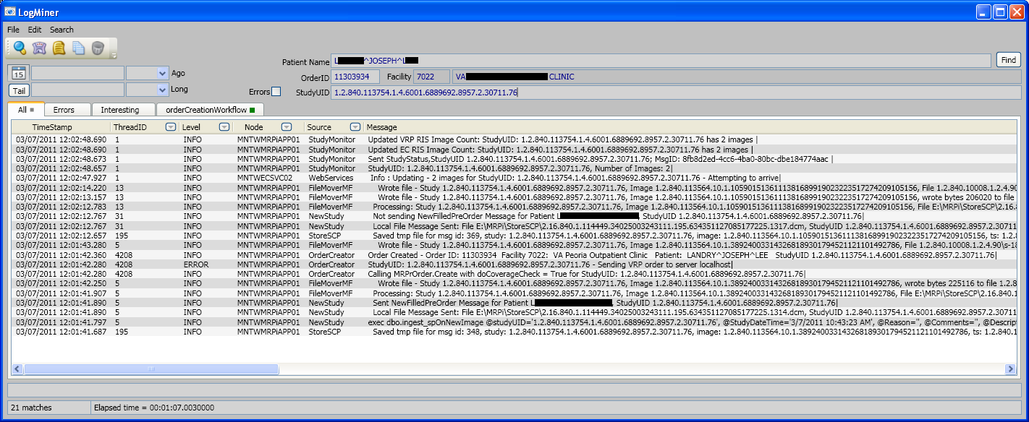
System Design
Logging and Monitoring
Why not put everything in the DB? There is just too much of it…
LogMiner
Log files stored on different servers
Data for one entity of interest (e.g. set of images) might cross servers
Needed a general tool for searching and unifying the file-based logs:

Slide 42
System Design
Evolution
Production stability is paramount
How do you introduce features without risk?
New features
Refactored features
Several types of risks
Errors
Incorrect requirements/specs
Performance impact
Selectively enable features
Ensure that code paths are disabled behind a guard setting
Enable for acceptance testing
Registry
User preference
Time of day

Slide 43
System Design
Evolution
Copy, modify, disable
Create a copy of a UI element rather than changing the original
Modify copy as needed
For release, copy is disabled by default
Acceptance test with select users
Change default to enabled for the next release
Delete old version in the following release
Works well for separable content such as views, tabs, pages
Some variation can usually be envisioned in any scenario
Often requires additional development effort
Need to use base classes or interfaces
Unchanging API whether new or old version

Slide 44
Downtime
jeff.kotula@vrad.com

Slide 45
Downtime
Errors resulting in delayed or degraded
patient care are not tolerable
525,600 minutes in a year
99.9% up-time = no more than 525 minutes down per year
That’s still nearly 9 hours – a lot from the client’s standpoint!
99.99% up-time = no more than 52 minutes down per year
This could be one single event…
Unscheduled downtime is minimized by fast emergency response
Automated or manual
Scheduled downtime is minimized by release deployment strategies

Slide 46
Downtime
Browser or web service requests
Redundancy and ACE minimize web-server downtime
Take half the servers off-line
Update them
Test them by bypassing the ACE router
Swap the active with the updated servers
Update the other half of the servers
Delaying this update also allows for easy roll-back
Database is the sticking point
Must update the database before activating the updated servers
Schema changes can be very time-consuming
1 to 1 downtime for schema updates!
Also, once it contains new production data, rollback is not feasible
In fact, similar problem with many standard maintenance activities
Re-indexing
ris.virtualrad.com
ACE
App1
App2
App3
AppN
Update these first
Update these second

Slide 47
Downtime
Options?
Replicate DB and pull the same swapping trick
Complex
Expensive
Evolve schema only in ways that don’t incur expensive changes to existing tables
Join in new data, rather than putting it in existing tables
Spaghetti schemas
Long-term maintenance problems
Query performance impacts
Don’t use relational DBs?
In some cases we are replacing use of the DB with memcached-inspired subsystems
Performance of generic queries?
Suggestions?

Slide 48
Peopleware
jeff.kotula@vrad.com

Slide 49
Peopleware
vRad uses 3 main tools to hook people into production
Operations Center
Tier 2 Support
Service Restoration Team (SRT)
OC: Operations Center
First line of defense
Monitor incoming and outgoing workflow
Watch for missing images
Match received faxes to orders
Match “orphan” images to orders
Connect radiologists to attending physicians
Call center

Slide 50
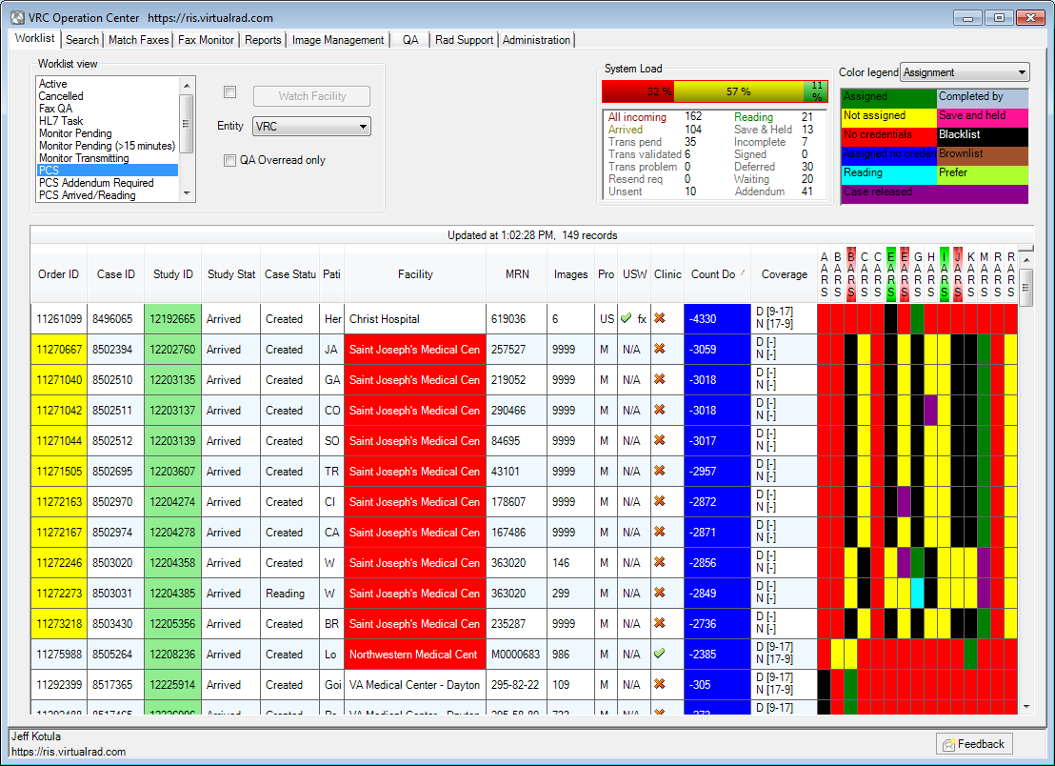
Peopleware: OC Application

Slide 51
Peopleware
Tier 2 Support
Network specialists
Monitor/maintain client connections
Image management
Monitor transmissions
Troubleshoot DICOM issues
Perform special image editing operations (merge, modify)
Radiologist support
Monitor/troubleshoot radiologist connectivity
Remote login to radiologist systems if needed
Much smaller staff than OC

Slide 52
Peopleware
SRT: Service Restoration Team
After-hours emergency response team
24/7/365 rotating on-call:
Senior technology management
RIS
PACS
Database
Networking
Radiologist support
If called, you own the problem
If you cannot solve, find someone who can
Escalate as needed

Slide 53
Conclusions
jeff.kotula@vrad.com

Slide 54
Conclusions
Constantly evolving
Performance
Volume
Business needs
Specific tools/techniques grow and change over time
Recognizing and dealing with Murphy’s law up-front is critical
Product and software design
Implementation and operations
Critical to view the system holistically
Must allow people to do anything manually the system would do automatically
No effort put into diagnostics, logging, or statistics gathering is wasted
Nor unpunished

Slide 55
Thanks
www.vrad.com
Jeff.Kotula@vrad.com
jkotula@gmail.com

