Slide 1


Property-Based Testing with QuickCheck
John Hughes

Slide 2
Example: GSM Text Message Encoding
unpack
a
b
c
d
e
f
g
g
a
b
c
d
e
f
g
a
b
c
d
e
f
g
f
g
a
b
c
d
e
f
a
b
c
d
e
f
g
0
0
0
a
b
c
d
e
pack

Slide 3
DEMO

Slide 4
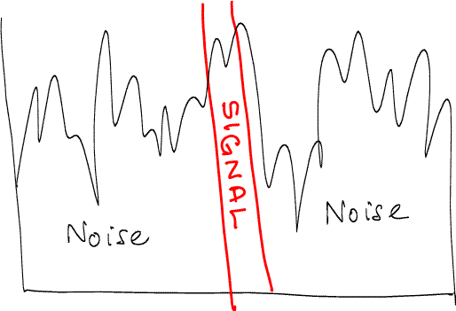
Property Based Testing
Properties
Test case
Test case
Test case
Test case
Test case
MinimalTest case

Slide 5
Benefits
Less time spent writing test code
  One property replaces many tests
Better testing
  Lots of combinations you’d never test by hand
Less time spent on diagnosis
  Failures minimized automagically

Slide 6
An Experiment
Unit tests
Properties

Slide 7
How good were the tests at find bugs—in other students’ code?
Unit tests
0 1 2 3 4 5 6 7 8 9 10 11
Better

Slide 8
Tests for Base 64 encoding
Expected results
base64_encode(Config) when is_list(Config) ->
%% Two pads
<<"QWxhZGRpbjpvcGVuIHNlc2FtZQ==">> =
base64:encode("Aladdin:open sesame"),
%% One pad
<<"SGVsbG8gV29ybGQ=">> = base64:encode(<<"Hello World">>),
%% No pad
"QWxhZGRpbjpvcGVuIHNlc2Ft" =
base64:encode_to_string("Aladdin:open sesam"),
"MDEyMzQ1Njc4OSFAIzBeJiooKTs6PD4sLiBbXXt9" =
base64:encode_to_string(
<<"0123456789!@#0^&*();:<>,. []{}">>),
ok.
Test cases

Slide 9
Writing a Property
prop_base64() ->
?FORALL(Data,list(choose(0,255)),
equals(base64:encode(Data),
???)).

Slide 10
Back to the tests…
Where did these come from?
base64_encode(Config) when is_list(Config) ->
%% Two pads
<<"QWxhZGRpbjpvcGVuIHNlc2FtZQ==">> =
base64:encode("Aladdin:open sesame"),
%% One pad
<<"SGVsbG8gV29ybGQ=">> = base64:encode(<<"Hello World">>),
%% No pad
"QWxhZGRpbjpvcGVuIHNlc2Ft" =
base64:encode_to_string("Aladdin:open sesam"),
"MDEyMzQ1Njc4OSFAIzBeJiooKTs6PD4sLiBbXXt9" =
base64:encode_to_string(
<<"0123456789!@#0^&*();:<>,. []{}">>),
ok.

Slide 11
Possibilities
Use the other encoder as an oracle
Someone converted the data by hand
Another base64 encoder
The same base64 encoder!
  Only tests that changes don’t affect the result, not that the result is right
Use an old version (or a simpler version) as an oracle

Slide 12
Round-trip Properties
prop_encode_decode() ->
?FORALL(L,list(choose(0,255)),
base64:decode(base64:encode(L))
== list_to_binary(L)).
What does this test?
NOT a complete test—will not find a consistent misunderstanding of base64
WILL find mistakes in encoder or decoder
Simple properties find a lot of bugs!

Slide 13
TAKE HOME MSG

Slide 14
The Student Problem
Interval Sets
  sets of integers represented using intervals
Implement:
  empty(), singleton(N), union(S1,S2), diff(S1,S2), member(N,S), to_list(S)
1
2
3
4
5
6
7
8
9
10
11
1 3
=< +1<
6 7
9 11
[{1,3},{6,7},{9,11}]

Slide 15
Generating Valid Interval Sets
A list of pairs?
  list({nat(),nat()}) ?
[{10,6},{12,12},{10,5}]
Swap misordered pairs
[{6,10},{12,12},{5,10}]
Sort the intervals
[{5,10},{6,10},{12,12}]
Drop overlapping ones
[{5,10},{12,12}]

Slide 16
The iset() generator
?LET generates values in two steps
iset() ->
?LET(L,list({nat(),nat()}),
drop_overlaps(
lists:sort(
[{min(A,B),max(A,B)} || {A,B}<-L]
))).

Slide 17
Validity
What does this test?
valid(S) ->
lists:all(fun valid_interval/1,S) andalso separated(S).
valid_interval({A,B}) ->
A =< B.
separated([{A,B},{C,D}|S]) ->
B+1 < C andalso separated ([{C,D}|S]);
separated(_) ->
true.
prop_valid() ->
?FORALL(S,iset(),valid(S)).

Slide 18
A nice property
prop_union_valid() ->
?FORALL({S1,S2},{iset(),iset()},
valid(union(S1,S2))).

Slide 19
How can we test union returns the right set?
Use lists as a model!
[{1,3}]
[{2,5}]
[1,2,3]
[2,3,4,5]
to_list
union
Interval sets
lists:umerge
Lists
[{1,5}]
[1,2,3,4,5]

Slide 20
A property for union
prop_union() ->
?FORALL({S1,S2},{iset(),iset()},
equals(
to_list(union(S1,S2)),
lists:umerge(to_list(S1),to_list(S2)))).

Slide 21
Let’s run some tests…

Slide 22
Property Driven Development
Property-based development is QUICK!
  Effort invested in setting up properties is quickly repaid
No luxury of leaving code ”half working”
Resulting code is very solid
  No going back to fix bugs in last week’s code
Mistaken design shows up fast
  Complex properties, complex code

Slide 23
Lessons from this example…
Simple properties find bugs!
Use a model to decide test outcomes
”Can I compute this another way?”

Slide 24
Time for some C code…

Slide 25
Modelling in Erlang
A queue contains… a list of numbers!
API Calls
API Calls
API Calls
API Calls
postconditions
Model state
Model state
Model state
Model state

Slide 26
A QuickCheck Property
prop_q() ->
?FORALL(Cmds,commands(?MODULE),
begin
{H,S,Res} = run_commands(?MODULE,Cmds),
Res == ok)
end).

Slide 27
Let’s run some tests…

Slide 28
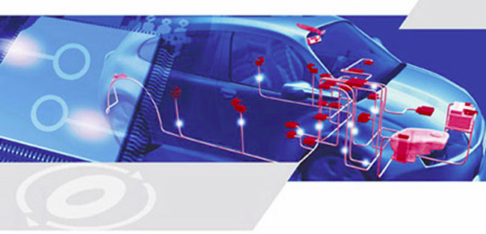
For real: AutoSAR testing
Standard software architecture for embedded processors in vehicles
Typical component
500 pages of spec
15K LOC of C
1500 LOC of QuickCheck

Slide 29
"We know there is a lurking bug somewhere in the dets code. We have got 'bad object' and 'premature eof' every other month the last year. We have not been able to track the bug down since the dets files is repaired automatically next time it is opened.“
Tobbe Törnqvist, Klarna, 2007

Slide 30

What is it?
300 people in 5 years
Application
Invoicing services for web shops
Mnesia
Distributed database: transactions, distribution, replication
Dets
Tuple storage
Race conditions?
File system

Slide 31
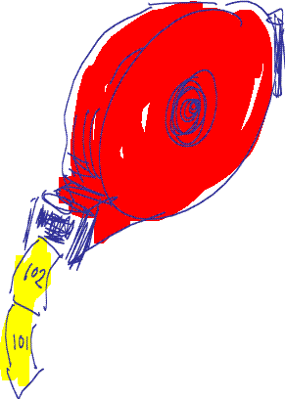
Imagine Testing This…
dispenser:take_ticket()
dispenser:reset()

Slide 32
A Unit Test in Erlang
test_dispenser() ->
reset(),
take_ticket(),
take_ticket(),
take_ticket(),
reset(),
take_ticket().
ok =
1 =
2 =
3 =
ok =
1 =
BUT…
Expected results

Slide 33
A Parallel Unit Test
reset
ok
take_ticket
1
2
1
3
1
2
take_ticket
3
2
1
take_ticket
Three possible correct outcomes!

Slide 34
Another Parallel Test
reset
take_ticket
take_ticket
reset
take_ticket
take_ticket
42 possible correct outcomes!

Slide 35
Property-Based Testing to the rescue!
Write properties instead of expected outputs
  e.g. sort([A,B,C]) == [1,2,3]
Use models to decide if tests pass…

Slide 36
The Model
Just an integer!
State transitions
Postconditions
next_state(S,_V,{call,_,reset,_}) ->
0;
next_state(S,_V,{call,_,take_ticket,_}) ->
S+1.
postcondition(S,{call,_,take_ticket,_},Res) ->
Res == S+1;

Slide 37
Sequential testing…
API Calls
API Calls
API Calls
API Calls
postconditions
Model state
Model state
Model state
Model state

Slide 38
Parallel Test Cases
Use the same model!

Slide 39
Generate parallel test cases
prop_parallel() ->
?FORALL(Cmds,parallel_commands(?MODULE),
begin
start(),
{H,Par,Res} =
run_parallel_commands(?MODULE,Cmds),
Res == ok)
end)).
Run tests, check for a matching serialization

Slide 40
DEMO
Prefix:
take_ticket() --> 1
reset() --> ok
reset() --> ok
reset() --> ok
take_ticket() --> 1
take_ticket() --> 2
reset() --> ok
take_ticket() --> 1
Parallel:
1. take_ticket() --> 2
take_ticket() --> 3
2. take_ticket() --> 2
Result: no_possible_interleaving
Sometimes:

Slide 41
take_ticket() ->
N = read(),
write(N+1),
N+1.
Prefix:
Parallel:
1. take_ticket() --> 1
2. take_ticket() --> 1
Result: no_possible_interleaving

Slide 42
dets
Tuple store:
  {Key, Value1, Value2…}
Operations:
  insert(Table,ListOfTuples)
  delete(Table,Key)
  insert_new(Table,ListOfTuples)
  …
Model:
  List of tuples
200 LOC
vs.
6.3 KLOC

Slide 43
Bug #1
insert_new(Name, Objects) -> Bool
Types:
Name = name()
Objects = object() | [object()]
Bool = bool()
Prefix:
open_file(dets_table,[{type,bag}]) --> dets_table
Parallel:
1. insert(dets_table,[]) --> ok
2. insert_new(dets_table,[]) --> ok
Result: no_possible_interleaving

Slide 44
Bug #2
Prefix:
open_file(dets_table,[{type,set}]) --> dets_table
Parallel:
1. insert(dets_table,{0,0}) --> ok
2. insert_new(dets_table,{0,0}) --> …time out…
=ERROR REPORT==== 4-Oct-2010::17:08:21 ===
** dets: Bug was found when accessing table dets_table

Slide 45
Bug #3
Prefix:
open_file(dets_table,[{type,set}]) --> dets_table
Parallel:
1. open_file(dets_table,[{type,set}]) --> dets_table
2. insert(dets_table,{0,0}) --> ok
get_contents(dets_table) --> []
Result: no_possible_interleaving
!

Slide 46
Bug #4
Prefix:
open_file(dets_table,[{type,bag}]) --> dets_table
close(dets_table) --> ok
open_file(dets_table,[{type,bag}]) --> dets_table
Parallel:
1. lookup(dets_table,0) --> []
2. insert(dets_table,{0,0}) --> ok
3. insert(dets_table,{0,0}) --> ok
Result: ok
premature eof

Slide 47
Bug #5
Prefix:
open_file(dets_table,[{type,set}]) --> dets_table
insert(dets_table,[{1,0}]) --> ok
Parallel:
1. lookup(dets_table,0) --> []
delete(dets_table,1) --> ok
2. open_file(dets_table,[{type,set}]) --> dets_table
Result: ok
false
bad object

Slide 48
"We know there is a lurking bug somewhere in the dets code. We have got 'bad object' and 'premature eof' every other month the last year.”
Tobbe Törnqvist, Klarna, 2007
Each bug fixed the day after reporting the failing case

Slide 49
How come?
Race conditions are hard to write test cases for
  So people don’t!
  Usually left until integration testing
If it’s not tested, why should it work?

Slide 50
Property-Based Testing
…delivers great testing for little effort
…finds buggy combinations you would never think of testing
…draws on functional programming, but is applicable to many kinds of system
…has been applied to telecoms products, databases, servers, gateways, real-time vehicle software…
…IS GREAT FUN!!!

Slide 51
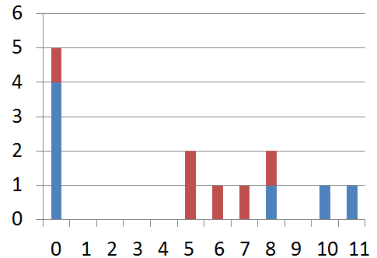



Property-Based Testing
This is where you want to be…

Slide 52
Want to know more?
Google ”QuickCheck”
  Haskell original and many reimplementations
www.quviq.com
  Commercial version, and free download for Erlang

