Slide 1
Overview of Cloud Computing
Sven Rosvall
ACCU 2011-04-16

Slide 2
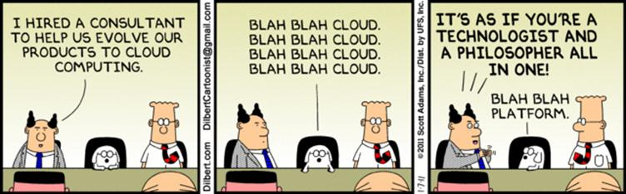
Takeaways
Understanding what Cloud Computing is
Players in the market
Building blocks of Cloud Computing and how to use them
Can my system be migrated?
Not covering Map/Reduce here

Slide 3
Defining Cloud Computing
Business - A method to address scalability and availability concerns for large scale applications.
Engineering - Providing services on virtual machines allocated on top of a large physical machine pool.
Practical - Find spare capacity automatically.
Big picture - Democratized distributed computing

Slide 4








Cloud Applications
No need to install
No need to download emails, documents, ...
Collaborate world-wide
Infinite storage for photos, backups, ...

Slide 5
Cloud Computing Offering
Application Programming
Fast and Massive
Scale Out
Automated Service Management
High Availability
Multi-Tenancy

Slide 6
Scaling Scenarios
“Predictable Bursting”
“Unpredictable Bursting”
Compute
Compute
Average Usage
Average Usage
Time
Time
“On and Off”
“Growing Fast”
Inactivity
Period
Compute
Compute
Average Usage
Average
Usage
Time
Time
Notes:
Predictable bursting happens to most retail websites during Christmas season.
Eirgrid runs a website to coordinate electric power production during the winter months. Site is shut down 9 months of the year.
Smugmug is a photo site that was one of the first AWS customers. Small startup that grew very fast.

Slide 7
Scaling in Real Life
• target.com • walmart.com
• toysrus.com • barnesandnoble.com
• turbotax.com • taxcut.com
• hrblock.com • taxact.com
~10x normal load
(Tax season)
~4x normal load
(Holiday shopping)
Jan 2009
Jan 2010
Jan 2009
Jan 2010
Source: Alexa
Source: Alexa

Slide 8
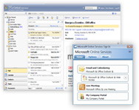
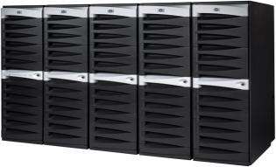
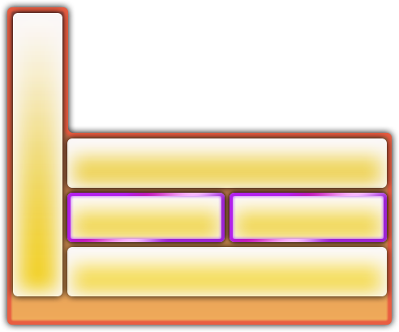

Everything as a Service
Infrastructure As a Service
Platform
As a Service
Software
As a Service
Provides VMs
Good for Legacy Apps
Not great for scalability
Provides APIs and Building Block Services
Requires a migration of apps
Great opportunity for scalability
Provides Web Apps
Multi-Tenant
Logical Separation of data
Commodity
Very little customisation
Seamless scaling

Slide 9
Everything as a Service
Infrastructure As a Service
Platform
As a Service
Software
As a Service
You manage
Applications
Applications
Applications
You manage
Data
Data
Data
Runtime
Runtime
Runtime
Managed by vendor
Middleware
Middleware
Middleware
Managed by vendor
Managed by vendor
O/S
O/S
O/S
Virtualization
Virtualization
Virtualization
Servers
Servers
Servers
Storage
Storage
Storage
Networking
Networking
Networking
Notes:
IaaS
You manage your VM’s fully.
Same VM image in Cloud as in your dev lab.
PaaS
VM managed by provider. OS upgrades, security, …
You provide the application as a complete executable.
VM environment different from dev environment. Surprises occur.
SaaS
VM and libraries managed by provider.
You provide code that uses the library.

Slide 10
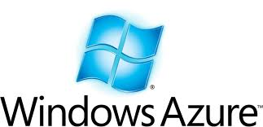



Main Providers
Infrastructure As a Service
Platform
As a Service
Software
As a Service

Slide 11
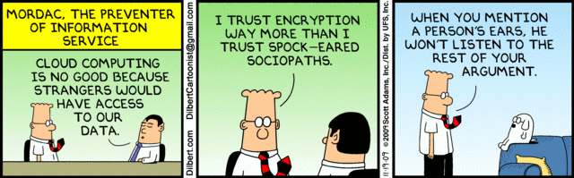
Security
Access control | Access keys, encryption
Where is my stuff? | Private clouds
Security procedures

Slide 12
Basic Building Blocks
RESTful API’s
Simple storage
  Blobs
  Tables
  Queues
Computing Entities
Notes:
Scalable

Slide 13
Blobs
Unstructured data
Reference object with a URL
Basic data storage unit

Slide 14
Tables
Structured data
“Entity Database”, non-relational
Sparse tables
Set of key-value pairs
Reference table with a URL

Slide 15
Queues
Message passing between components.
Guaranteed delivery (at least once)
Reference queue with a URL

Slide 16
Computing
VM
VM
PaaS
SaaS
IaaS
VM
VM

Slide 17
Trends
Relational databases
Geo-failover
Network traffic management
Edge computing
Notes:
Relational databases required for migrating existing applications.
Edge: CDN and computing close to the user. Akamai. Google/Bing maps with directions.

Slide 18
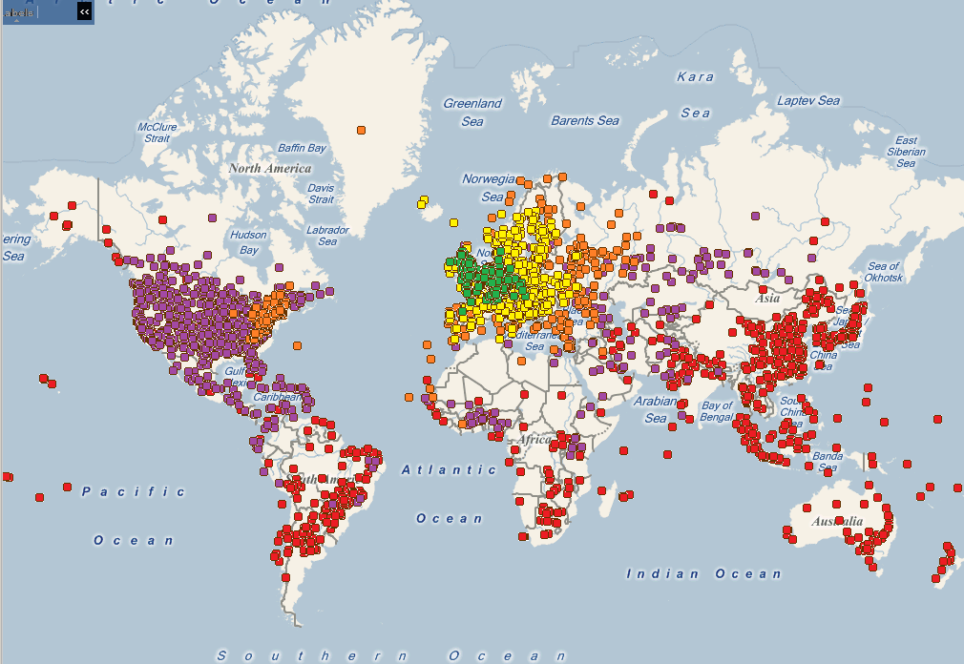
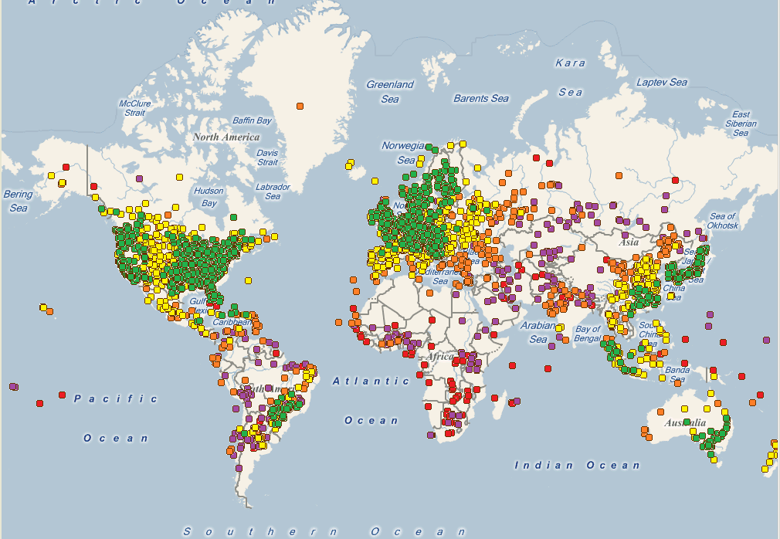
Content Delivery Network
Caches static content close to users

Slide 19
Developing for the Cloud
Think big!
  Millions of users?
  Network load?
  Store TB of data?
Prepare for scale
  Simplicity
  Bottlenecks?
  Single Point of Failure?
Prepare for failures
  Network
  Crashing servers
  Server updates
Migrating?
  From SOA?
  From RDB?
  IaaS or PaaS?

Slide 20
Concurrency Issues in the Cloud
Lots of simultaneous operations
Rare problems happens
  Network
  Crashing servers
  Server updates
No transactions

Slide 21
Design Practices
Design for fault tolerance
  Retry
  Idempotency
Synchronisation
  Optimistic Consistency
Notes:
Optimistic concurrency is preferred over locking.
Locks may get stuck if the locker crashes.
You can still read some value.

Slide 22
Examples
Place an order on website
  Confirmation does not arrive in time.
Transfer money / Reserve order items
  Deduct money fails – retry
  Deposit money – Crash before finished

Slide 23
Place an order
Solution: Idempotent operations

Slide 24
Idempotent Operations
Can be applied multiple times with same result.
Examples:
Lookup your address
Change your address
HTTP GET/PUT/DELETE (not POST)

Slide 25
Updating
Read = €100
-€20
€100
€80
Write = €80

Slide 26
Updating
Read = €100
-€20
€100
€150
?
Write = €80
Read = €100
+€50
Write = €150

Slide 27
Optimistic Concurrency
Get version marker (E-Tag) when reading object
Only allow write if version marker is unchanged.

Slide 28
Updating
Read = €100 v1
-€20
€150 v2
€100 v1
X
Write = €80 v1
Read = €100 v1
+€50
Write = €150 v1

Slide 29
Updating
Read = €150 v2
-€20
€150 v2
€130 v3
Write = €130 v2
Read = €100 v1
+€50
Write = €150 v1

Slide 30
Job Control
A job is managed by a message on a queue.
A worker picks up a message and executes the job.
If the worker crashes, the message is returned to the queue after a timeout. Another worker picks up the message.
The message is only deleted from the queue when the job is complete.

Slide 31
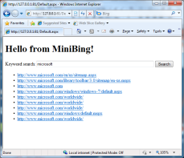
Demo – MiniBing
Blob Storage
Table storage
Internet
Web pages
Web index
blob
blob
blob
blob
blob
blob
Web Crawler
Web Crawler
Web Crawler
Web Crawler
Web Crawler
Web Crawler
Web Crawler
Web Crawler
UI Frontend
Web Crawler
Web Indexer
Indexing queue
URLs
Search query
Query results
Bootstrapping the crawler
Crawling queue
Worker Role
Web Role

Slide 32
Resources
http://en.wikipedia.org/wiki/Cloud_computing
http://aws.amazon.com/
http://www.microsoft.com/windowsazure/
http://code.google.com/appengine/
http://www.salesforce.com/

Slide 33
Questions?

