Slide 1

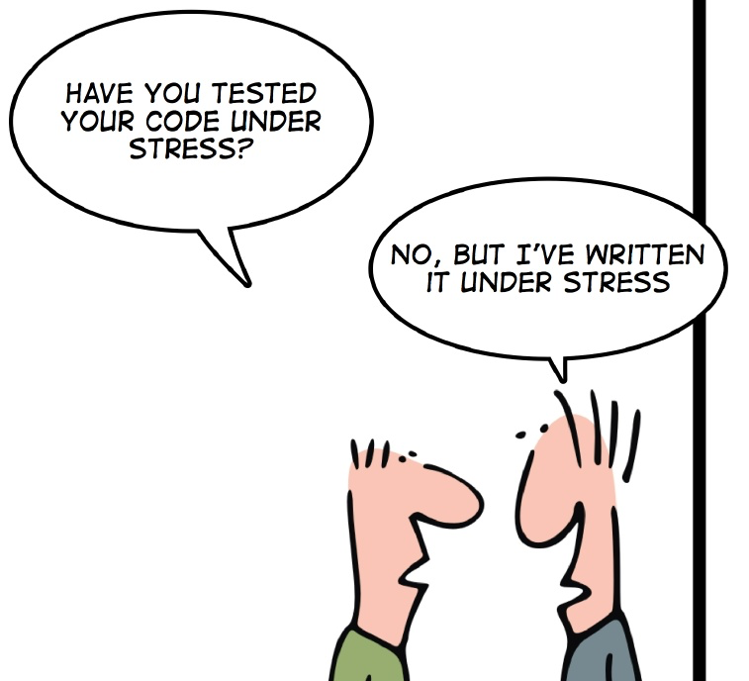
How we test software at
Unity Technologies
Dmytro Mindra
Unity Technologies/ Ciklum
Odessa, Ukraine

Slide 2

Notes:
http://en.wikipedia.org/wiki/Unity_Technologies
Unity Technologies was founded in 2004 by David Helgason (CEO), Nicholas Francis (CCO), and Joachim Ante (CTO) in Copenhagen, Denmark

Slide 3
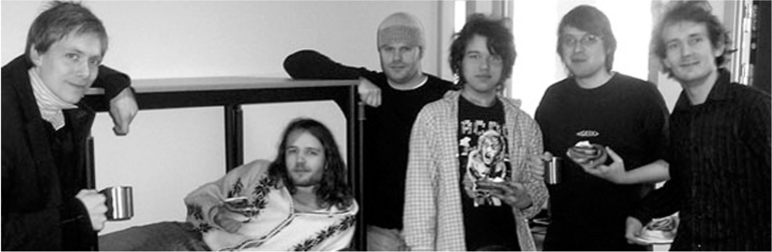

Slide 4
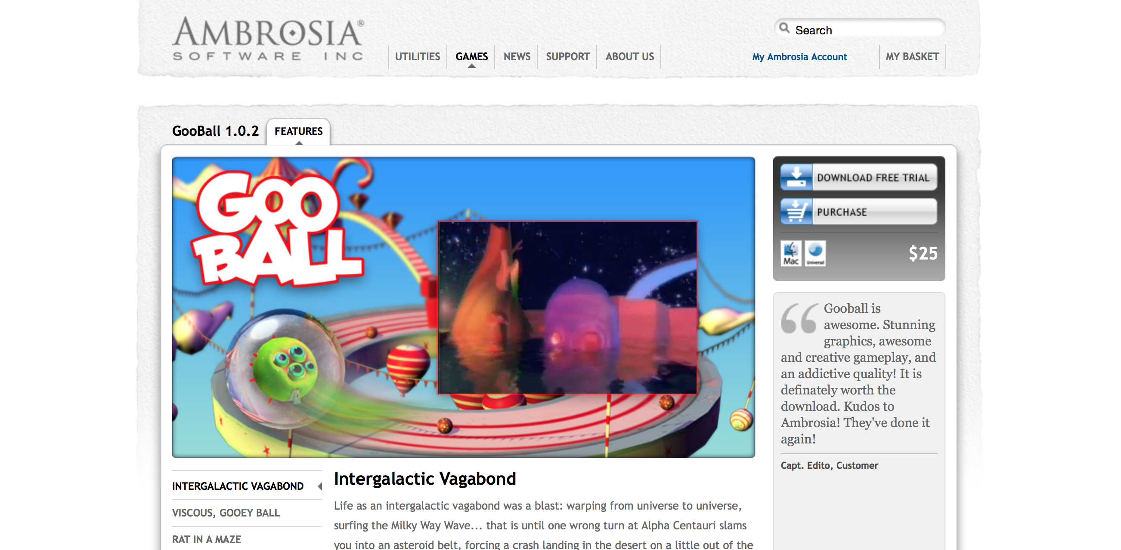
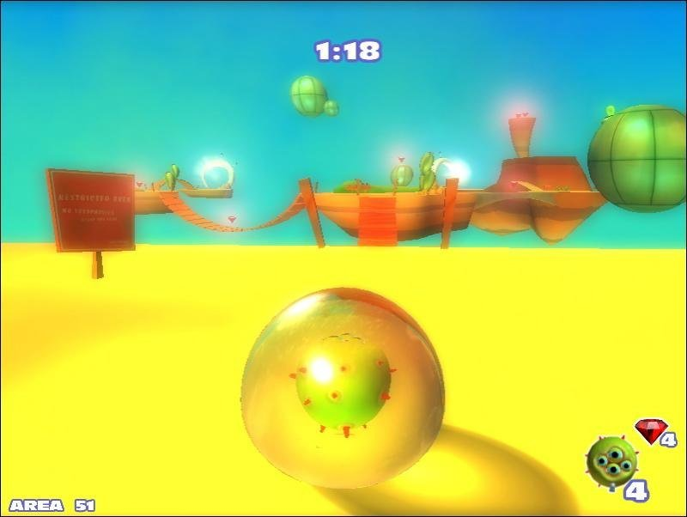
http://www.ambrosiasw.com/games/gooball/
Notes:
http://www.ambrosiasw.com/games/gooball/

Slide 5

Начало
Notes:
http://www.marketwired.com/press-release/unity-technologies-wins-prestigious-wall-street-journal-technology-innovation-award-1325173.htm

Slide 6

“Democratize” game development
Solve hard tech problems
Provide Big Value
5 major versions over 10 years
100,000+ games built with Unity active in the wild
Installed 600 millions of times
that are played more than a billion times each month.

Slide 7


Slide 8


Slide 9
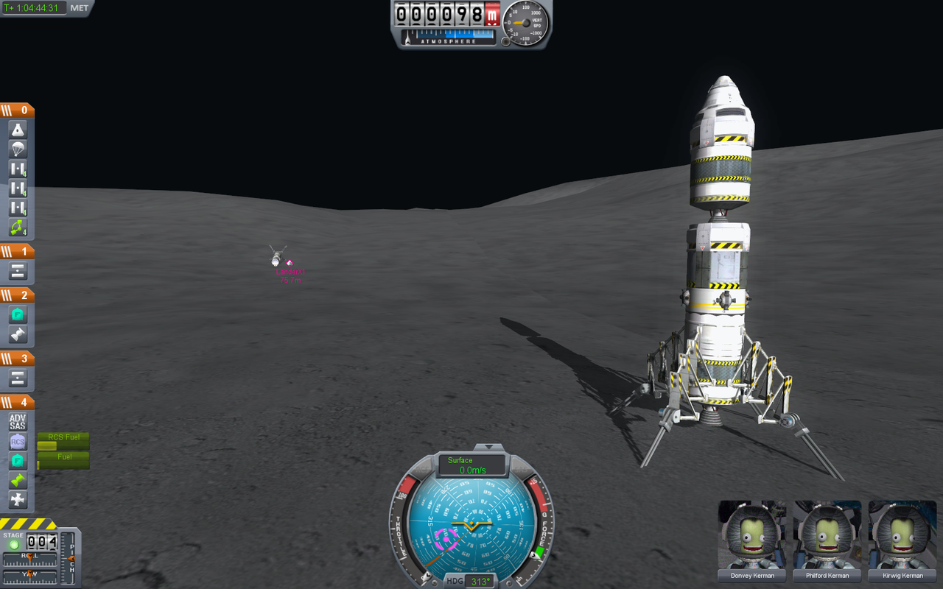

Slide 10
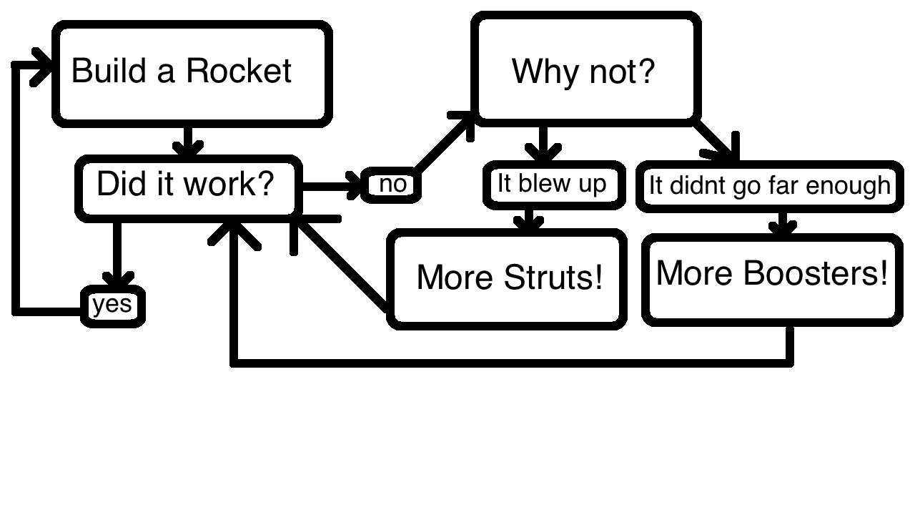

Slide 11
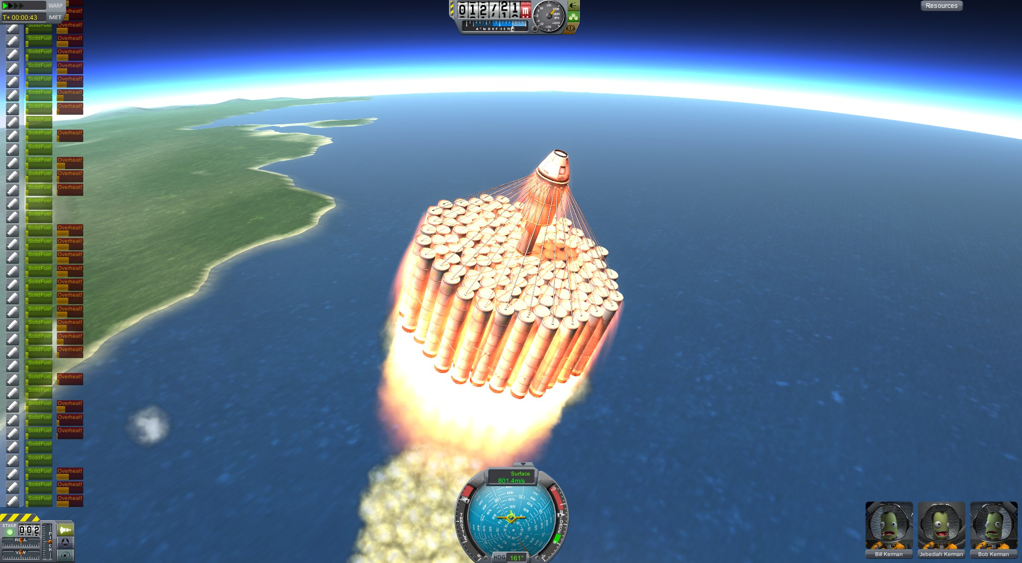

Slide 12
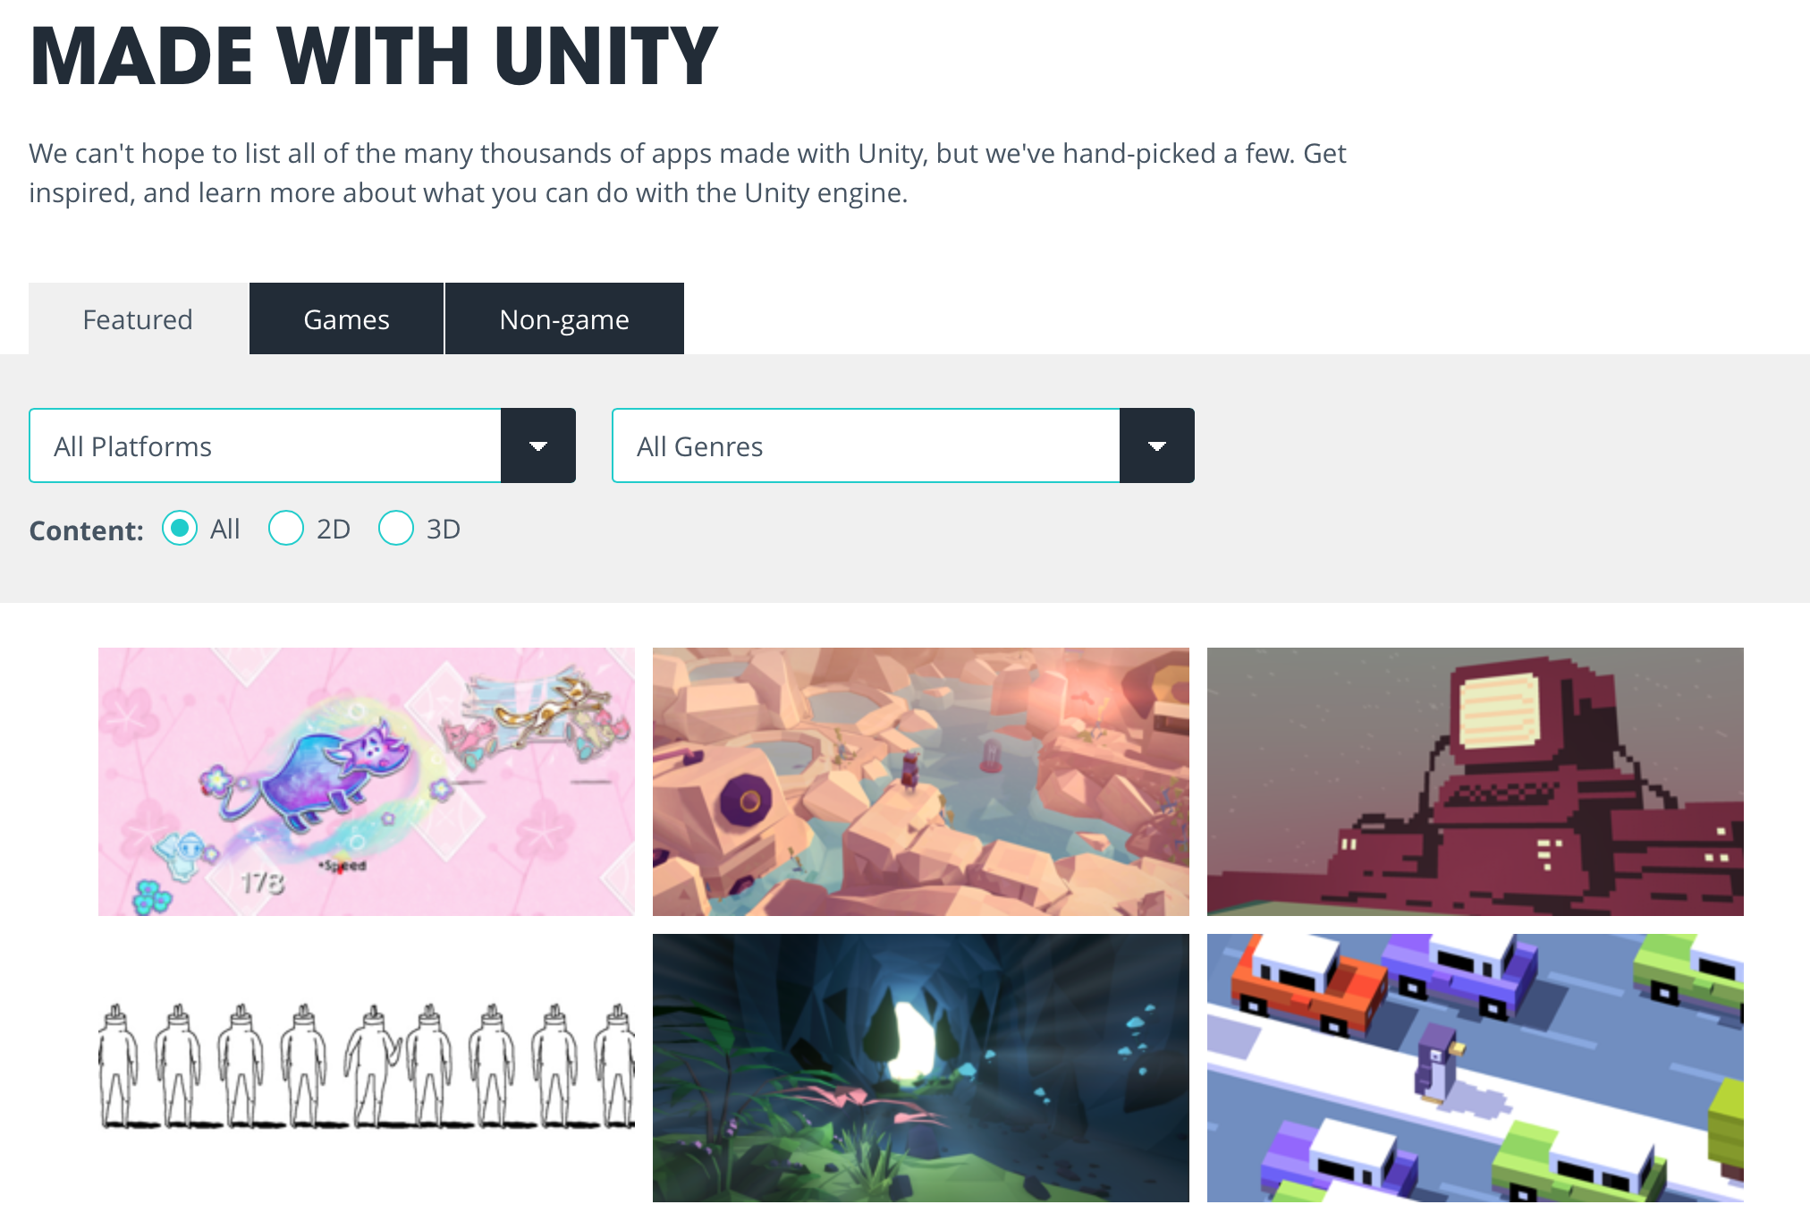

Slide 13


Slide 14
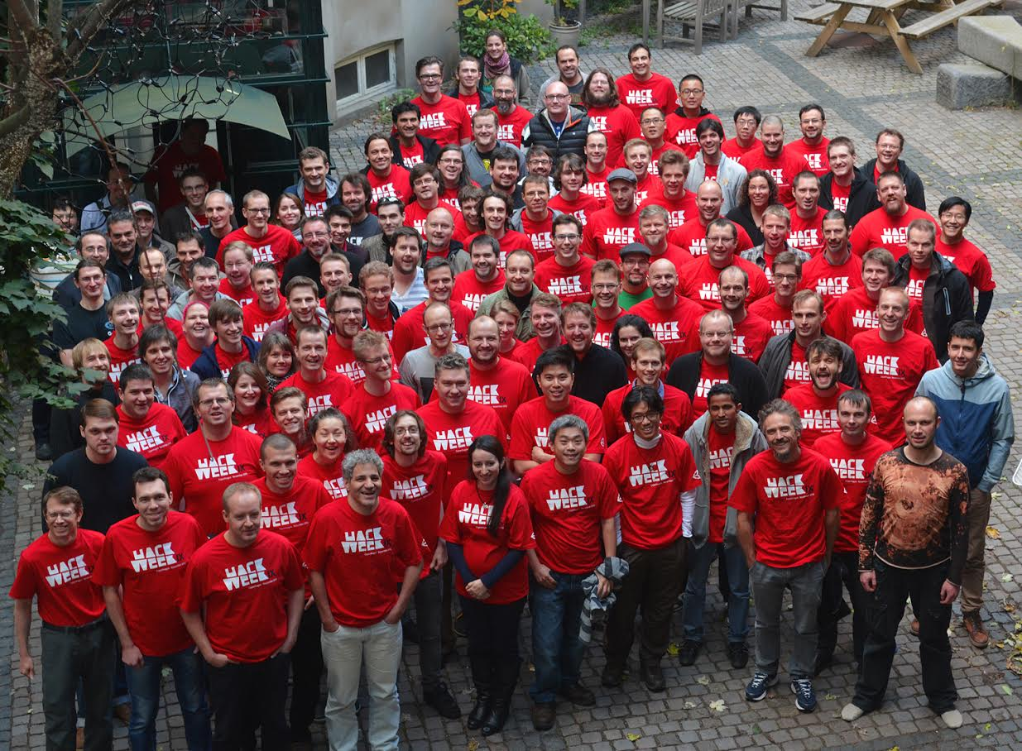
Innovation
Hackweek
FAFF
Team weeks

Slide 15
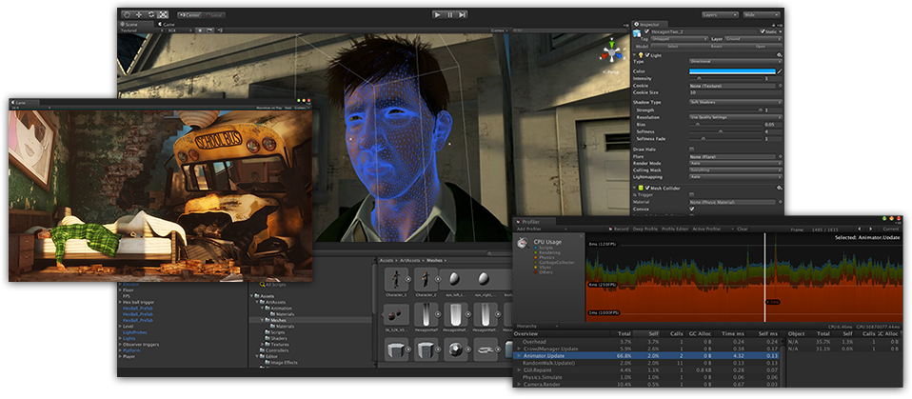
Our products
UnityEngine - C/C++
UnityEditor - C#/Mono
Unity Games
UnityScript
Boo
Mono
Unity Ads
Unity Cloud Build
Unity Analytics

Slide 16
21

Slide 17
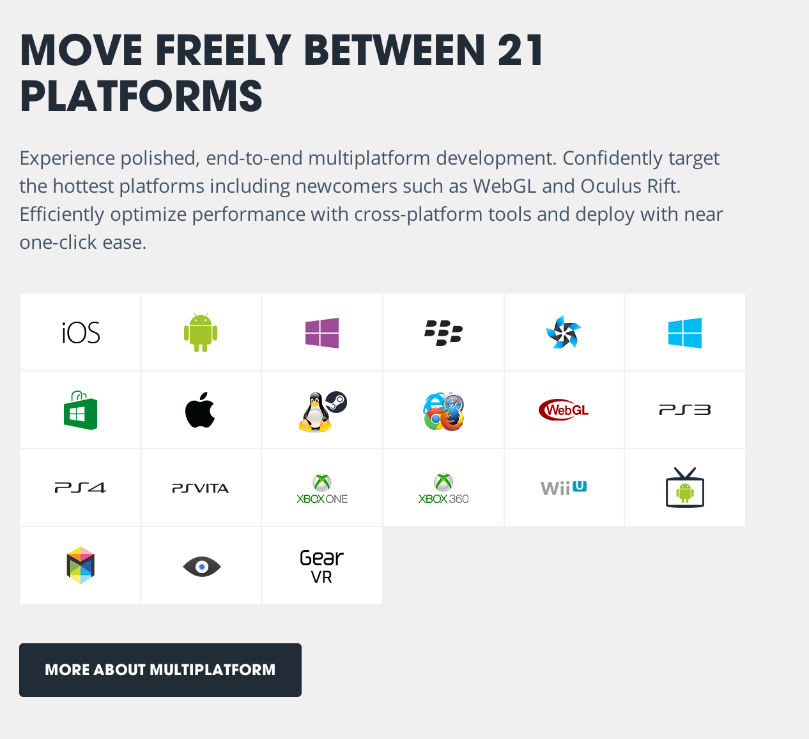
Platforms
å

Slide 18
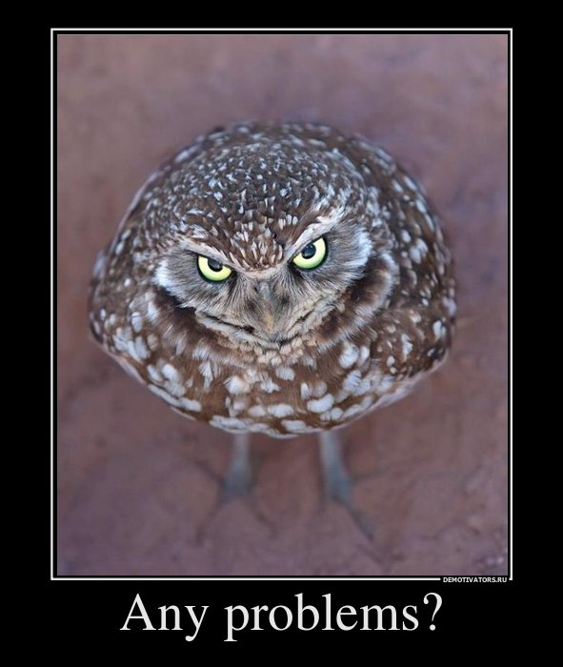
Supporting 21+ platforms

Slide 19
The challenges
Lots of platforms (Windows, OSX, IOS, Android, Xbox 360, Playstation 3, Wii, Web, …)
Unit testing not (always) an option
Many of the regressions we see come from integrations between components
Backwards compatibility
>4.5 million developers
>600 million device installations (regressions have great impact)
Notes:
http://unity3d.com/public-relations

Slide 20







QA Division
STE
SDET
Toosmiths
Local QA teams for acquired products
Notes:
Marc Eric Quesnel

Slide 21

Born to build tools for test automation!

Slide 22
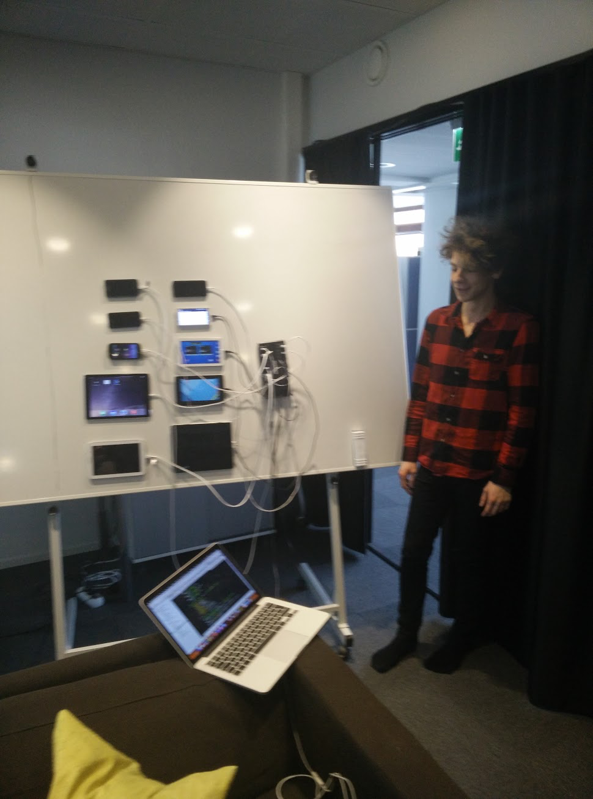
Notes:
Tibor

Slide 23

Toolsmiths
11 Toolsmiths

Slide 24
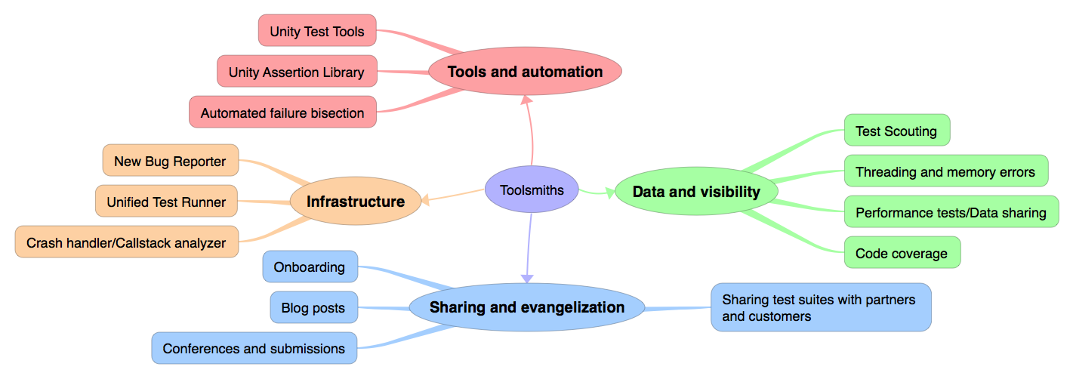
Toolsmiths

Slide 25
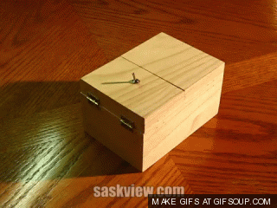

Slide 26
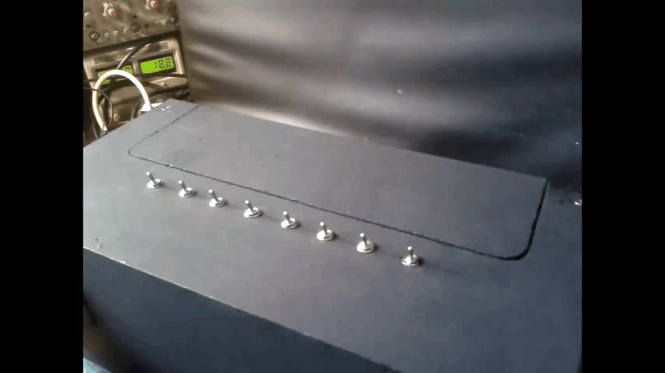

Slide 27
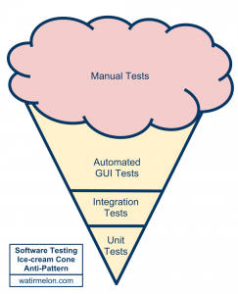
Anti Pattern

Slide 28
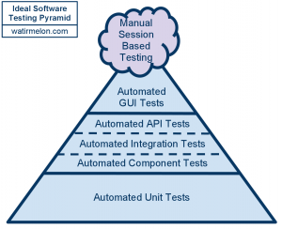
Ideal Approach

Slide 29
Test Automation
Unit Tests
Runtime Tests
Performance Tests
Model Based Tests
Graphics Tests
Multithreading analysis
Crash Analysis

Slide 30
Manual
Release Acceptance Tests (RATs)
Exploratory Testing week (ET week)
Full Test Pass (FTP)
Release Candidate Full Test Pass (RC FTP)
Webplayer bash

Slide 31
Exploratory Testing
The guidebook tour
The antisocial tour
The back alley tour
The saboteur tour
…
Notes:
https://www.satisfice.com/articles/et-article.pdf
http://www.slideshare.net/sriks7/exploratory-testing-1551648

Slide 32
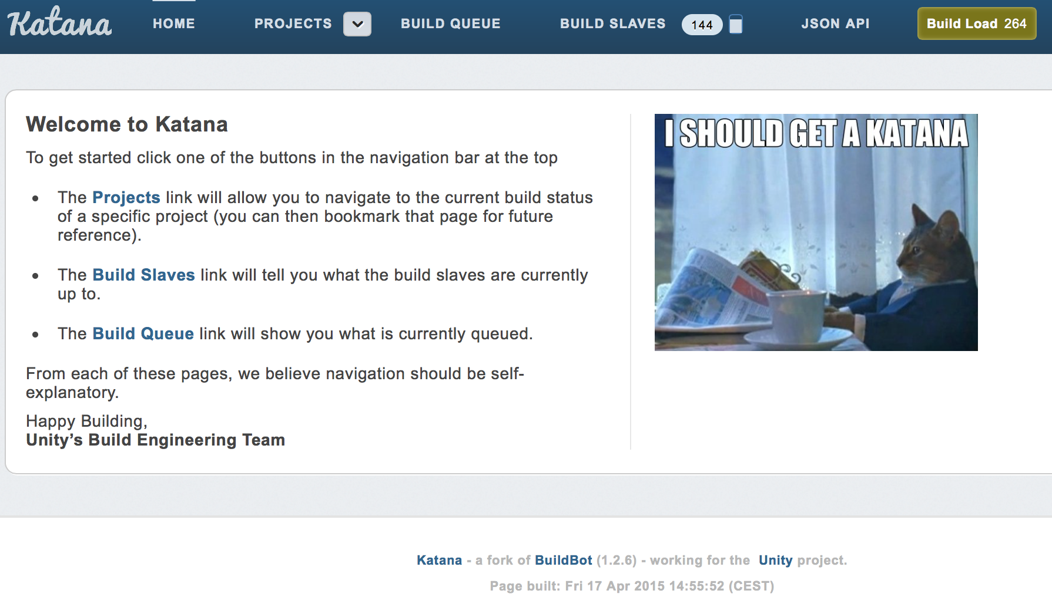
Continuous Integration
From TeamCity to Katana

Slide 33
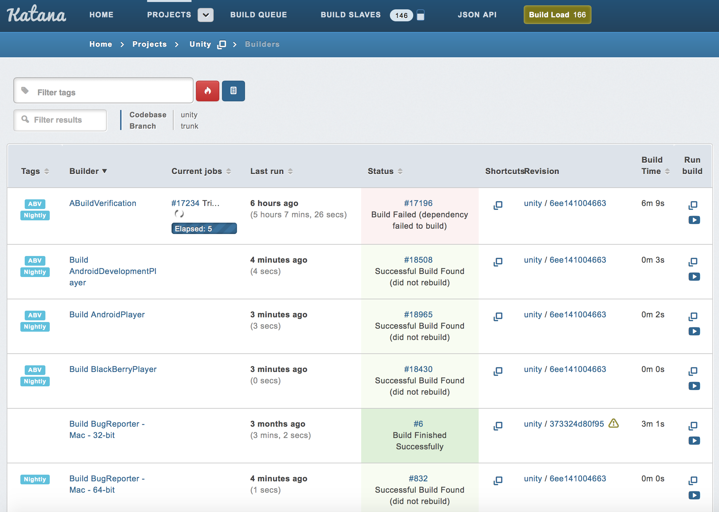

Slide 34



Runtime Tests
Report
Deploy
Build

Slide 35
Framework
4. Create
Assets
&
Build Scene
5. Set up a web server
6. Build / Start player
3. Start
Editor
7b. Consume Results
7a. Execute Test
RuntimeTests
Automation.Players
1. Lunch
Test
Runner
2. Load
Test Assembly
8. Report results

Slide 36
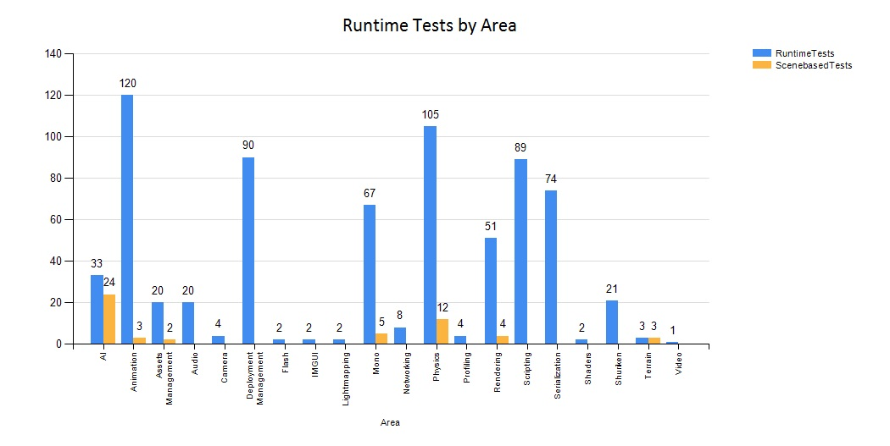
Runtime Tests

Slide 37
Runtime Tests
>1200 unique Runtime API test cases
>9000 Runtime API test cases (>20 platforms/players) are run in a single automated build verification test suite. The number is rapidly increasing.
>200.000 Runtime API test cases per day (all platforms)

Slide 38
Runtime Tests
The framework (and our build system) runs tests on multiple platforms in parallel.
Entire suite is less than 30 minutes, and half that time is spent setting up the environment and building players (actual test execution time is about 15 minutes on average).
The framework is also used by external companies to integration test their products with Unity players.

Slide 39
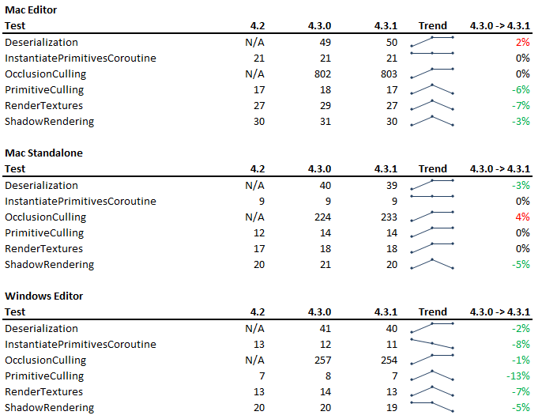
Performance Tests

Slide 40
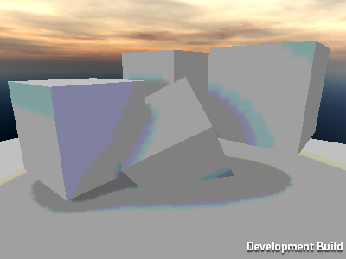
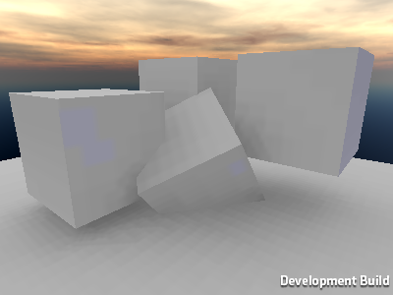
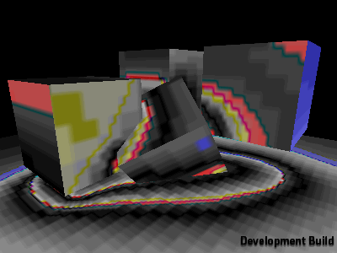
Graphics Tests
Correct
Actual
Diff

Slide 41
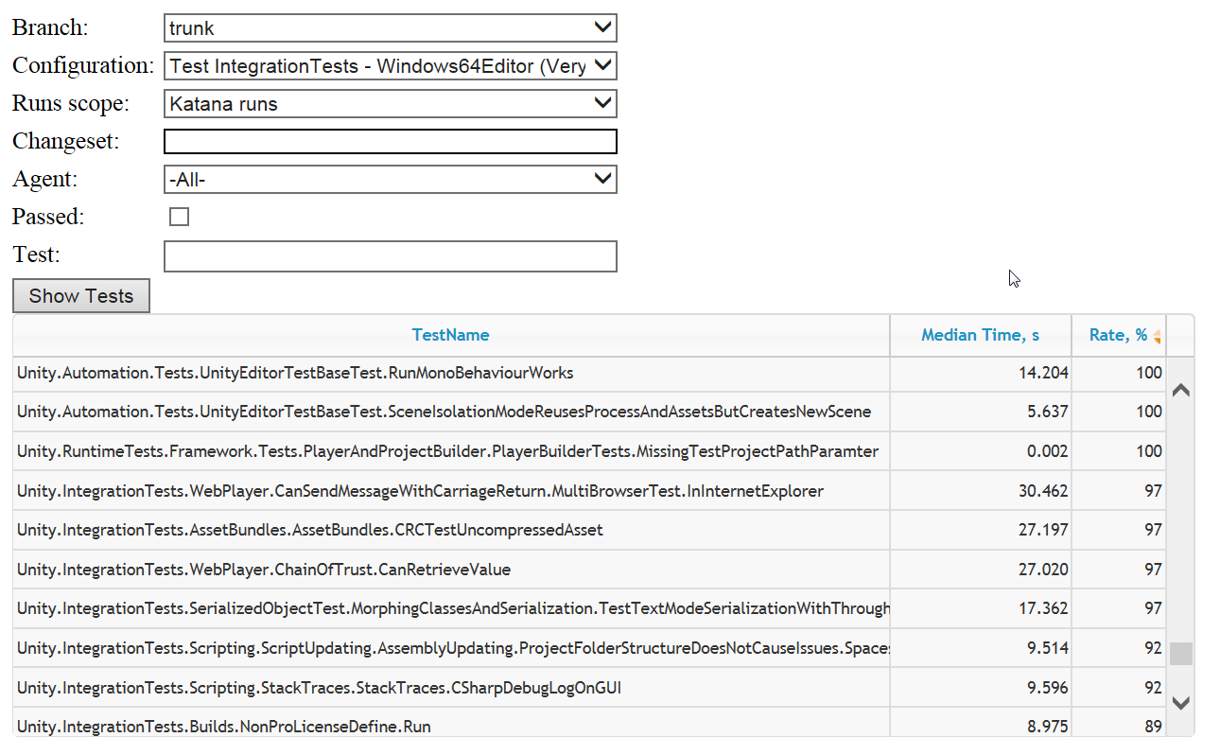
Unified Test Runner / Hoarder

Slide 42
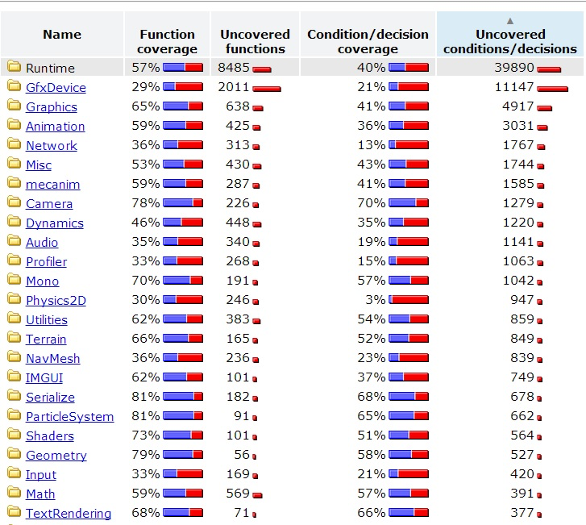
Code Coverage
Notes:
http://blogs.unity3d.com/2014/02/27/how-do-we-use-code-coverage-for-unity/
We are now able to get C++ code coverage for all test suites when running on Windows. This means we are able to see exactly what parts of the C++ codebase our test suites are hitting. We will use this information to make our test suites more effective and efficient, but we will also use it as input when planning our manual testing efforts.

Slide 43
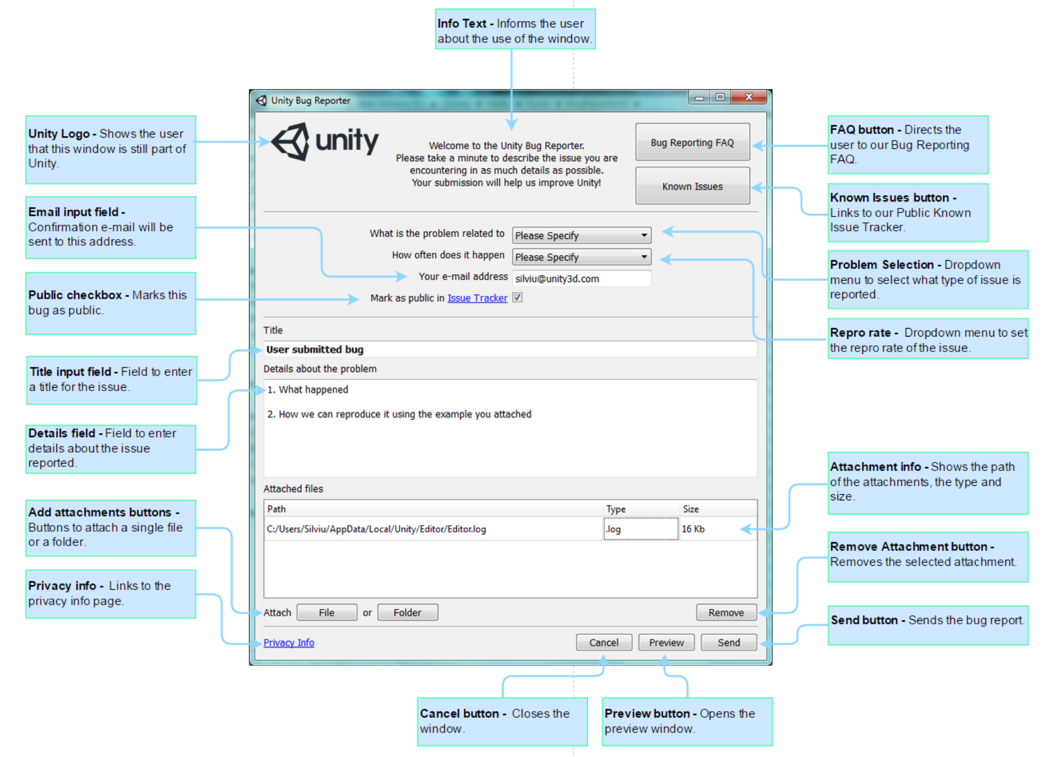
Bug Reporter

Slide 44
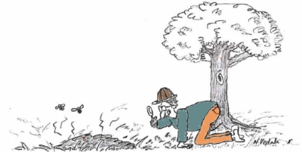
Crash Analyzer

Slide 45
Public Bug Tracker
http://issuetracker.unity3d.com

Slide 46
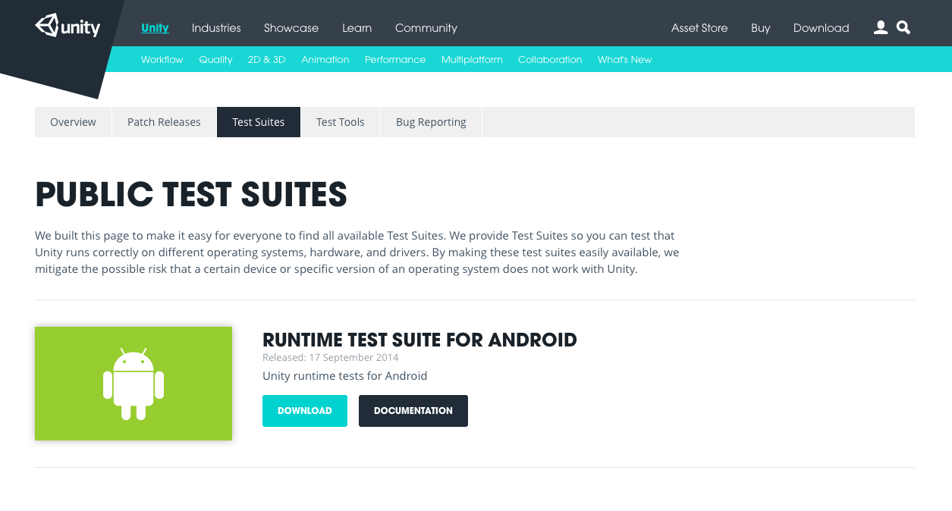
Public Test Suites

Slide 47
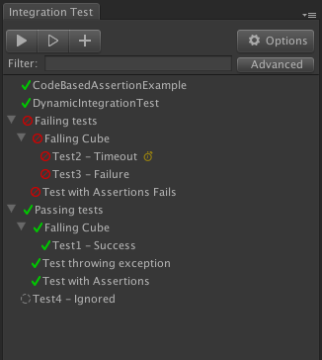
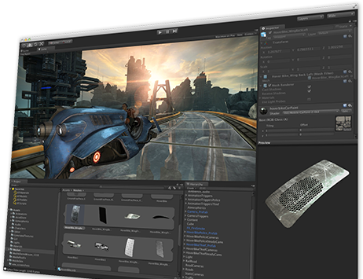

Unity Test Tools
Microservice architecture.
TCP socket.
C# messages.
Player connection.
Per platform implementation.
Supports text, images, etc.
Player
Runner
Multi-platform build pipeline
Editor

Slide 48
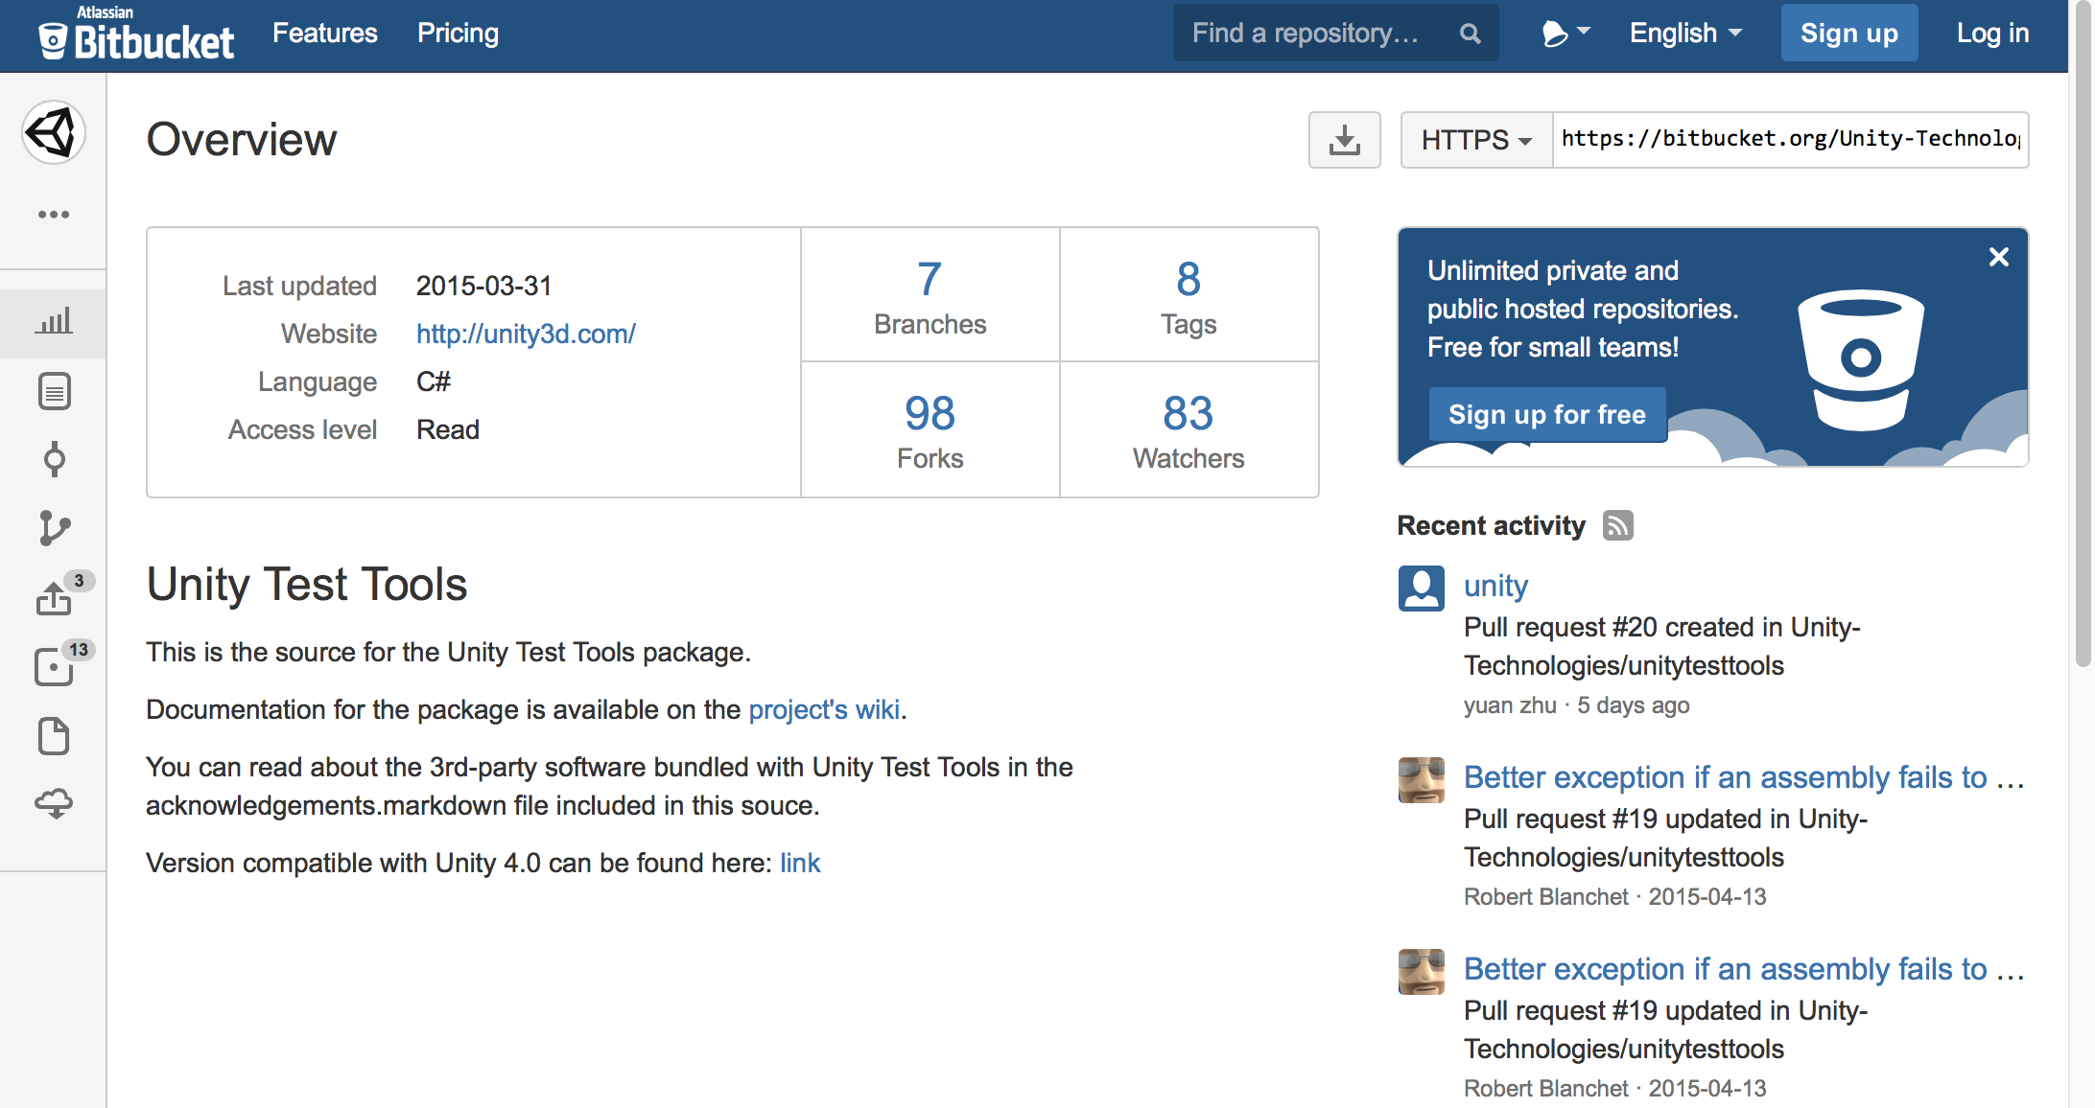

Slide 49
Our Future
Data, Analysis, Reporting
Fast and stable tests
Sharing
Notes:
Testing is gathering information with an intention to do something about it!

Slide 50
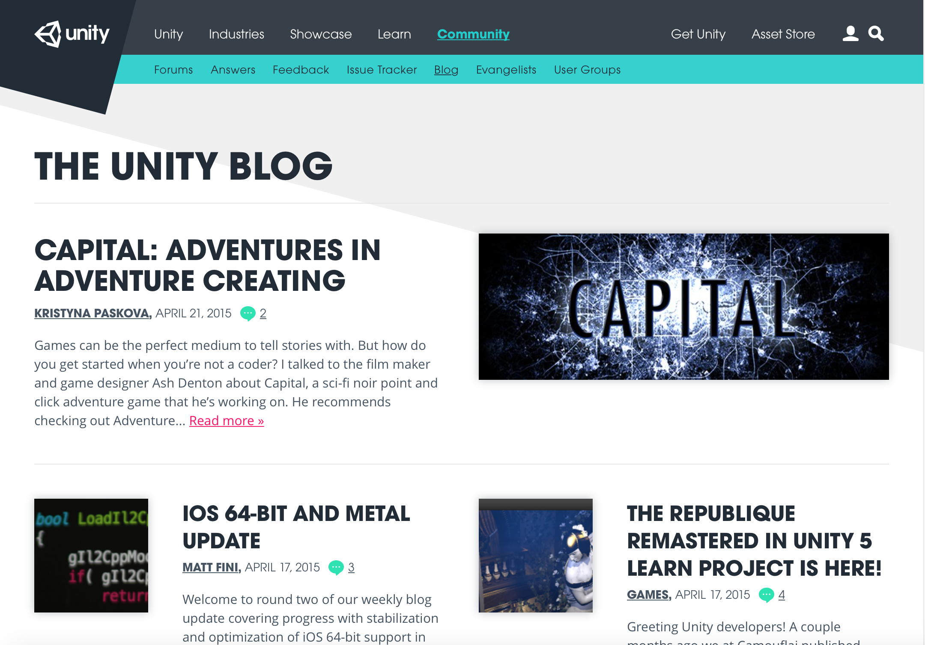

Slide 51
Questions

Slide 52
Thank You! (we are hiring)

