Slide 1
Mock Objects in Functional Testing
Sven Rosvall
Notes:
Some slides are animated. They look quite messy unless viewed in slideshow mode.

Slide 2
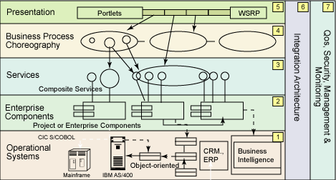
Dimension Data Cloud Business Unit
Notes:
I am working with cloud management systems. This is built as a multi-tier SOA application. This means we have many services that depend on each other which complicates testing.

Slide 3
Testing Lifecycle
Unit Test
Functional Test
System Test
Production

Slide 4
Unit Testing

Slide 5
Functional Testing
Notes:
Put developed classes and any libraries together into a service/link unit/executable. Test this in a test bed where other services are provided as a fixed installation or mocked out.

Slide 6
System Testing
Notes:
Test several services/executables together as a system as it will be deployed in the production environment.

Slide 7
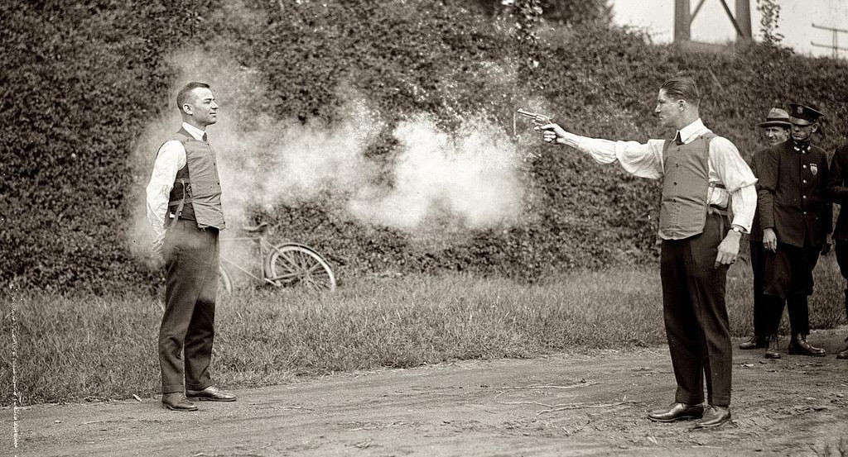
Production
Notes:
Deliver your work to production.

Slide 8
Test Responsibilities
Unit Test
Functional Test
System Test
Production
Developer
Tester
Operators

Slide 9
Test Environments
Unit Test
Functional Test
System Test
Production
Desktop
Test Environment
Production
Developer
Tester
Operators
Notes:
Different environments we use to run our components/systems for the purpose of testing or production.

Slide 10
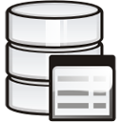
Test Environment
Notes:
Test environments are complex to set up and maintain. There may be complex external systems such as directories, databases, payment systems, networks, security. There are also many services that must be provided at the correct version. Can be really difficult if many of these services are under development simultaneously. Some companies use many test environments, each with different purposes.

Slide 11
Test Environments
Unit Test
Functional Test
System Test
Production
Desktop
Test Environment
Production
Developer
Tester
Operators
Notes:
As the test environments are tricky to maintain, we want to reduce the dependency on them. Do this by “test in production” and more developer testing.

Slide 12
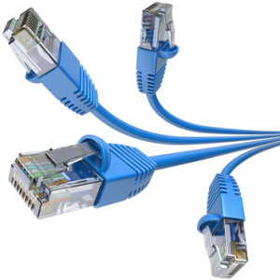
Test in Production
Notes:
Test in production by introducing your service that uses production services to provide live data support. Test your service manually at first. Then let a load balancer direct some live traffic to the new service.

Slide 13
Test in Production
Notes:
The service under test can also be introduced at middle-tier level.

Slide 14
Test Environments
Unit Test
Functional Test
System Test
Production
Desktop
Test Environment
Production
Developer
Tester
Operators

Slide 15
Functional Testing
Test Frame-work
Notes:
Test one service at a time. Provide dependent services. These services may in turn depend on other services. This makes the test environment complex, even if the service under test is small.

Slide 16
Mocking Dependent Services
Goals:
Mimic required functionality for testing
Easy to maintain and to deploy
Verify requests
Control expected responses
Remove indirect dependencies

Slide 17
Modes of communication
Synchronous Requests
Asynchronous Messages
Files
Shared memory
Database updates and triggers

Slide 18
Mocking an HTTP service
Simple mock HTTP service
Test Harness
Mock Service
Embedded HTTP service within test program
Test Harness
Mock Service

Slide 19
WireMock
@Rule public WireMockRule wireMockRule = new WireMockRule(PORT);
String responsePayload = fromFile("GetDeviceResponse_ok.json");
stubFor(get(urlEqualTo("/api/device?limit=100" + "&filter.component_unique_id=" + vmRefId + "&filter.component_root_device=" + vcenterDID)) .withHeader("Authorization", equalTo("Basic " + new String(basicAuth, Charset.forName("UTF-8")))) .willReturn(aResponse() .withHeader("Content-Type", "application/json") .withStatus(HttpStatus.SC_OK) .withBody(responsePayload)));
Notes:
D:\Users\Sven\DiData\code\oec-sl-adapter\trunk\oec-sladapter-facade\src\test\java\com\dimensiondata\sciencelogic\adapter\facade\internal\SlGetDeviceMediatorTest.java

Slide 20
Asynchronous Communication
Test Harness
Notes:
Let the test harness create messages and input files. It receives messages and files, and may in turn provide new files and messages as response to them.

Slide 21
Proprietary Communication
Protocol is hidden in a client library.
Protocol is verbose and complex.

Slide 22
Solution: Mock Client Library
Mock Client
Test
Harness
Notes:
The mock client library is linked in with the service in place of the real client library. It allows for a back door to control its behaviour, i.e. verify calls to the library, generate response values or inject error conditions.

Slide 23
Mock Client Library
Use a back door connection for:
Response data
Inspecting request data
Control exceptions
Backdoor runs in its own thread.
May require care when serializing data.
Use same technology as is used for the service’s inputs.
Notes:
Serializing: Show AsrCommunicationLogWrapper
Used in MockN2AdapterEndpoint
The mock itself MockAsrFacade

Slide 24
Application state
Stateless | Stateful
State kept in some dependent service. | State kept in application.
No need to set up state before each test case. | Run application functionality to set state correctly for each test.
Run test cases in any order. | or ... Run tests in specific order to use state set in previous tests.
Notes:
We prefer stateless applications. These are much easier to test.

Slide 25
Database Usage
Database stores state.
Database as part of the application?
Resetting content between tests.
Mocking Database Access Layer

Slide 26
Database and Application
“Database is a part of the application” | “Database is a dependent service”
ORM make database schema tightly coupled to the application. | Database developed independently of application internal structures.
Don’t let schema bleed into the test code. | Test code is allowed full access to database

Slide 27
Database Preparation
Use a golden image of database for quick start. May contain lots of static data.
Recreate schema and data
Recreate data only
Roll-back data changed during test
Prepare test specific data
Tests that don’t update database
Notes:
Reset DB: AbstractApi2FuncTestBase.resetDatabase()

Slide 28
Inputs and outputs
For a stateless service
Identify input stimuli and the side effects they cause.
Split each scenario to include one stimulus only.
Notes:
See ServerRestApi2FuncTest
deployServerRequest()
sendDeployServerCompletedMessage()

Slide 29
Input Stimuli
HTTP requests
Messages
Database triggers
File creation

Slide 30
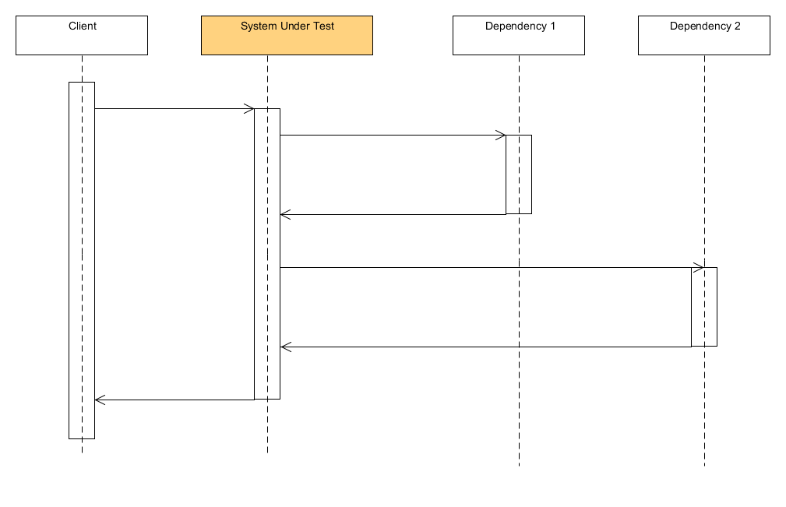
Minimize test scenario scopes
Notes:
Example bank transactions. A transaction may require several steps for example customer verification.
Split a scenario into sub-scenarios, each starting with a single input stimuli. Test the actions from the system under test.

Slide 31
Questions

