Slide 1

Notes:
This is the “walk in” – advance to next slide when I actually start

Slide 2
Naming is Hard:
Let's Do Better
Kate Gregory
kate@gregcons.com
www.gregcons.com/kateblog
@gregcons
Notes:
Welcome everyone, I’m delighted to be with you. I’ve included a few “pause points” where I can catch up on questions. And remember: a question is when you need more information. If you want to tell me something about yourself, there will be time for that later, in Remo.
So let’s get started!
When I talk about what makes some code better than others, I always include the advice to give things “good names.” And then I pretty much move on to the next slide, because the details of what makes something a good name will take up at least one talk. This is one of those talks. Naming is subjective, and demanding, and I’m not going to give you a pile of “turn the handle” rules in this talk that will generate good names for you. Instead, I’m going to show you things to value, things to care about when you’re naming.

Slide 3
Naming Things
It matters
This is how we explain ourselves
  To each other
  To our customers, users, managers, …
C++ people are famously bad at it
It’s a learned skill
  That means we can improve
Notes:
The first thing to care about is in fact choosing good names. It matters.
C++ developers are famously bad at naming: our idioms, guidelines, and lore are rich in examples of terrible names. After all there are two hard problems in C++: cache invalidation, naming things, and off-by-one errors.
Consider RAII, which stands for scope bound resource management, or west const which perhaps should be const west, or all the samples that feature an object called x which is an instance of a class called X, and so on.
It is trivially easy to find examples of terrible naming in C++ courses and books and talks and worst of all, live production code

Slide 4
Not Naming Conventions
camelCase, snake_case, PascalCase, m_thing, thing_, ALLCAPS
Bikeshed that stuff on your own time
Pick a convention and stick to it
Use tools for that kind of renaming
Notes:
This isn’t about whether the class is called Employee with a capital e or lowercase e, or whether the employee’s member variables are called startdate or _startdate or start_date or the like. It’s about calling the class Employee vs Associate vs Person

Slide 5
Names Carry Meaning
Inactive date, end date or expiry date?
  Can you use it on that date?
  Is it actually a date and time?
  What do the users call it?
Does empty() empty a collection, or tell you whether or not it’s empty?
  What does clear() do?
Notes:
Move quickly here these points will be made again

Slide 6
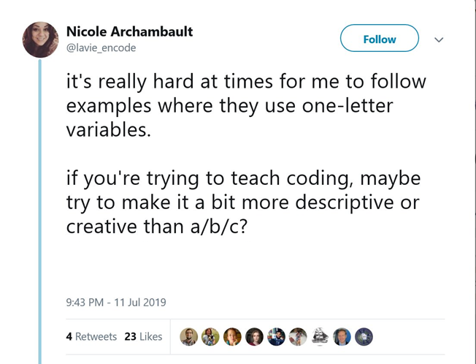
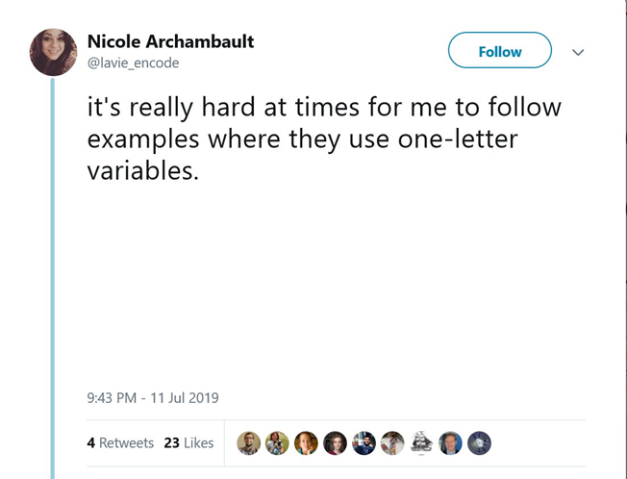
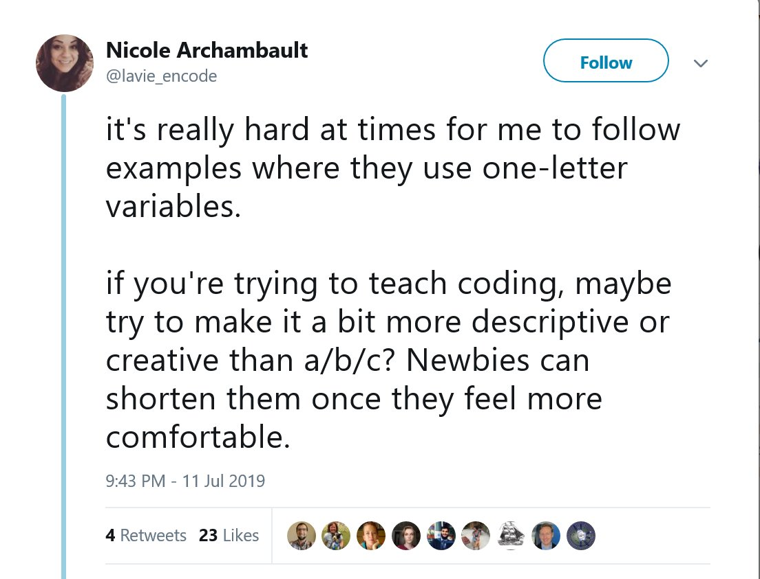
It Matters Everywhere
Notes:
Now, naming is important if I’m writing a real API or building a real system that will be maintained by a team, but if I’m just tossing an example together to explain what nodiscard means or what const means then I can use single letter variables and such like, right? No.

Slide 7
Names tell a story
void setStatus(ApplicationStatus s)
{
status = s;
lastUpdated = now();
if (status == ApplicationStatus::Approved)
{
// . . .
}
if (status == ApplicationStatus::Denied)
{
// . . .
}
}
void setStatus(ApplicationStatus s)
{
status = s;
}
void Approve()
{
status = ApplicationStatus::Approved;
lastUpdated = now();
// . . .
}
void Deny()
{
status = ApplicationStatus::Denied;
lastUpdated = now();
// . . .
}
If you name things well, you need less comments
Bad names confuse
Really bad names mislead
void setStatus(ApplicationStatus s)
{
status = s;
lastUpdated = now();
}
Notes:
Here, the … are setting a bunch of things other than status. Approved date, approved by, possibly a lot of other things too. You don’t expect that from a name like setWhatever, you expect that will just set whatever. This sort of function tends to grow organically – at first you only need to set the status, so that’s what you call the function. Then you need to set some other things, and it’s still happening for whatever status you’re setting, so that’s fine, then there’s some special stuff when you approve it, so you add it here, then later someone adds some more stuff for when you deny it, and before you know it you have a name that conflicts with the reality of the program.
Not understanding something is bad. But misunderstanding it, being sure it does something other than what it really does, is worse.
When you split it into two functions, they get names that make sense. And the calling code changes too. Instead of setting the status to approved, which is a 5 word phrase, they approve, which is just one. Same for denying.

Slide 8
Naming is hard
Giving something the correct name may happen long after it’s first written
When refactoring, one technique is to give functions literally nonsense names
  Dfhtjd
Or extremely verbose ones
  SetShippingCostsAdjustTotalAndMarkAsShipped
Eventually you give things their “true names”
Notes:
Except that it might not say “shipping costs” it might say “dollar amount 3” and it might not say total it might say “accumulated amount 4” because those things may not have their real names yet at the moment.
True names may change over time especially as business rules change
Doesn’t mean it’s an optional step or something you can get around to if the deadline permits, but it does mean that you should not be paralyzed and unable to go forward because you don’t know a good name for something. If you’re committed to it having a good name eventually, you can loop back and fix things up after the code is written.
I will come back to this point later in the talk

Slide 9
Naming requires empathy
Notes:
If you’re refactoring a hundred line block of code into a private member function, naming it is pretty easy. You know what it does so you call it that. Update. Ship. Release. Whatever. Things get harder if you’re naming a function in a public API, especially one that will be called by people who aren’t on your team and don’t use your words for things. And the more generic things get, the harder naming becomes, because you keep getting further from the person who’s going to consume the thing you’re naming, who’s going to consume your name.

Slide 10
An <algorithm> story
sort
partial_sort
partial_sort_copy
top_n
top_n_sorted
1
5
4
2
9
7
7
9
2
5
1
4
1
2
4
9
5
7
1
2
4
Notes:
When you are told this story: the implementor’s story, it all makes perfect sense. It’s logical, It’s intuitive. It’s obvious.
But put yourself in the shoes of the person who wants to find those best performers. They don’t think this way. That’s not the service they were looking for.
It can be argued (and Conor Hoekstra has done it) that partial_sort_copy is really top_n_sorted and the nonexistent nth_element_copy would be a good candidate for top_n. I don’t disagree. My point is that someone who wants the best performers in their collection isn’t looking for sort. They don’t want to sort their collection. To give them a name that reflects their needs in their application is very different than building a name based on the history of the function or how it is implemented internally or even what it does. What’s it FOR?

Slide 11
Question Pause

Slide 12
Consistency
Notes:
But I promised you heuristics. Naming matters, and it’s hard, because it requires you to understand the real meaning and purpose of the thing you’re naming, and to have empathy with the person who’s going to consume your name. There are, however, some guidelines you can follow to get better names and the first one is to be consistent.

Slide 13
User Nomenclature
Names exist outside your code
  Headings on reports
  Emails
  Prompts
  Human conversations about the system
Use the same words/names in all contexts
  Everyone should call things by their proper names, everywhere
Notes:
The connection between the business and the software goes in both directions. When you randomly choose report headings, or prompts on a dialog, then users will learn those words and use them not only in discussing the software, but in doing their jobs. It’s probably best if they chose those words for the people who come after them, not you.
Software tends to outlast employees. New users and customers will call things by the names they see on the screen and in their emails
Translation layer makes it harder to think and to communicate

Slide 14
User Nomenclature
Don’t use the same words for different things
  Be arbitrary: a certification expires but a coupon becomes invalid
  Then stick to it
Don’t accept similar English words in conversation; stay precise
  Expired/inactive/invalid
  Coupon/voucher/discount
Notes:
The connection between the business and the software goes in both directions. When you randomly choose report headings, or prompts on a dialog, then users will learn those words and use them not only in discussing the software, but in doing their jobs. It’s probably best if they chose those words for the people who come after them, not you.
Software tends to outlast employees. New users and customers will call things by the names they see on the screen and in their emails
Translation layer makes it harder to think and to communicate

Slide 15
Don’t Invent Business Words
Naming pieces of a function is hard
Avoid pre/post and other “dependent” names
  Unless the business uses them
Prefer single English words like Save or Location to implementation-focused words like UpdateConfigFile or StorageCoOrdinates
PreLoad(user, section);
Load(begin, end, filter);
PostLoad(user, category);
Notes:
Users don’t know the words for everything your software does. But that doesn’t mean you shouldn’t think of them while you name things.
Example. You’re writing or refactoring a very long function. You’ve already identified a big chunk in the middle and called it Load(). There is probably a very strong temptation to call the stuff before that PreLoad and the stuff after that PostLoad. But those aren’t words in your business universe. Are there already words for the steps before loading and the steps after loading? Perhaps in order to Load from a file, you have to figure out the file name, and that’s what all that code is doing. There’s no extra information in “the stuff we do before load”. I already know it’s before load, because I can read the code in front of me. Tell me something I don’t know, like that you’re working out the file name or checking permissions or ensuring nobody else has the file open. And tell me in the name of the function itself.
If Save won’t work, SaveConfiguration is better than UpdateConfigFile. Of course, it may start with a long and complicated name, or a name that focuses on how it does it. Try to eventually reach a name like Save that emphasizes what it does for those who call it, not how it achieves that.

Slide 16
Don’t Mismatch Natural Pairs
Begin goes with end, not last (last goes with first)
Create goes with destroy, not cleanup
Open goes with close, not release
Next goes with previous, not rewind
Put goes with get, not retrieve
Source goes with destination, not target
Notes:
This applies to everything you might name: pairs of local variables, free functions, member functions, parameters into a function, and so on.
And so on. You mostly know this, you only need to pause a moment and think. When you’ve set up a pair, have you set up a natural pair? If you’re not sure, ask some folks. It’s a great twitter poll ☺.

Slide 17
Metaphors Aren’t Universal
Not everyone has your background
Many are very overloaded
  Red/Green
  White/Black
Does filter() include or exclude?
  Try include_if() and exclude_if()
Try using a more literal word
Notes:
Sure, you may know that the “good cowboys” wore white cowboy hats and the baddies wore black cowboy hats, but lots of people never watched those movies. It’s like referring to someone as a “redshirt” – star trek references don’t work for everyone. Encoding your cultural references into a name may not create a long lasting explanation.
Red/Green: stop/go, start/stop, pass/fail or of course port and starboard
White/Black: allow/deny, good/bad – even if your metaphorical use of these is not rooted in “White means good and black means bad” it is likely to connect to people’s memory of that, which is usually unpleasant
Pink/Blue doesn’t solve any gender binary issues and not everyone uses these colours for genders
Some people might “filter out all the odd numbers” or “filter so only the odd numbers remain”
This also applies to master and slave, or to master on its own – I’ve avoided it for decades because it’s gendered and nobody noticed, there’s always a substitute. Instead of “dummy” try “placeholder” or unused – again, this isn’t “political correctness” – not everybody can map your metaphor to what you’re doing and being completely clear and explicit about your intention is better than relying on a lookup table that is built with decades of exposure to one particular culture.

Slide 18
Some Heuristics for Functions

Slide 19
Verbs Help Functions
Make Sense
Ideally a service of the system or object: Update, CalculateTax, DeductFees, MarkAsRead
You may want to use helper verbs
  IsEmpty() is less ambiguous than Empty()
    [[nodiscard]] is a signal that people misunderstand the name you’re using now

Slide 20
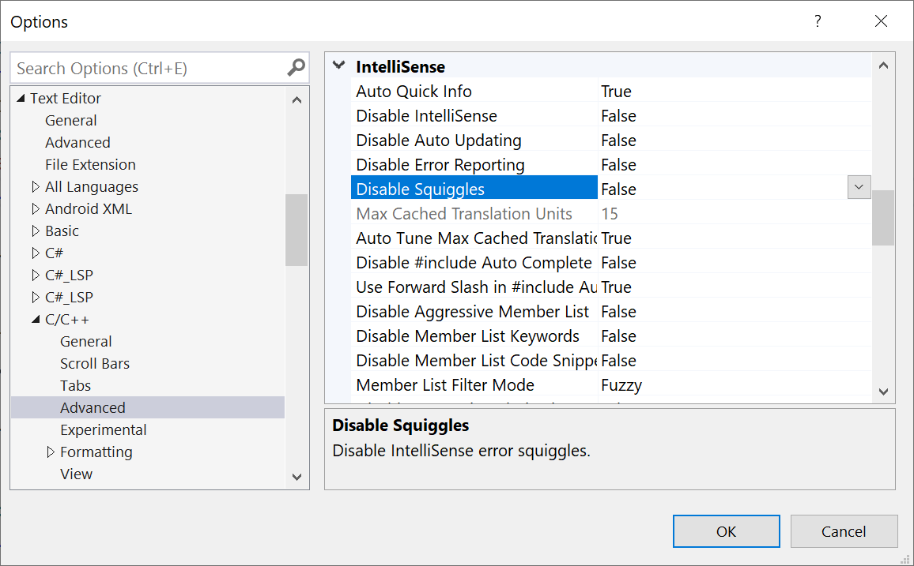
Verbs Help Functions
Make Sense
  HasX() and CanX() are also useful
    IsShippable() vs CanShip() vs getShipStatus()
    if (!ReadyToShip()) vs if (NotReadyToShip())
    if (! isInvalid())
Notes:
To me, getShipStatus should return an enum one of which is ReadyToShip or the like. So this is the difference between writing if (CanShip) vs if (GetShipStatus == ReadyToShip). You have to think about someone calling the function while you’re naming the function. I wouldn’t want getShipStatus() to return just true or false. This will come back later when I talk about enums
Thinking about how people call your function, do you want them to always have to put that “not” operator in there, or could you name the function to match what people actually test? Is double negation a challenge (VS options)?

Slide 21
Order Matters
If you are going to have a noun and a verb in each function name, should they be VerbNoun or NounVerb?
  We never say TaxDetermine() or FeesCharge() but we do say EmployeeUpdate() and InventoryCheck() – why?
Make a deliberate choice, think about it

Slide 22
Tools Matter
If similar functions all start the same
  They are listed together in IDEs that show alphabetical lists of functions
  They may be sorted together by tidiers that do so
  You may have to type more of them before you can autocomplete
Do HasEntries() and HasRisks() belong together?
  Away from GetRisks() and GetEntries(), and AddEntry() and AddRisk()?

Slide 23
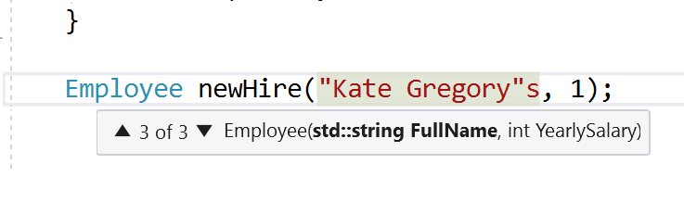
Parameters
Serve two purposes
  They are local variables in the function scope, so you name them with that in mind
    Never shadow member variables, but please also don’t argx
  They are cues to the function caller
    Never omit them in headers
Notes:
If you must distinguish between the parameter and the member variable it shadows, then this is an argument for a naming convention that distinguishes member variables, not parameters. Because it also cues the caller, and argWhatever is not a nice clue to the caller.

Slide 24
Question Pause

Slide 25
Some Heuristics for Classes
Notes:
Also structs
Why do we use pair and tuple? Why not?

Slide 26
Classes Are Nouns
Anything ending in er (et al) is suspect without a noun
Don’t overdecorate
  Suffixes like proxy, factory, adapter, interface – really needed?
  Monad? Singleton? AbstractFactory? Base? Impl?
  Prefixes such as project names are clutter
    We have namespaces
    Project names and code names change
Notes:
Manager, Updater, Normalizer, Formatter … what do they manage, update, normalize, or Format?
Real world objects or people like printer, shipper, and manager may be ok
At minimum add a noun, but consider just using the noun alone
I am not saying all decoration is wrong, but it has to earn its keep. Is InventorySingleton better than Inventory?

Slide 27
Classes Are Nouns
Don’t list the contents
  NameAndAddress? NameAddressAndPhone? NameAddressPhoneAndEmail?
  ContactInfo
Purpose of this class?
AbsoluteOrientationEulerAnglesFusionAlgorithmUsingAccelerometerAndMagnetometerTest
Notes:
Think “up a level” or creating an abstraction. Just listing the contents is kind of still a tuple. You wanted an abstraction, what is that thing you want?
Remember the purpose of this class in the larger system

Slide 28
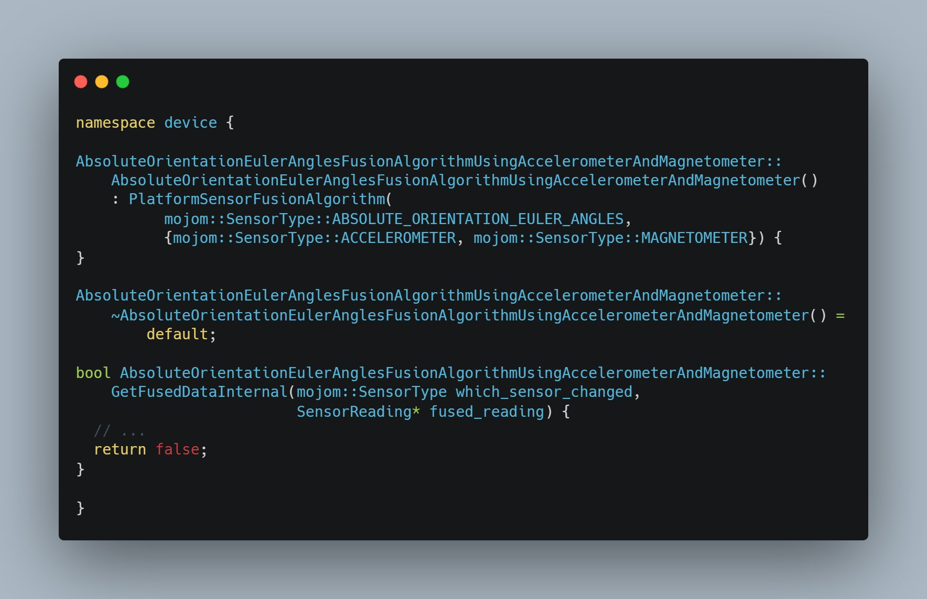
Notes:
This is something Patricia Aas tweeted recently. I don’t even know what any of these words means. But surely when you select these various types and whatnot, you create a thing that can be named? Understood? We don’t say Elevated Sleep Surface Using Small Underhead Paddings and Overbody Warmth Retainer do we?

Slide 29
Members
The class name is implicitly included; don’t repeat it
  Employee::EmployeeName → Employee::Name
  Employee::PrintEmployeeRecord() → Employee::PrintRecord()
Notes:
If the people in your company say things like “we’ll need to print an employee record whenever that happens” and it is a report with Employee Record in big letters at the top, then maybe PrintEmployeeRecord is ok. But normally, leave the class name out of the function names.

Slide 30
Members
Adjectives are your friend
  FullName is better than Name
  AnnualSalary is better than Salary
Avoid encoding type
  Possible exception for dates
    HireDate not Hired
    ShipDate not Shipped
Notes:
On the matter of encoding type, again look to how people talk. “What was the ship date?” is something a normal human would say. “What was the weight converted to a string?” is not.

Slide 31
Traditional Member
Function Names
If you put real work in a constructor or a destructor, others will know when it happens
  Eg open/close a file
We recognize get/set for better or worse
  Try to reserve get for {return thingy;} and use fetch/read/load/retrieve otherwise
  People expect getThingy() to be const
Notes:
Be aware that some newcomers interpret get as “read” or “prompt the user for” – not just “return the value already held in the class”

Slide 32
Traditional Member
Function Names
void Temperature(int t) and
int Temperature() const are also well known
  Some people really hate them; be careful

Slide 33
Enums
if (nextApplication.getStatus() == ApplicationStatus::Approved)
{
// . . .
}
Prefer scoped enums
  So you don’t have to encode enum name into values eg NT_OK, SB_OK etc
As with members, don’t repeat the enum name
Think about whether or not to “leak” the enum values outside of the class they help
if (nextApplication.isApproved())
{
// . . .
}
Notes:
Why is a scoped enum better than an unscoped enum?
If the enum is used lots of places then a getStatus that leaks it is fine. But if it’s really mostly used internally, consider keeping it internal. Encapsulate.
Call back to setApplicationStatus() vs Approve() and Deny()

Slide 34
Some Heuristics for Local Variables

Slide 35
Rarely, Shorter is Better
i, j, k in loops
  If loop is right; consider a ranged for or an algorithm
x, y, t, v etc in scientific calculations
  Use the same notation as the formula
When it has a tiny scope
  almost like a pronoun
string r = getNextResponse();
while (!r.empty())
{
responses.take(r);
}
Notes:
In this example, assuming r is never used again after the loop, it’s easy to remember that it’s a response. It’s like using a pronoun to refer to someone the second time instead of repeating their whole name every time. If this is your habit, this super short name actually tells people it has a super short scope, that you don’t need to think about it again after the loop is over. It wouldn’t be wrong to call this local “response” but it also isn’t wrong to be super small here

Slide 36
Most of the Time,
Longer is Better
Nouns
Add Adjectives liberally
  Next, current, remaining, active, . . .
Avoid Encoding Only Type
  And other forms of overdecorating
Employee e;
vector<Policy> policies;
double d;
Notes:
Most plurals are too similar to the singulars, so adding adjectives helps. Not Employees but perhaps AllEmployees, ActiveEmployees, ActiveEmployeeList, or Department
A vector of Policy objects called Policies is not that different from a double called d or an integer called i that is not a loop index.
A thought: does using auto lead to better names? So many almost always auto examples are examples of terrible naming that is improved when the type is removed.

Slide 37
Most of the Time,
Longer is Better
Focus on the purpose of the variable, not what it holds
  Why are you building a collection of Policies? What is that collection for?
Consider the greppers
Notes:
Naming is hard, but when you’re doing it right, suddenly it isn’t. A descriptive name just fits better and you can see that you’re explaining yourself.
Plurals - just sticking an s on the end may be hard to spot (name, names) so perhaps nameList would be better? still hard to grep for so ideally two suffixes - one for the single instance, one for the collection.
I will say that jamming 5 or more words together is probably too long. Think hard if you find yourself doing that. You can keep the long name while you learn what it truly is, but it should boil down to a shorter name later. NameAddressPhoneAndEmail example.

Slide 38
Abbr
Abbreviations are generally bad
  Special dispensation to id
First syllable only may be obvious to you, not others
First letters is generally write-only
  ar
  ti
  rd
Vowels are free
Notes:
There are some things for which the initials are the name. Think GPS or IBM. If you Google the initials and the first hits are all the thing you think it stands for, it’s fine to use the initials as the variable name. If not, spell it out.
Annual revenue, total income, and revenue delta. With income and revenue being used as synonyms (remember earlier don’t use different names for the same thing)
Once upon a time there were length limits on variable names. Those days are gone. Spell it out.

Slide 39
Some Heuristics for Templates
Notes:
all of the above plus typenames

Slide 40
All of the Above
If you write a templated function, it’s a function, so use those approaches
If you write a templated class, it’s a class, so use those approaches

Slide 41
All of the Above
Then there’s the matter of the typenames
  template<class T> or template<typename T>?
  Compiler doesn’t care
  Some humans say typename if int etc are ok, class if they are not
    Very weak signal
Notes:
Ok, the compiler cared for template templates up until C++ 17, but that was then

Slide 42
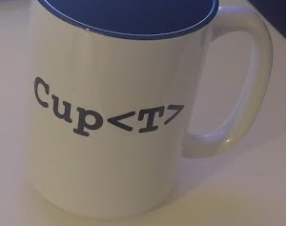
Typename Names
template <class _Elem,
class _Traits = char_traits<_Elem>,
class _Alloc = allocator<_Elem>>
class basic_string { // null-terminated transparent array of elements
// . . .
template <class _Ty,
class _Alloc = allocator<_Ty>>
class vector { // varying size array of values
Only one? T
Two? Please be meaningful
Notes:
Yes, I know most samples with two typenames use T and V. But that’s because they’re made up samples. This is what the Visual C++ STL uses for string and vector.

Slide 43
Question Pause

Slide 44
When does naming happen?
Notes:
You may think that it depends. You may think there are many different answers. But there’s really only one. You name something…

Slide 45
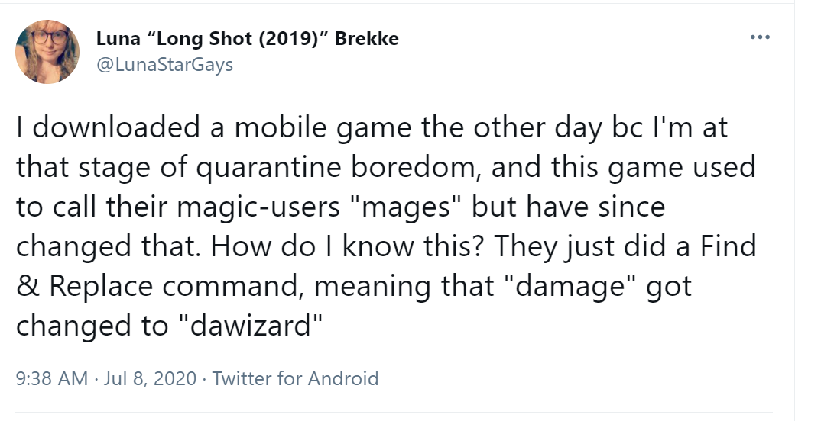
When You Know What It Is
Sometimes before you even write the code
Sometimes after you’ve been reading or debugging for some time
Never miss an opportunity to fix a name
  Have good tools for this
Sometimes when code changes, names need to change too
Notes:
“I’m going to need to read all the prices, store them, then for each item look up the price and… “ you haven’t typed any code but I know these words are going to be in the names of the classes, functions, and local variables in this code
It can be hard to get it right the first time (when you know the least) so be willing to change it as you learn
You have to have tools (not just search and replace) so that it’s only a moment’s work to change a name, and the change ripples everywhere
Name, name and phone, name phone and email, … contact info again

Slide 46
Temporary Names
Especially in refactoring
But also in greenfield work
How will you remember to give it a true name later?
Never choose something rude or embarrassing
Notes:
You may be designing and typing and you say “then I need to process each of them” so for now you call the function Process. That’s a terrible name. Later, when it’s written, when the requirements are all met, when people have told you all the steps they forgot to tell you, it can get its real name.
Leaving artifacts in your code to remind yourself to do things with that code does not work.

Slide 47
Names as Motivation and Review
Process() can be 5000 lines long and nobody understands it
When you insist on a better name, this will change
Probably will start with giving names to parts of it
Eventually the whole team will “get” what it does, and it becomes name-able
Notes:
“read all the prices, store them, then for each item look up the price and…”

Slide 48
Names as Motivation and Review
Things are hard or impossible to name when they are the wrong size
  Demanding good names makes things the right size
Good names make the code tell a story
  Demanding a story will get you good names
Notes:
“read all the prices, store them, then for each item look up the price and…”

Slide 49
Better Naming
Care about the code you write, and the people who will read it
Think about the purposes functions, classes etc serve and how they are used
Don’t be paralyzed by being unable to name something at first
  Fix it later!

Slide 50
Better Naming
Demand good names from yourself and those around you
When you learn what something is, fix its name
When you change what something is, change its name
Use consistency and story telling to guide your choices
Notes:
… because yes, Naming is Hard, and we can and will Do Better. Thankyou

