Slide 1
Notes:
Hi everyone, my name is Julia and I’m a Product Manager on the C++ team at Microsoft. My team maintains a suite of tools for C++ developers, like Visual Studio, VS Code, the MSVC compiler, MSBuild, and vcpkg. I specifically work on C++ development experiences in Visual Studio Code. Today, I’m going to give you the tools and tips to level up your debugging workflow.

Slide 2
Level up your debugging workflow
Recommendation #1: Use CMake Presets to easily debug the same project on different platforms and in different editors/IDEs
Recommendation #2: Use Disassembly View to understand how data is represented in memory
Recommendation #3: Automatically catch bugs in your program before shipping to production by setting up a CI/CD pipeline
Recommendation #4: Use GitHub Codespaces to create consistent, fast, and clean development environments accessible from your browser

Slide 3
Write code
Integrate
Run and debug
Test

Slide 4
Write code
Integrate
Run and debug
Test

Slide 5
Local debugging: the problems
You and your coworkers are on different host operating systems, and it’s difficult to share your build and debug configurations
You build, test, and debug your program on different platforms, and each time you switch platforms, you have to spend time getting your program to build successfully
Dependencies aren’t set up correctly, the build and debug configurations are different
You and your coworkers are using IDE-specific build and debug configurations, making it difficult to switch between different editors/IDEs

Slide 6
Local debugging: the problems solutions
CMake Presets
vcpkg
Visual Studio
VS Code
GitHub Actions
GitHub Codespaces

Slide 7
Recommendation #1: Use CMake Presets to easily debug the same project on different platforms and in different editors/IDEs

Slide 8
What is CMakePresets.json?
Released by Kitware in CMake 3.19
3.21 or higher required for CMakePresets.json v3
Allows users to specify common configure, build, and test options and share them with others
Lives at the root of the project, intended to be checked in to source control
Configure and build with the same CMakePresets.json file in Visual Studio, in VS Code, from the CLI, and in your CI pipeline

Slide 9
Example configurePreset (1/3)
{
"name": "macos-base",
"description": "Sets compilers, build type",
"inherits": [ "base" ],
"cacheVariables": {
"CMAKE_BUILD_TYPE": "Debug",
"CMAKE_CXX_COMPILER": "clang++"
},
"vendor": {
"microsoft.com/VisualStudioSettings/CMake/1.0": {
"hostOS": [ "macOS" ]
}
}
}

Slide 10
Example configurePreset (2/3)
{
"name": "macos-base",
"description": "Sets compilers, build type",
"inherits": [ "base" ],
"cacheVariables": {
"CMAKE_BUILD_TYPE": "Debug",
"CMAKE_CXX_COMPILER": "clang++"
},
"vendor": {
"microsoft.com/VisualStudioSettings/CMake/1.0": {
"hostOS": [ "macOS" ]
}
}
}

Slide 11
Example configurePreset (3/3)
{
"name": "macos-base",
"description": "Sets compilers, build type",
"inherits": [ "base" ],
"cacheVariables": {
"CMAKE_BUILD_TYPE": "Debug",
"CMAKE_CXX_COMPILER": "clang++"
},
"vendor": {
"microsoft.com/VisualStudioSettings/CMake/1.0": {
"hostOS": [ "macOS" ]
}
}
}

Slide 12
Example base configurePreset
{
"name": "base",
"description": "Sets generator, build and install directory, vcpkg",
"hidden": true,
"generator": "Ninja",
"binaryDir": "${sourceDir}/out/build/${presetName}",
"cacheVariables": {
"CMAKE_INSTALL_PREFIX": "${sourceDir}/out/install/${presetName}",
"CMAKE_TOOLCHAIN_FILE": {
"type": "FILEPATH",
"value": "$env{VCPKG_ROOT}/scripts/buildsystems/vcpkg.cmake"
}
},
"environment": {
"VCPKG_FEATURE_FLAGS": "manifests,versions,binarycaching,registries"
}
}

Slide 13
Example buildPreset
{
"name": "macos-verbose-build",
"description": "Passes -v to Ninja",
"configurePreset": "macos-base",
"inherits": "core-build",
"nativeToolOptions": [ "-v" ]
}

Slide 14
Demo #1: Use CMake Presets to build and debug a Fibonacci program in Visual Studio, VS Code, and from the command line across Windows, Linux, and Mac

Slide 15
Demo #1 key takeaways
With CMake Presets and vcpkg, you can easily build and debug your project on/for multiple platforms
CMakePresets.json enables consistent builds from the command line, in CI/CD pipelines, from Visual Studio, and VS Code
vcpkg simplifies the process of specifying, acquiring, and maintaining project dependencies
Declare project dependencies in vcpkg.json and check-in to source control to ensure you and your teammates are using the same versions of libraries

Slide 16
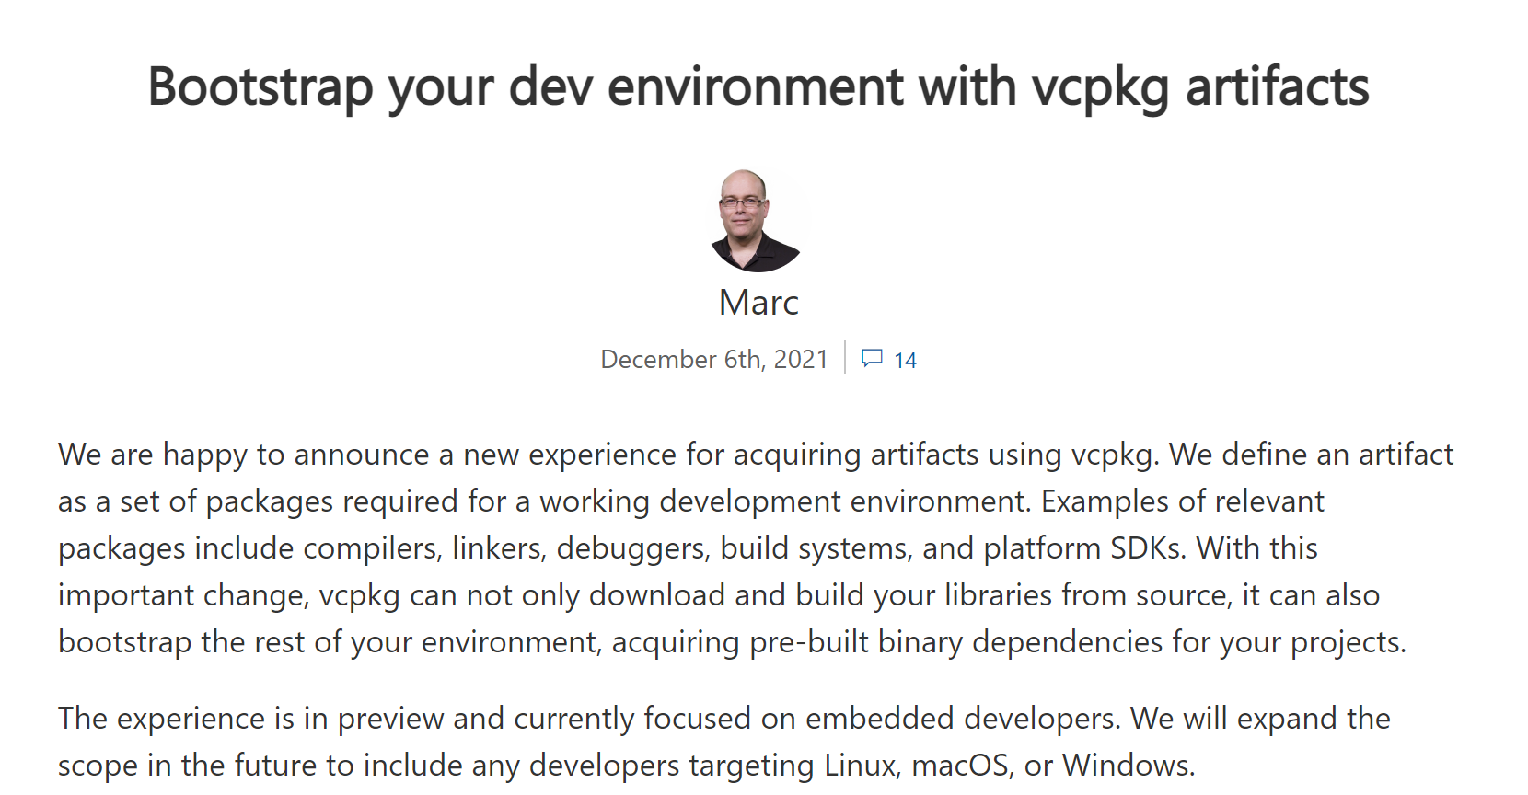
vcpkg artifacts for embedded developers
New!

Slide 17
Recommendation #2: Use Disassembly View to understand how data is represented in memory

Slide 18
Disassembly View in VS Code: #1 upvoted GitHub issue!

Slide 19
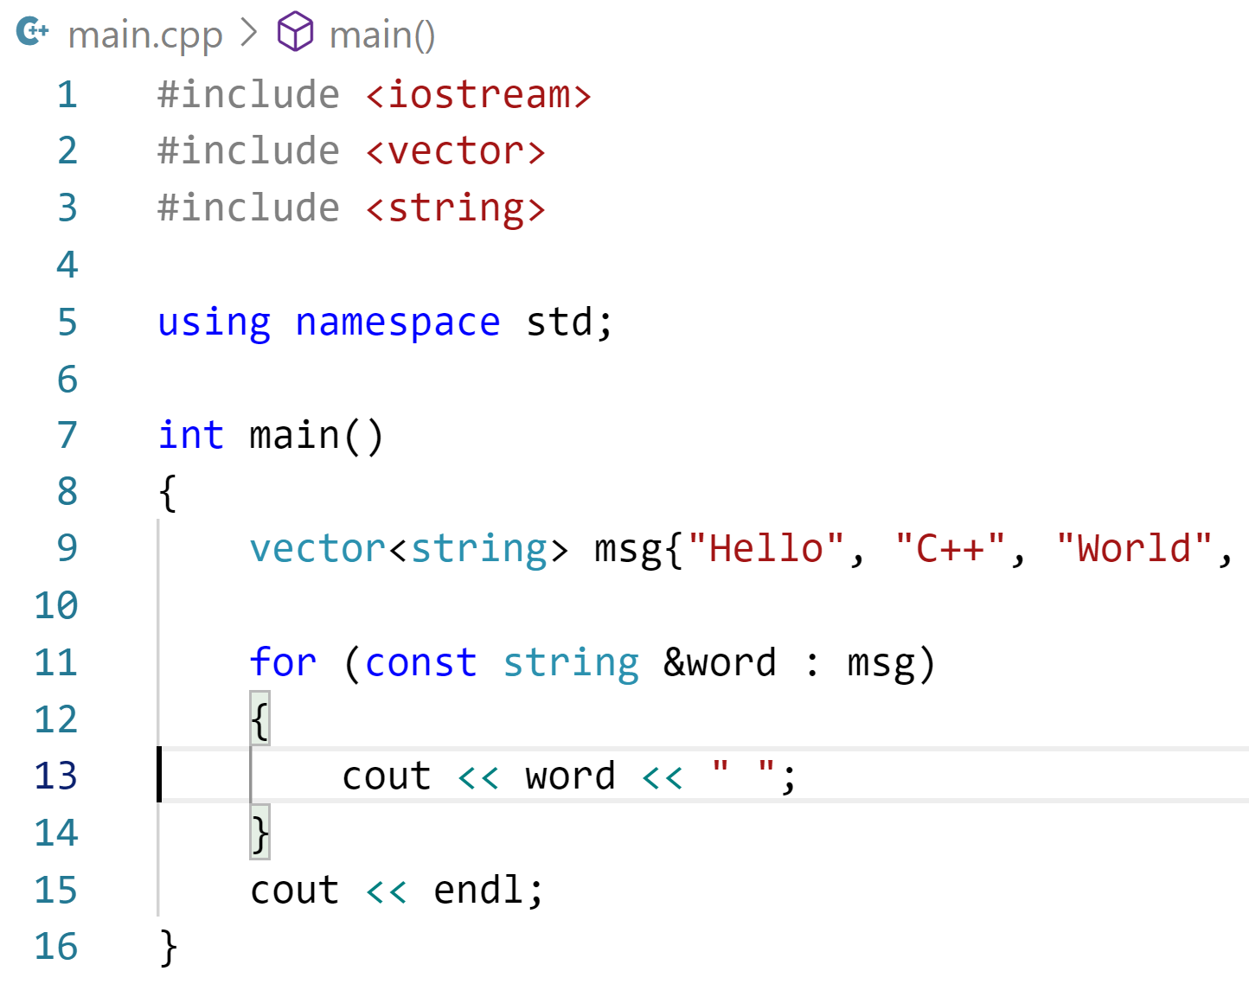
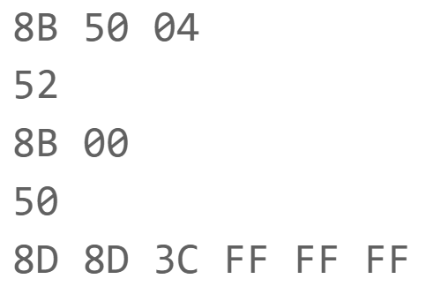
How a C++ program is made
main.cpp
C++ source code
main.o
Machine code
main.exe
Executable
C++ compiler
Linker

Slide 20
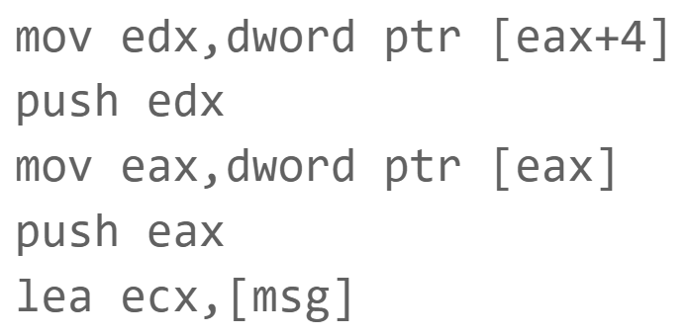
How a C++ program is made
main.cpp
C++ source code
C++ compiler
main.o
Machine code
main.exe
Executable
main.s
Assembly code
C++ compiler
Assembler
Linker

Slide 21
How a C++ program is made
main.cpp
C++ source code
C++ compiler
main.o
Machine code
main.exe
Executable
main.s
Assembly code
C++ compiler
Assembler
Linker

Slide 22
Why is Disassembly View helpful?
Sometimes the code generated by your compiler isn't giving you the performance you're looking for. Examining the assembly can give you insight into these issues, giving you a chance to make code changes, modify compiler switches, etc. to get what you need
Understand how data is represented in memory

Slide 23
Demo #2: Debug a Blink program on a Raspberry Pi using CMake Presets and Disassembly View in VS Code

Slide 24
Demo #2 key takeaways
Take advantage of Disassembly View to look at how your program is being represented in memory
VS Code provides full C++ IntelliSense and debug support for Raspberry Pi

Slide 25
Recommendation #3: Automatically catch bugs in your program before shipping to production by setting up a CI/CD pipeline

Slide 26
Continuous Integration (CI)
What is Continuous Integration (CI)?
“The process of automating the build and testing of code every time a team member commits changes to version control” [What is Continuous Integration? - Azure DevOps | Microsoft Docs]

Slide 27
Continuous Integration (CI)
What is Continuous Integration (CI)?
“The process of automating the build and testing of code every time a team member commits changes to version control” [What is Continuous Integration? - Azure DevOps | Microsoft Docs]
What are the benefits?
Reduces risk – detect and locate errors more quickly
Ensures quality – shipped product is always tested
Efficient – spend more time coding, less time manually testing and waiting

Slide 28
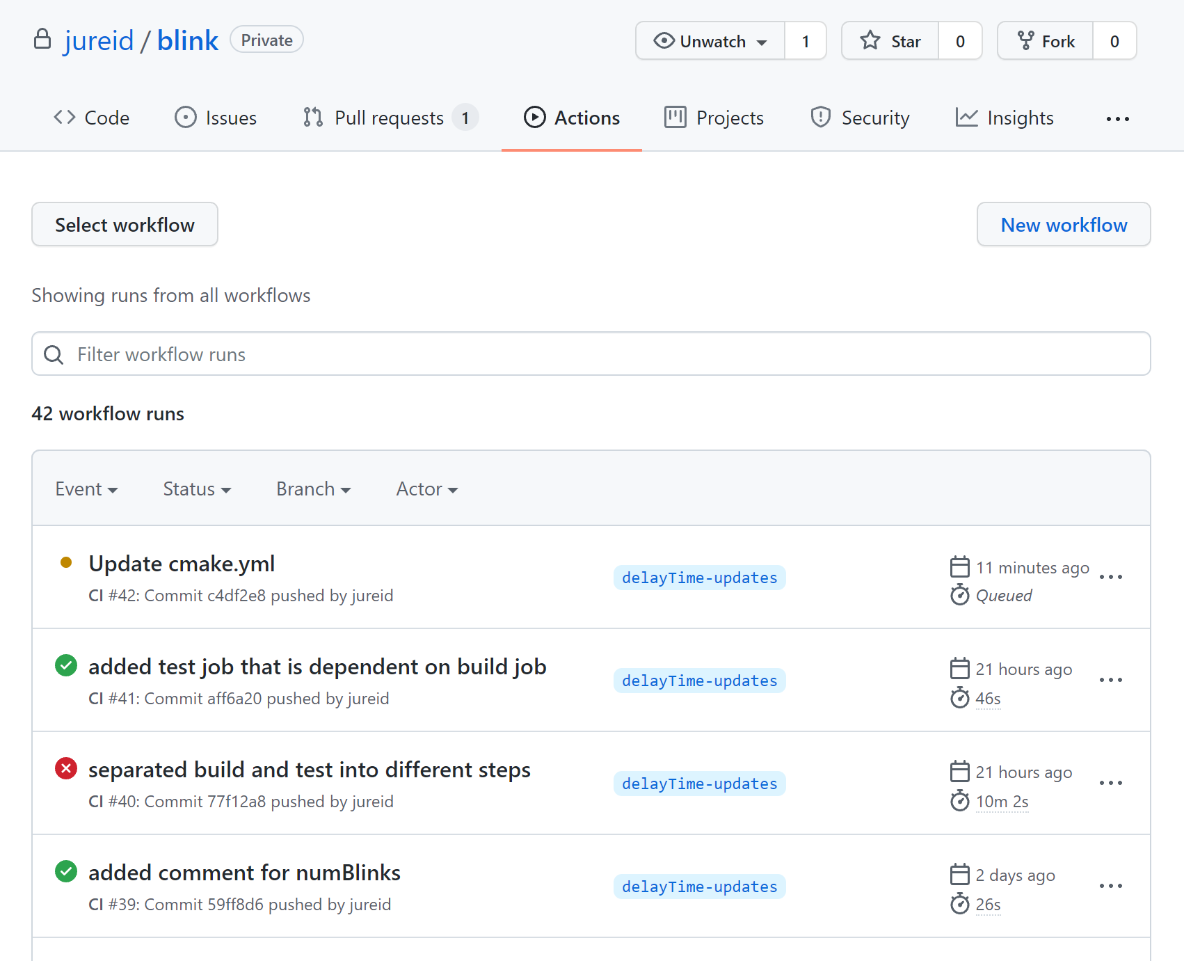
GitHub Actions for Continuous Integration (CI)
What: GitHub Actions offers workflows that build and test your code

Slide 29
GitHub Actions for Continuous Integration (CI)
What: GitHub Actions offers workflows that build and test your code
When: Workflows run when a specified GitHub event occurs

Slide 30
GitHub Actions for Continuous Integration (CI)
What: GitHub Actions offers workflows that build and test your code
When: Workflows run when a specified GitHub event occurs
Where: Workflows run on GitHub-hosted virtual machines or self-hosted machines

Slide 31
GitHub Actions for Continuous Integration (CI)
What: GitHub Actions offers workflows that build and test your code
When: Workflows run when a specified GitHub event occurs
Where: Workflows run on GitHub-hosted virtual machines or self-hosted machines
How: Workflows are defined in .yml files in your project’s .github/workflows folder

Slide 32
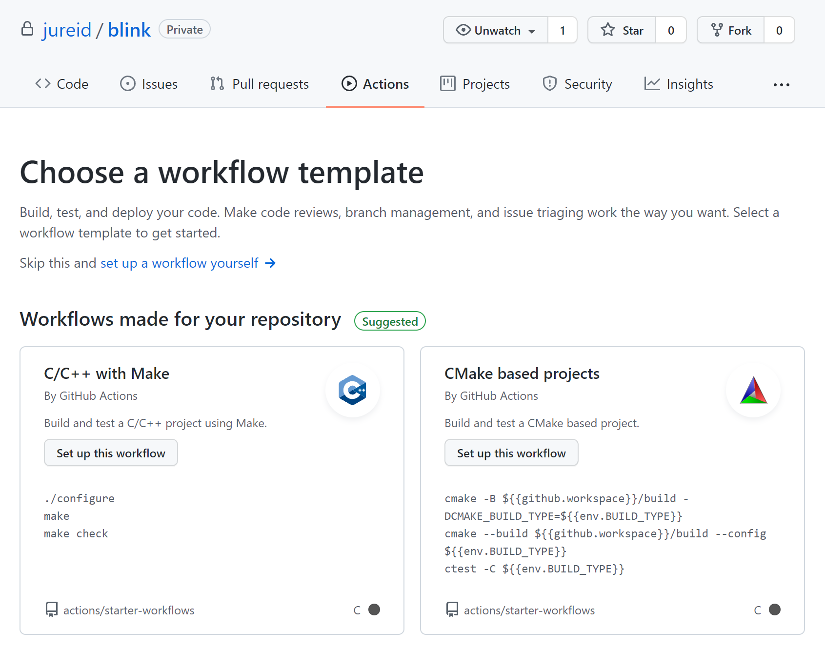
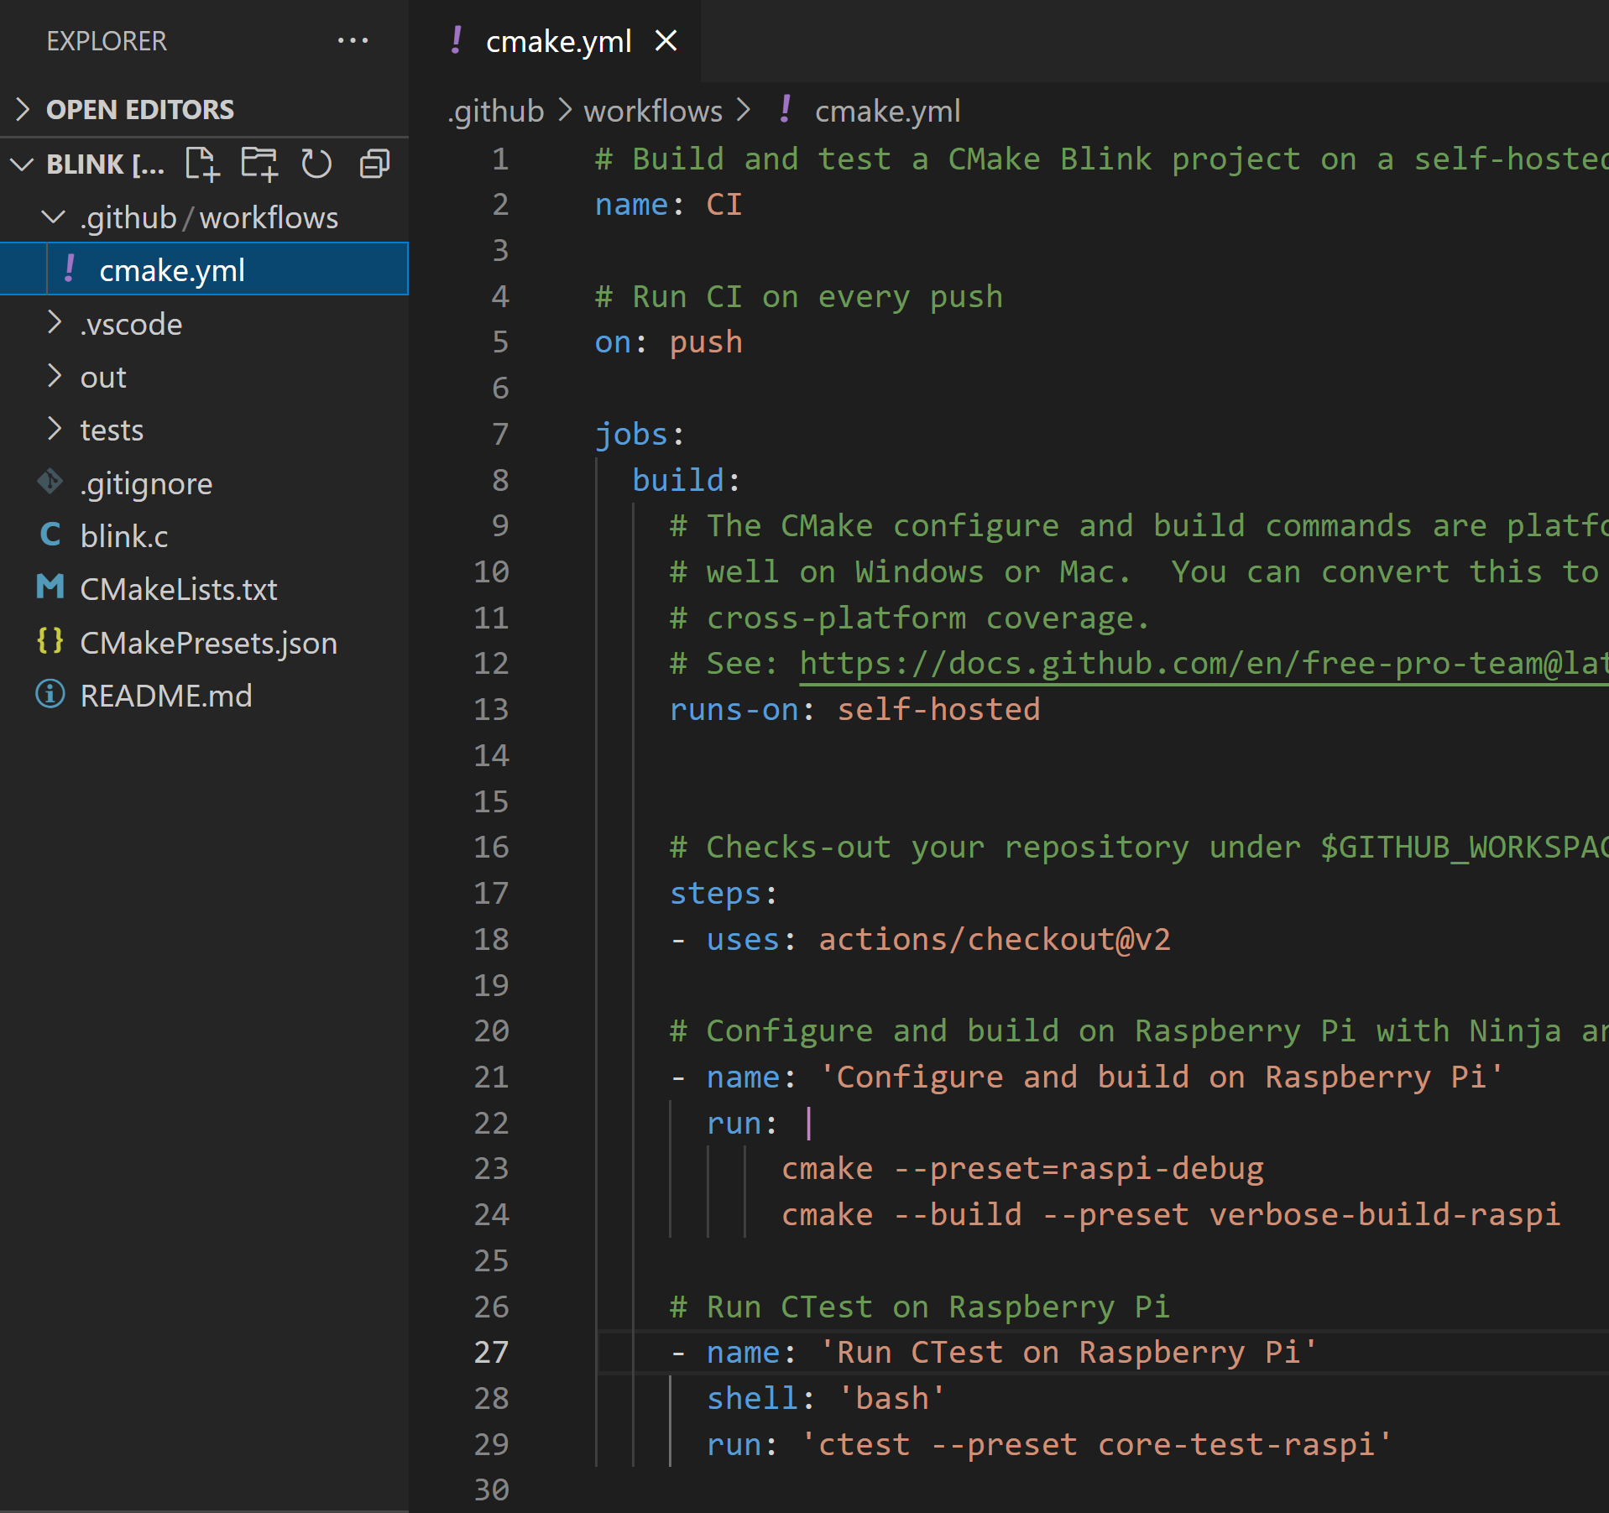
GitHub Actions for Continuous Integration (CI)

Slide 33
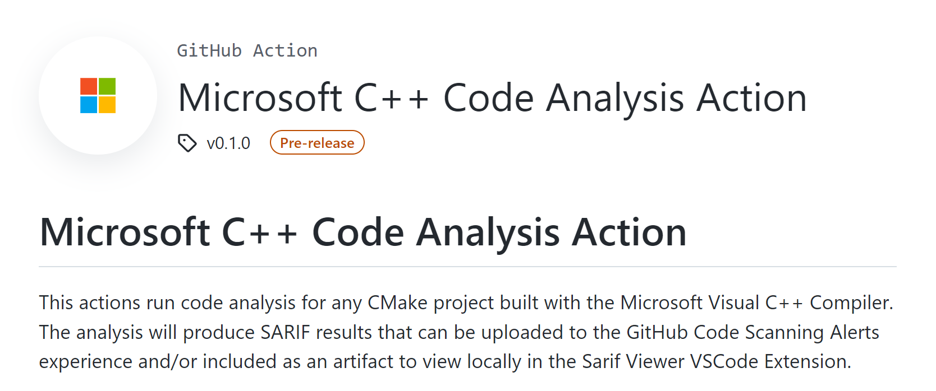
GitHub Actions for Continuous Integration (CI)

Slide 34
Write code
Visual Studio Code
Integrate
Run and debug
GitHub Actions
Test

Slide 35
Recommendation #4: Use GitHub Codespaces to create consistent, fast, and clean development environments accessible from your browser

Slide 36
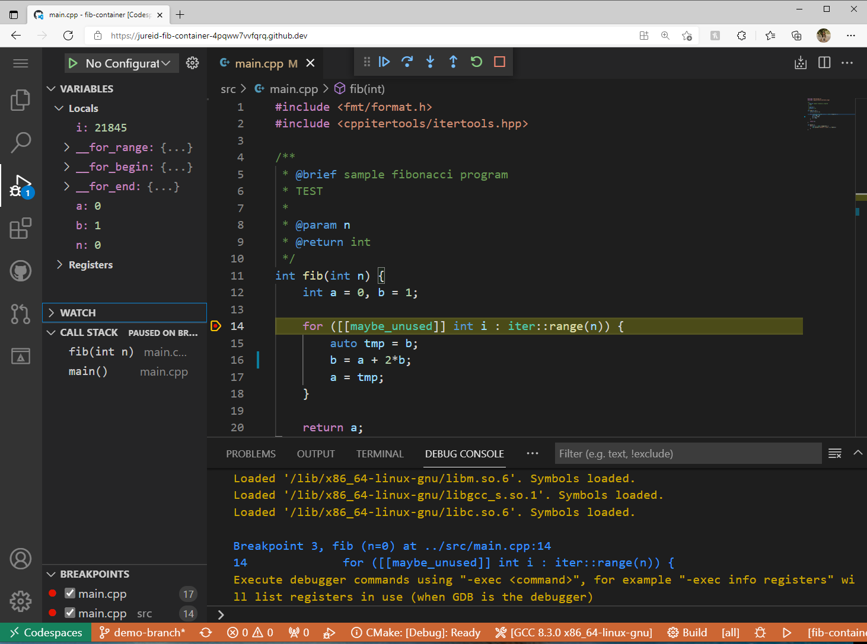
GitHub Codespaces

Slide 37
Write code
GitHub Codespaces
Integrate
Run and debug
GitHub Actions
Test

Slide 38
Demo #3: Use GitHub Actions and GitHub Codespaces to debug, build, and test our Blink program in the cloud

Slide 39
Demo #3 key takeaways
GitHub.dev and GitHub Codespaces enable you to write and commit code directly from your web browser on any device

Slide 40
Demo #3 key takeaways
GitHub.dev and GitHub Codespaces enable you to write and commit code directly from your web browser on any device
No need to install an editor or clone the repo!

Slide 41
Demo #3 key takeaways
GitHub.dev and GitHub Codespaces enable you to write and commit code directly from your web browser on any device
No need to install an editor or clone the repo!
GitHub Actions makes it easy to build and test your code in CI/CD workflows

Slide 42
Demo #3 key takeaways
GitHub.dev and GitHub Codespaces enable you to write and commit code directly from your web browser on any device
No need to install an editor or clone the repo!
GitHub Actions makes it easy to build and test your code in CI/CD workflows
GitHub-hosted runners for automatic machine upgrades and zero maintenance
Self-hosted runners for more control over hardware and OS

Slide 43
Local debugging: the problems solutions
CMake Presets
vcpkg
Visual Studio
VS Code
GitHub Actions
GitHub Codespaces

Slide 44
Level up your debugging workflow
Recommendation #1: Use CMake Presets to easily debug the same project on different platforms and in different editors/IDEs
Recommendation #2: Use Disassembly View to understand how data is represented in memory
Recommendation #3: Automatically catch bugs in your program before shipping to production by setting up a CI/CD pipeline
Recommendation #4: Use GitHub Codespaces to create consistent, fast, and clean development environments accessible from your browser

Slide 45
Helpful resources
Extensions for Visual Studio Code
C++ extension pack (ms-vscode.cpptools-extension-pack)
Remote Development extension pack (ms-vscode-remote.vscode-remote-extensionpack)
GitHub Codespaces extension (GitHub.codespaces)
Documentation
CMake Presets: https://aka.ms/cmake-presets-docs
GitHub Codespaces: https://aka.ms/github-codespaces-docs
GitHub Actions: https://aka.ms/github-actions-docs
News
C++ Team blog: https://aka.ms/cppblog

Slide 46
Q&A
Thank you
Twitter: @jureid22

