Slide 1


Slide 2
The Problem:
The One Definition Rule

Slide 3
The One Definition Rule
The C++ Standard [basic.def.odr] requires:
Every symbol in a program must be defined only once
For symbols granted an exception to the above rule, multiple definitions must be generated from identical token sequences.

Slide 4
The One Definition Rule
The Standard does not require tooling to detect or report One Definition Rule Violations (ODRVs)
Compilers perform few checks to enforce ODR-cleanliness
Linkers generate artifacts assuming inputs are ODR-clean
A single violation causes the entire program’s behavior to be undefined!
Real-world behavior ranges from benign to malignant
No straightforward analysis to determine if a particular ODRV is dangerous.

Slide 5
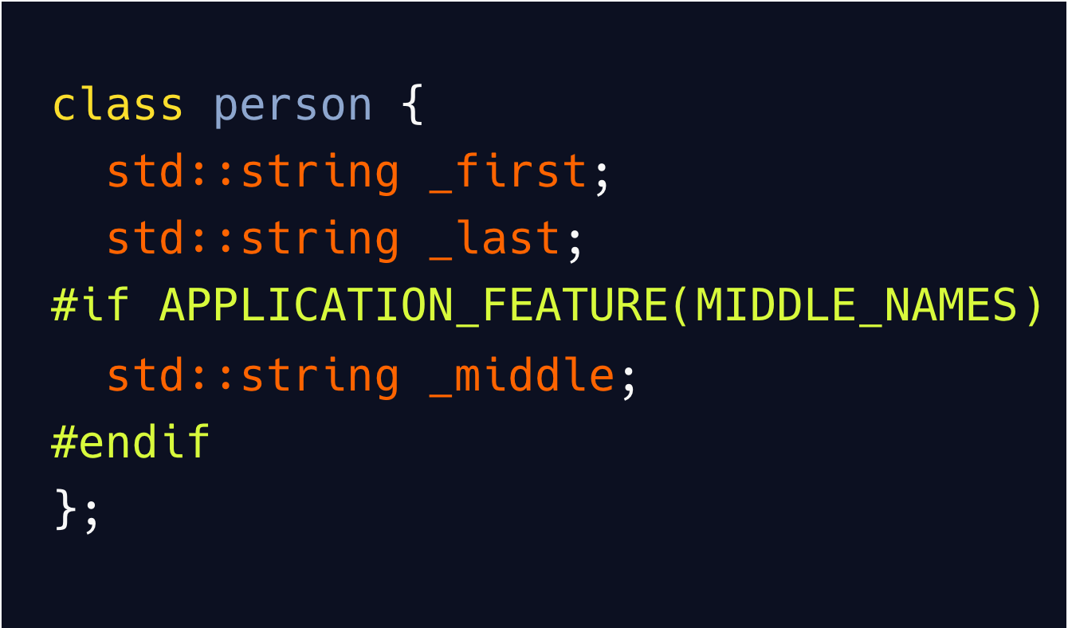
Example: One Definition Rule Violation
What size is this structure?
48 bytes (with the feature disabled)
72 bytes (with the feature enabled)
If MIDDLE_NAMES is not defined consistently everywhere, this is an ODRV
E.g., between one or more components
E.g., between mismatched build variants (e.g., debug/release)
Everywhere person is used (member, parameter, etc.) is another possible ODRV

Slide 6
Real-World ODRV Examples
Multiple, conflicting definitions of the same symbol in more than one compilation unit
MIDDLE_NAMES in person (previous example)
In-house example of two completely unrelated definitions of a particular symbol
Compiling a given header/source file with different compiler settings or #defines
Debug/Release, (no-)RTTI, mismatched preprocessor values, etc.
Overriding operator new/delete in a DLL, but hiding it from the rest of the app
Then passing C++ objects across that DLL boundary
Multiple varying copies of a dependency (e.g., Boost, JPEG, zlib, …)
ODRVs can be embedded anywhere (DLL, static library, or executable)

Slide 7
ODRV Behaviors
ODRVs are subtle, silent, dangerous, and difficult to debug
Obscure, hard-to-reproduce crashes
Often won’t reproduce in sample code!
Erratic debugging behaviors:
Jumping into routine X only to find yourself in routine Y
The debugger showing “corrupted” data structure fields
A general sense the debugger is lying to you
Exceptions failing to get caught
Crashing in the destructor after passing an object across a DLL boundary

Slide 8
The Solution:
ORC

Slide 9
Demonstration

Slide 10
How ORC Works
Scans all object files that contribute to a final library/component/executable
Parses DWARF Information Entries (DIEs) for all object file symbols
For multiply-defined symbols, ORC ensures specific attributes are identical
Byte sizes / member offsets / field counts / vtable offsets / etc.
Mismatches signal ODR violations between the multiple symbol definitions
C++ Implementation
Able to process 200,000,00 DIEs in 50,000 compilation units in ~1 minute
Memory consumption upwards of 50GB
Notes:
Able to process ~3.5GB of components in ~1 minute

Slide 11
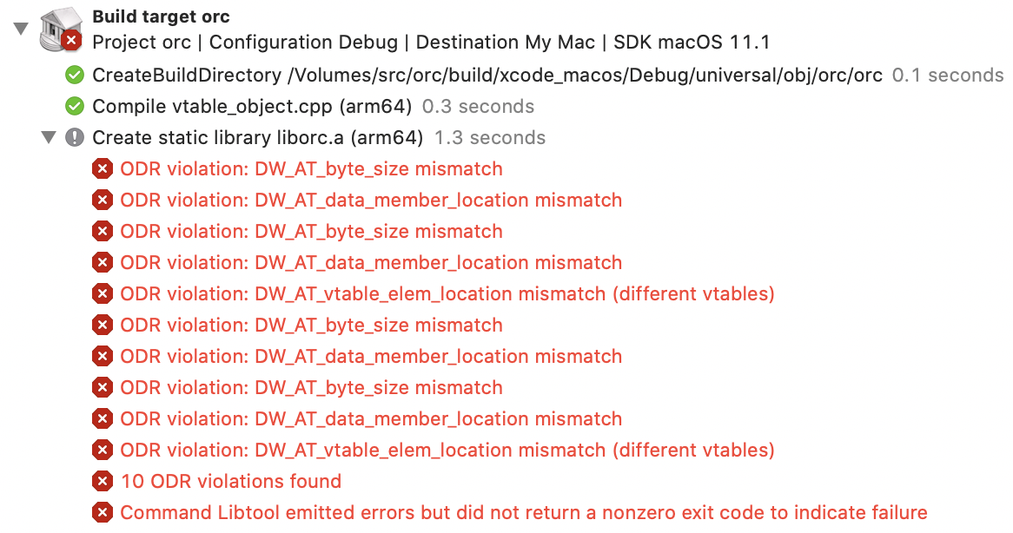
Augmenting the Linker
Intended to run as a drop-in replacement for both libtool and ld
Build/link arguments are forwarded to the proper tool
Derives object file list from command line arguments
Scans all object files used to build/link this component for ODRVs
Also has a standalone mode
Aids in building / testing / debugging ORC itself

Slide 12
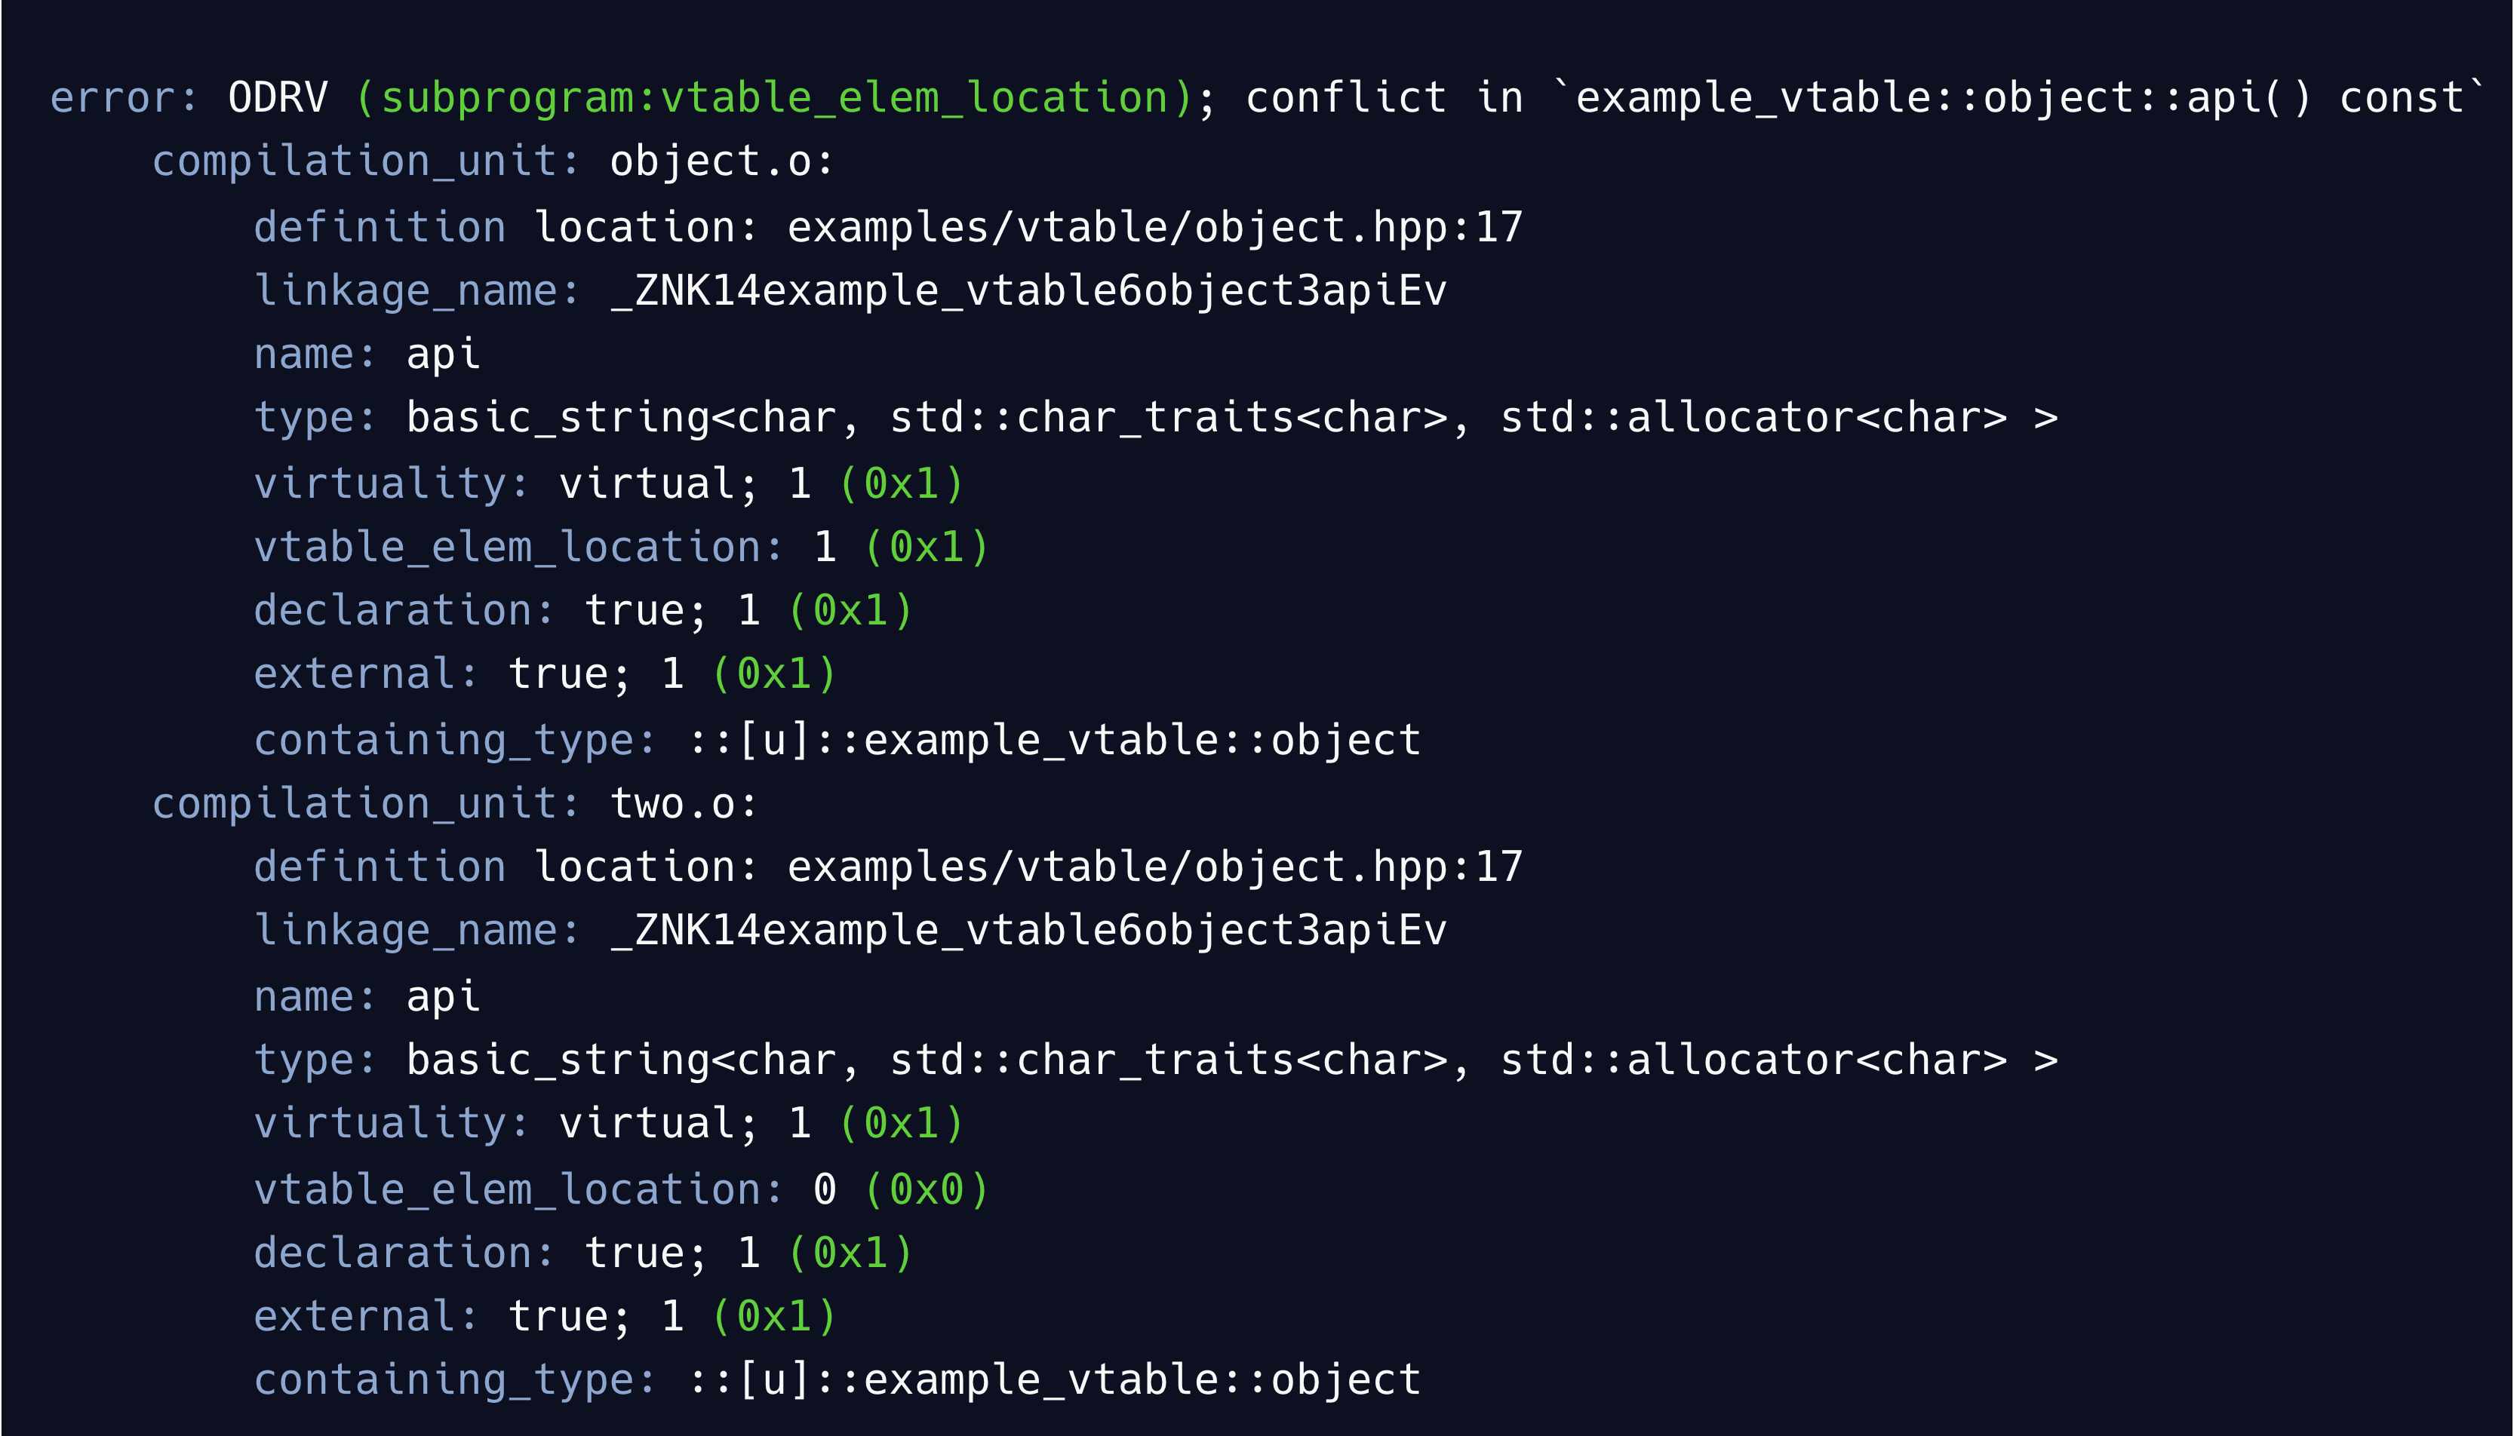
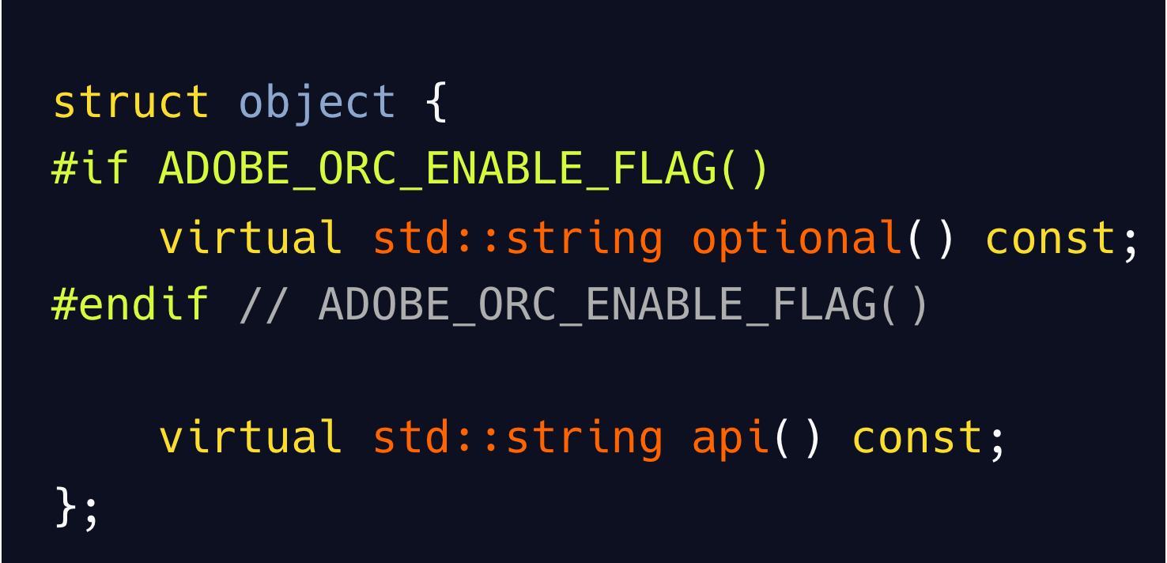
What Does an ODRV Report Look Like?

Slide 13
By The Numbers:
Scanning Photoshop with ORC

Slide 14
Example: Photoshop Unit Test Application
Tests most core features for Photoshop on iOS
Shares 95% of its sources with the Photoshop desktop product
A Full Rebuild
82 components compiled from source
80 “smaller” components built individually
Two larger components: a large library & the final application
~40 minutes on 2017 iMac Pro

Slide 15
Example: Photoshop Unit Test Application
Initial “smaller” components (N = 80)
Two Final Components
 | TUs | DIEs Processed | ODRVs
Median | 23 | 77,418 | 0
Standard Deviation | 188 | 1,398,125 | ~0.6
Max | 886 | 6,969,510 | 5
“Clean” Component
DWARF Data
 | TUs | DIEs Processed | ODRVs
Large Library | 1,725 | 128,733,742 | 0
Final Unit Test Application | 47,928 | 204,940,507 | 521

Slide 16
Next Steps:
Using and Improving ORC

Slide 17
Take the ORC challenge!
ORC is open source
https://github.com/adobe/orc
Easy to build and use
Results can be unsettling

Slide 18
Use ORC for Debugging
If you suspect you have an ODRV
Jumping into routine X only to find yourself in routine Y
The debugger showing “corrupted” data structure fields
A general sense the debugger is lying to you
ORC logs can be searched for types on the stack near crashes.

Slide 19
Improving ORC
github.com/adobe/orc
Reduced memory footprint
Output stability
Support for other toolchains
Richer DWARF data
Improve ODRV Reporting

