Slide 1
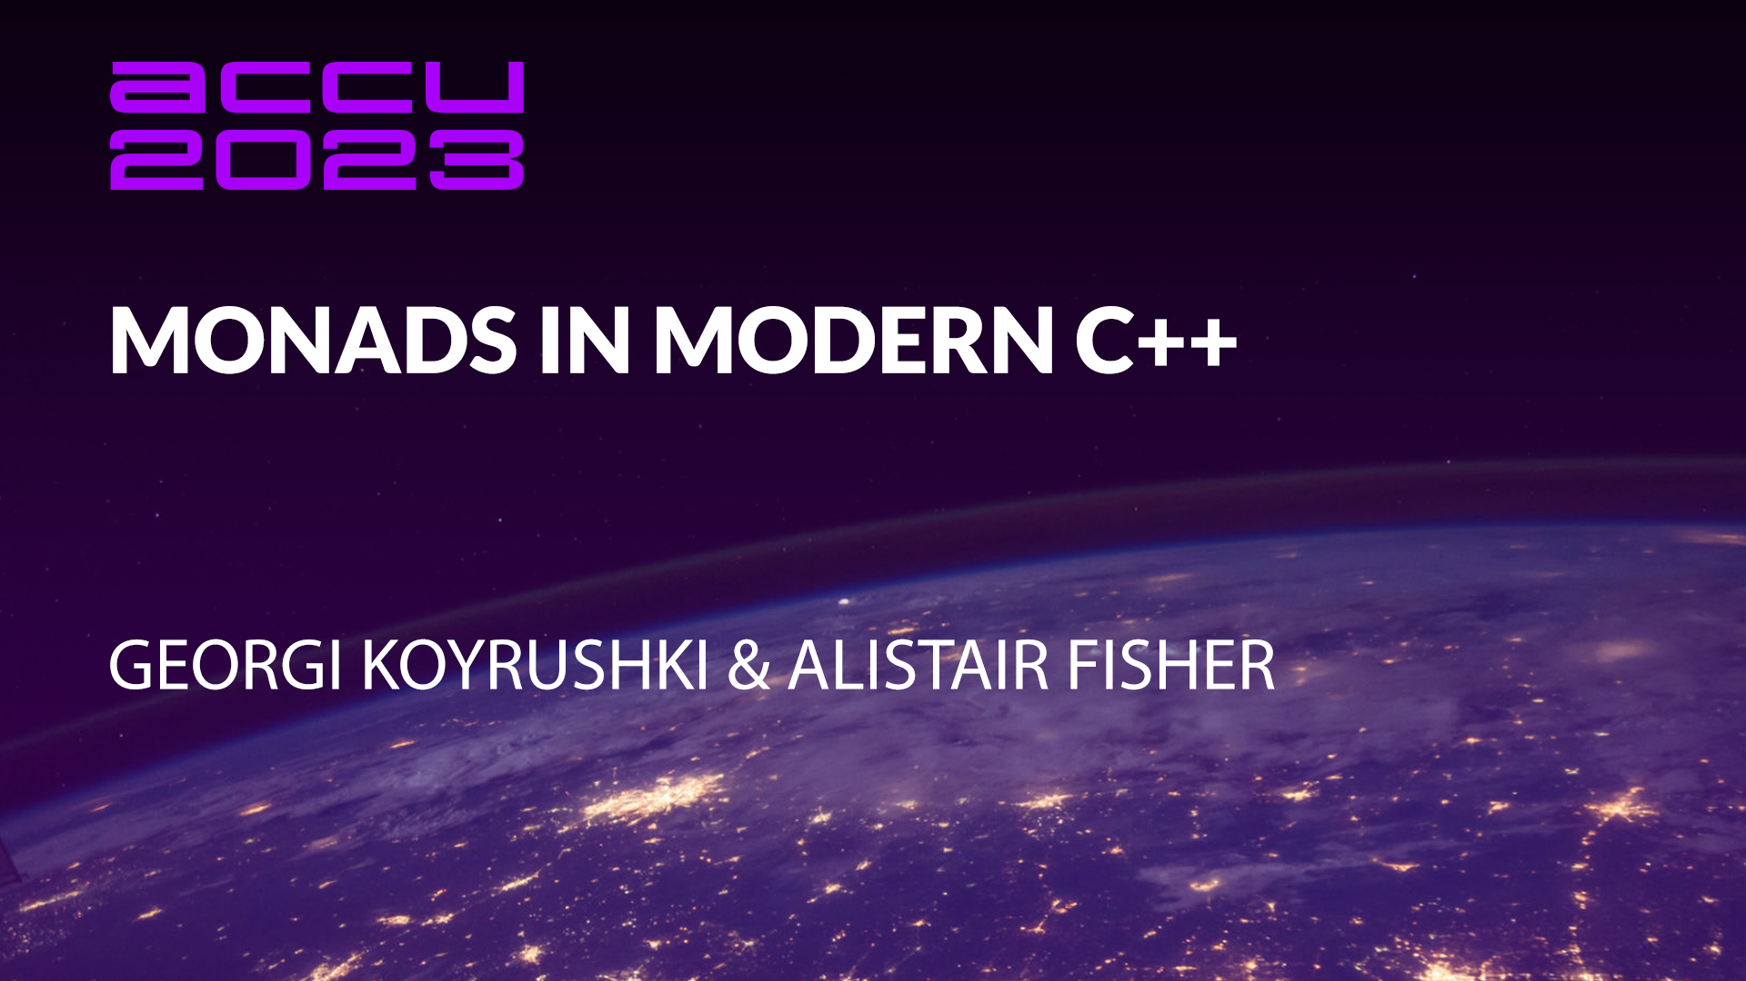

Slide 2
Monads in Modern C++
ACCU 2023
April 20, 2023
Georgi Koyrushki, Senior Software Engineer
Alistair Fisher, Engineering Team Lead

Slide 3


Speaker introductions
Georgi Koyrushki
Senior Software Engineer, Multi-Asset Risk System (MARS)
Alistair Fisher
Engineering Team Lead, MARS

Slide 4
Agenda
Motivation: Why do we care about monads?
Theoretical basis: What are monads?
Beyond theory: Monads in the STL and the wider world

Slide 5
What is a monad?
“A monoid in the category of endofunctors”

Slide 6

The curse of the monad
“In addition to its being good and useful, it’s also cursed and the curse of the monad is that once you get the epiphany, once you understand - "oh that's what it is" - you lose the ability to explain it to anybody else.”
- Douglas Crockford

Slide 7
Monad: a definition
In functional programming, a monad is a structure that combines program fragments (functions) and wraps their return values in a type with additional computation. In addition to defining a wrapping monadic type, monads define two operators: one to wrap a value in the monad type, and another to compose together functions that output values of the monad type (these are known as monadic functions). General-purpose languages use monads to reduce boilerplate code needed for common operations (such as dealing with undefined values or fallible functions, or encapsulating bookkeeping code). Functional languages use monads to turn complicated sequences of functions into succinct pipelines that abstract away control flow, and side-effects.

Slide 8
Monad: a definition
In functional programming, a monad is a structure that combines program fragments (functions) and wraps their return values in a type with additional computation. In addition to defining a wrapping monadic type, monads define two operators: one to wrap a value in the monad type, and another to compose together functions that output values of the monad type (these are known as monadic functions). General-purpose languages use monads to reduce boilerplate code needed for common operations (such as dealing with undefined values or fallible functions, or encapsulating bookkeeping code). Functional languages use monads to turn complicated sequences of functions into succinct pipelines that abstract away control flow, and side-effects.

Slide 9
Some theory
Notes:
In this section we’ll be talking about the concepts.
However, rest assured - it’s not going ot be dry theory - the stuff we’re saying, we’ll try to back up with supporting examples in code.
Show how those concepts that stem from maths actually (a field called category theory) map into nice programming patterns.
Before we move into any of that…

Slide 10
What makes us qualified for this talk?
What makes C++ qualified for this talk?
C++ is very well known to be
  Procedural
  Imperative
  OO
  Generic
  … AND…
  Functional (as of C++11)
Functions in modern C++
are first-class citizens
(ish)
https://www.modernescpp.com/index.php/first-class-functions
Notes:
I’ve seen a lot of presenters do that – discuss what makes them qualified to give the particular talk…
I think it’s a really nice way to start off a presentation, but… I’m not gonna do that today… Instead, I wanna ask a slightly different question -
What makes C++ qualified for this talk? Let’s put C++ on the spot…
What makes C++ good enough to be able to incorporate those patterns from functional programming.
When we say C++, what do we really think of… We know that it can support a few paradigms:
- We can do procedural programming; similarly imperative
- OO
- Generic, which is to do with template metaprogramming & building generic libraries.
- And… I’m gonna make a bold claim here.. As of C++11 we can also support functional paradigm… Which is really what’s relevant here…
I guess what does functional paradigm mean… One of the definitions is functions are first-class citizens in that language… And I think
you can say that - functions in modern C++ are first class citizens (ish). Probably not in the strictest form and also from the purists perspective, lambdas don’t
just produce results, but can also contain side effects, etc., BUT I don’t think this is necessarily a yes or no type of thing - you’re either
fully functional or not at all - I think C++ fits somewhere in the middle…
To back up those claims…

Slide 11
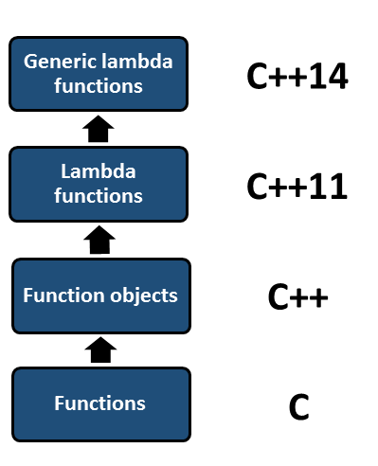
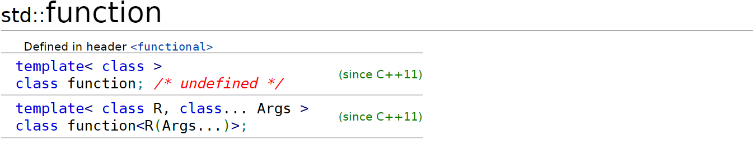

What makes us qualified for this talk?
What makes C++ qualified for this talk?
C++ is very well known to be
  Procedural
  Imperative
  OO
  Generic
  … AND…
  Functional (as of C++11)
Functions in modern C++
are first-class citizens
Overloading () operator on classes
(ish)
https://www.modernescpp.com/index.php/first-class-functions
Notes:
We can briefly view how functions have evolved during the years…
- Starting off with the plain C functions, which were nothing more
- C++ came & we were able to overload () operator on classes -> function objects
- Modern C++ took that much further – we were given lambdas & some nice utilities like std::function
- Further iterations of the standards improved on that – capture initializations/generic lambdas and so on..
Overall, functions nowardays play a big role in C++ & believe it is because of this, we can discuss those
functional programming techniques in C++

Slide 12
What is a Monad actually?
Let’s Start with Functors
Notes:
Now onto what all of us are here for… What is a monad?
I guess we’ll get there eventually, but we need to start with something simpler – a thing called Functors…
Monads & Functors are related concepts, often used interchangeably → even in official documentations, etc. But functors
are definitely simpler to grasp & it does pay to understand them first before explaining monads…

Slide 13
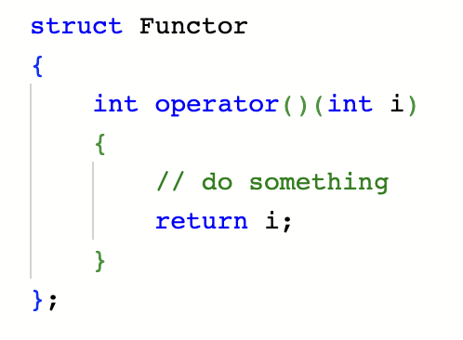
What’s a functor?
Notes:
So what is a functor…
I guess the first thing coming to mind to a C++ developer is something like this
- a class with its () operator overloaded
- allowing instances of that class to act as functions or callables
Well… This is not what we mean by functors in functional programming… What is it then…

Slide 14
Let’s be (semi-) formal
Any type F that provides the following two operations:
given a type A, the ability to instantiate an instance of F<A> from an instance of A. In C++ terms: a constructor.
The following operation, commonly called map, fmap or transform. Given an instance of F<A> and a function from A to B produce an instance of F<B>.
A concept from category value theory
Functor<A>
// aka map, fmap, etc.
transform :: (A -> B) -> Functor<B>
Notes:
Here on the lower part of the slide we have a semi-formal definition of functor…
A construct/type, parametrised with:
A type A
And also defines an operation - transform (known by different names outside of c++ - fmap in Haskell/map in scala…)
Taking as input a mapping (A -> B) & returning a Functor<B>.
Note that transform is a function taking another function as arugment…
In other words, functor is able to transform itself into another functor of a different type.
I guess there’s more to this… There are certain laws functors need to comply with, I’ve created an appendix at the end of the presentation, but here we can omit those & stick to the relevant bits…
Could we convert into something we’re a bit more familiar with?

Slide 15
C++ - IFIED
template<typename A>
struct Functor
{
template <typename B>
Functor<B> transform(std::function<B(A)>);
};
transform can also be defined externally
template <typename A, typename B>
Functor<B> transform(Functor<A>, std::function<B(A)>);
Notes:
This here is our Functor C++-ified…
Functor is a struct, taking a type parameter A…
B is a type parameter of transform, returning Functor<B>...
The mapping we can simply represent with a std::function<B(A)>...
A piece of note, transform doesn’t necessarily need to be a member method… We can also define it
externally like so… What does functor mean then – it is a type, for which defining
transform makes sense…
What makes sense means, we gonna see in the following example…

Slide 16
Example: Our First Functor - std::vector
01: // somewhere in namespace std...
02:
03: template <typename A>
04: struct vector
05: {
06: // ...
07: template <typename B>
08: vector<B> transform(function<B(A)> f)
09: {
10:
11:
12:
13:
14:
15:
16: }
17: // ...
18: };
Notes:
We basically want to make std::vector a functor…
Note: focusing on concepts, rather than what’s happening in the real life & optimality… On one hand,
vector doesn’t have a transform member method (this is just imaginary). On the other, we’re passing
things by value here, this is intentional, we don’t want to overload the slide with optimizations at this point.
This should come a bit later…
Let’s try to implement transform for vector… So the first thing to start with…

Slide 17
Example: Our First Functor - std::vector
01: // somewhere in namespace std...
02:
03: template <typename A>
04: struct vector
05: {
06: // ...
07: template <typename B>
08: vector<B> transform(function<B(A)> f)
09: {
10: vector<B> out;
11:
12:
13:
14:
15: return out;
16: }
17: // ...
18: };
Notes:
Is to define our output… And this is a vector of type B…
Now what goes into the rest of the implementation…
We said functor needs to abstract away some common control flow…
What is that when it comes to vector & ranges in general?
Well, this is traversing the vector or range…

Slide 18
Example: Our First Functor - std::vector
01: // somewhere in namespace std...
02:
03: template <typename A>
04: struct vector
05: {
06: // ...
07: template <typename B>
08: vector<B> transform(function<B(A)> f)
09: {
10: vector<B> out;
11: for (auto elA : *this)
12: {
13: out.emplace_back(f(elA));
14: }
15: return out;
16: }
17: // ...
18: };
Notes:
What we’re doing here, going through each element of this, converting it via our f function
and creating our new vector<B> off those transformations…
The common control flow with vectors is for loops, here we just pulling that up into transform…
Now how is that useful?
We gonna take a look at an example…

Slide 19
Using our vector functor
We have a vector of strings, representing numbers
{“1”, “2”, “3”,....}
We want to double the numbers and return them, again as strings
{“2”, “4”, “6”,....}
We have the following operations already:
int convertStringToInt(std::string);
int doubleInt(int);
std::string convertIntToString(int);
Notes:
Which would hopefully showcase what we’re gaining via functors…
A simple goal – asume we have a vector of strings, representing numbers… What we wanna do is
double the numbers and return them again as strings…
As good engineers, we have broken the solution down into 3 modular steps & we’ve defined the following operations
- one to convert string to int
- another one to double an integer
- last one to convert an int back to string.
Now let’s see how this is gonna look without functors…

Slide 20
Without functor
01: std::vector<std::string> doubleNumbers(std::vector<std::string> input)
02: {
03: std::vector<std::string> output;
04: for(auto str: input)
05: {
06: int asInt = convertStringToInt(str);
07: int doubled = doubleInt(asInt);
08: output.push_back(convertIntToString(doubled));
09: }
10: return output;
11: }
Notes:
The typical imperative way of doing this would be to create an output vector…
Go through each element of the input, apply each operation & then populate
the output vector… Finishing by returning the output…
Note there’s nothing wrong with this code, nothing particularly complicated, it’s pretty much what
we get hired to do… However, I would also argue there’s nothing particularly exciting about this snippet & at
the end of writing it I didn’t feel fulfilled in any way…
Let’s look at how it is with our new functor:

Slide 21
vs. with functor
01: std::vector<std::string> doubleNumbers(std::vector<std::string> input)
02: {
03: std::vector<std::string> output;
04: for(auto str: input)
05: {
06: int asInt = convertStringToInt(str);
07: int doubled = doubleInt(asInt);
08: output.push_back(convertIntToString(doubled));
09: }
10: return output;
11: }
1: std::vector<std::string> doubleNumbers(std::vector<std::string> input)
2: {
3: return input
4: .transform(convertStringToInt)
5: .transform(doubleInt)
6: .transform(convertIntToString);
7: }
Notes:
Basically we have our input, we do 3 transforms. Note here each returns a new vector and that is
the input to the other one…
Nice composition, reminiscent of the builder pattern, but we always end up with new objects…
I guess a small thing to point is this isn’t going to compile in its current form….

Slide 22
vs. with functor
01: std::vector<std::string> doubleNumbers(std::vector<std::string> input)
02: {
03: std::vector<std::string> output;
04: for(auto str: input)
05: {
06: int asInt = convertStringToInt(str);
07: int doubled = doubleInt(asInt);
08: output.push_back(convertIntToString(doubled));
09: }
10: return output;
11: }
1: std::vector<std::string> doubleNumbers(std::vector<std::string> input)
2: {
3: return input
4: .transform(std::function{convertStringToInt})
5: .transform(std::function{doubleInt})
6: .transform(std::function{convertIntToString});
7: }
Notes:
We’d need
to explicitly convert our functions to std::function… Don’t ask why…

Slide 23
vs. with functor
01: std::vector<std::string> doubleNumbers(std::vector<std::string> input)
02: {
03: std::vector<std::string> output;
04: for(auto str: input)
05: {
06: int asInt = convertStringToInt(str);
07: int doubled = doubleInt(asInt);
08: output.push_back(convertIntToString(doubled));
09: }
10: return output;
11: }
1: std::vector<std::string> doubleNumbers(std::vector<std::string> input)
2: {
3: return input
4: .transform(convertStringToInt)
5: .transform(doubleInt)
6: .transform(convertIntToString);
7: }
Notes:
But we can quite easily get to this thing over here
if instead of std::function we use a type parameter. Gonna make the code slightly more complicated…
Another point is… Compared to the imperative solution, we have 3 for loops… And again, there’s a way to fix this with
lazy evaluation, but performance isn’t what we’re after here…
I guess what I want to focus on here is how beautiful the solution with transform is…
It’s much nicer, more concise, declarative, don’t have to write any for loops. Seems like an improvement
to me from an API standpoint… Probably the only one disagreeing with me would be your formatter

Slide 24
vs. with functor
01: std::vector<std::string> doubleNumbers(std::vector<std::string> input)
02: {
03: std::vector<std::string> output;
04: for(auto str: input)
05: {
06: int asInt = convertStringToInt(str);
07: int doubled = doubleInt(asInt);
08: output.push_back(convertIntToString(doubled));
09: }
10: return output;
11: }
1: std::vector<std::string> doubleNumbers(std::vector<std::string> input)
2: {
3: return input
4: .transform(convertStringToInt)
5: .transform(doubleInt)
6: .transform(convertIntToString);
7: }
1: std::vector<std::string> doubleNumbers(std::vector<std::string> input)
2: {
3: return input.transform(convertStringToInt).transform(
4: doubleInt).transform(convertIntToString);
5: }
clang-format :(
Notes:
clang-format always kills my joy of manually formatting my code…
I wanna ask this question now – is this the first time we’re seeing something like this?

Slide 25
Have we seen something like this elsewhere?
1: std::vector<std::string> doubleNumbers(std::vector<std::string> input)
2: {
3: return input
4: | ranges::views::transform(convertStringToInt)
5: | ranges::views::transform(doubleInt)
6: | ranges::views::transform(convertIntToString)
7: | ranges::to<std::vector>;
8: }
Notes:
This does look familiar, doesn’t it…
Obviously ranges, big player in the game… Part of the standard now, too…
Much superior implementation – with lazy evaluation, solving all
the issues we mentioned before…
But basically next time you use ranges transform, don’t forget the underlying pattern peaking
through it…
The next question I have is…

Slide 26
Why just std::vector?
1: std::optional<std::string> doubleNumbers(std::optional<std::string> input) {
2: if (!input)
3: return std::nullopt;
4:
5: auto asInt = convertStringToInt(*input);
6: auto doubled = doubleInt(asInt);
7: auto toString = convertIntToString(doubled);
8: return std::make_optional(toString);
9: }
1: std::optional<std::string> doubleNumbers(std::optional<std::string> input) {
2: // similar to Haskell’s Maybe::fmap
3: return input
4: .transform(convertStringToInt)
5: .transform(doubleInt)
6: .transform(convertIntToString);
7: }
Notes:
We can mb agree that treating vector as a functor is useful… Now my question is…
Can we go beyond std::vector…
Is something like this unusual – we still want to double a number, but this time our number string is wrapped within an optional (not a vector)...
Optional - quite an important type in the standard…
This is how we’d typically do it – we first need to verify our input contains a value. If not, return
an empty optional. Otherwise, extract the value in the optional, carry out our 3 steps… And
return a new optional with the result…
Now I’m going to show how this looks with a functor…
We do our 3 transforms… Looks suspiciously similar to the vector example… But this is what patterns are all about, right?
Note we don’t have a single if/else statement here
why? I guess all this control flow is encapsulated within our transform…
Let’s take a look at how it’s implemented…

Slide 27
std::optional functor
01: // somewhere in namespace std...
02:
03: template <typename A>
04: struct optional
05: {
06: // ...
07: template <typename B>
08: optional<B> transform(function<B(A)> f)
09: {
10:
11:
12:
13:
14:
15:
16: }
17: };
Notes:
This time, this is a bit closer to reality – there is a transform & a bunch of other monadic operations coming for std::optional in C++23… We just have to wait on it…
But a simple implementation is like so…

Slide 28
std::optional functor
01: // somewhere in namespace std...
02:
03: template <typename A>
04: struct optional
05: {
06: // ...
07: template <typename B>
08: optional<B> transform(function<B(A)> f)
09: {
10: optional<B> out;
11:
12:
13:
14:
15: return out;
16: }
17: };
Notes:
We have our output optional of the new type B…
What about our f function?

Slide 29
std::optional functor
01: // somewhere in namespace std...
02:
03: template <typename A>
04: struct optional
05: {
06: // ...
07: template <typename B>
08: optional<B> transform(function<B(A)> f)
09: {
10: optional<B> out;
11: if (this->has_value())
12: {
13: out = f(this->value())
14: }
15: return out;
16: }
17: };
Notes:
Well we only want to call it, conditionally on this containing a value…
Otherwise, there’s nothing to call f on and we just return an empty optional…
This is where this conditional check gets hidden.
*next slide* So what happens here…

Slide 30
Why just std::vector?
1: std::optional<std::string> doubleNumbers(std::optional<std::string> input) {
2: if (!input)
3: return std::nullopt;
4:
5: auto asInt = convertStringToInt(*input);
6: auto doubled = doubleInt(asInt);
7: auto toString = convertIntToString(doubled);
8: return std::make_optional(toString);
9: }
1: std::optional<std::string> doubleNumbers(std::optional<std::string> input) {
2: // similar to Haskell’s Maybe::fmap
3: return input
4: .transform(convertStringToInt)
5: .transform(doubleInt)
6: .transform(convertIntToString);
7: }
Notes:
Just to re-iterate…

Slide 31
Why just std::vector?
1: std::optional<std::string> doubleNumbers(std::optional<std::string> input) {
2: if (!input)
3: return std::nullopt;
4:
5: auto asInt = convertStringToInt(*input);
6: auto doubled = doubleInt(asInt);
7: auto toString = convertIntToString(doubled);
8: return std::make_optional(toString);
9: }
1: std::optional<std::string> doubleNumbers(std::optional<std::string> input) {
2: // similar to Haskell’s Maybe::fmap
3: return input
4: .transform(convertStringToInt) // if this.has_value() => convertStringToInt(*this)
5: .transform(doubleInt) // if this.has_value() => doubleInt(*this) ...
6: .transform(convertIntToString);
7: }
Notes:
Each transform calls the passed function, only conditionally, upon this having a value present…
Personally, I think the argument for functors in optional is even stronger here…
Due to this non-linear control flow of having to check the presence of value… Not
to mention forgetting to check if an optional contains value is quite dangerous…
Obviously the functor code looks much tighter…

Slide 32
Why bother?
Notes:
Now you might ask yourself the question… Why should I care about this… I’m pretty sure I’m never going to forget
the null checks in my code & everybody in my team is the same…
Well, here’s a small proof that you’re probably wrong…
Those are all PRs from one of our repos to fix issues with unguarded access to optionals, leading to dizasters on PROD…
This is a severely misrepresented sample of those cases… I just got very tired of taking screenshots and removing sensitive info…
The big thing here is if something is repetitive & boring => I am definitely gonna forget about it… If it’s dangerous to forget about it,
then we have an issue, don’t we…
So definitely functors are useful… But… They’re only half of the story & I’m handing it off to Alistair now to talk something a bit more interesting…

Slide 33
Monads

Slide 34
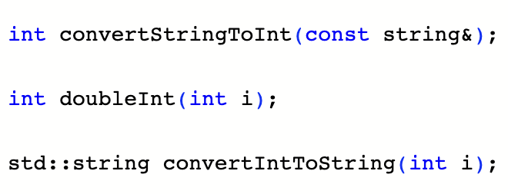
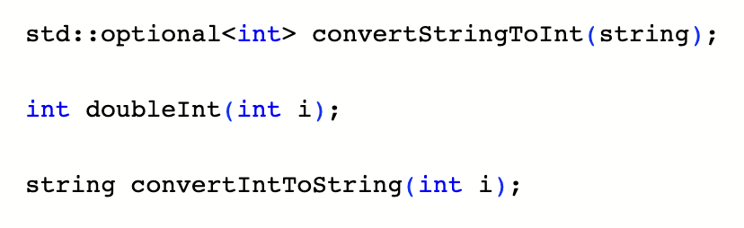
Where the functor starts to break down

Slide 35
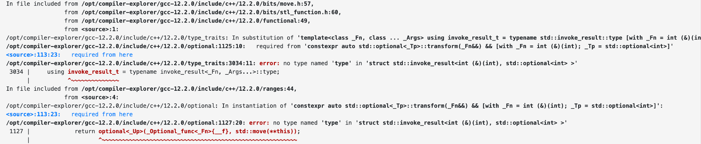
Oh

Slide 36
What happened?
01: optional<string> doubleNumberFunctor(const optional<string>& opt)
02: {
03: return opt.transform(convertStringToInt) // optional<optional<int>>
04: .transform(doubleInt) // compile error - can’t apply
05: // doubleInt to optional<int>
06: .transform(convertIntToString);
07:}

Slide 37
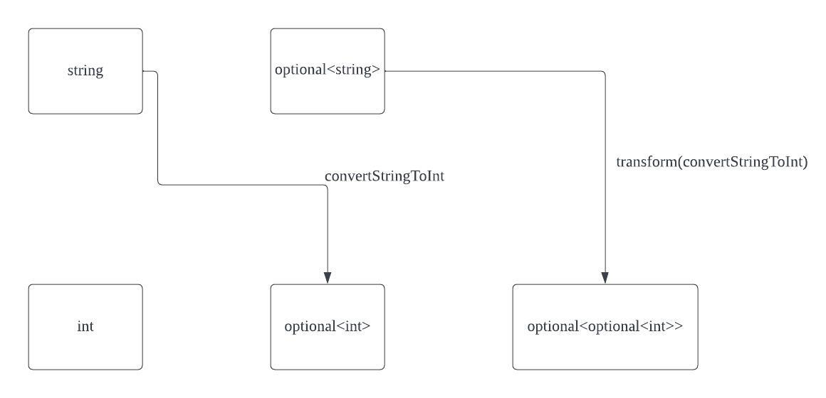

Slide 38
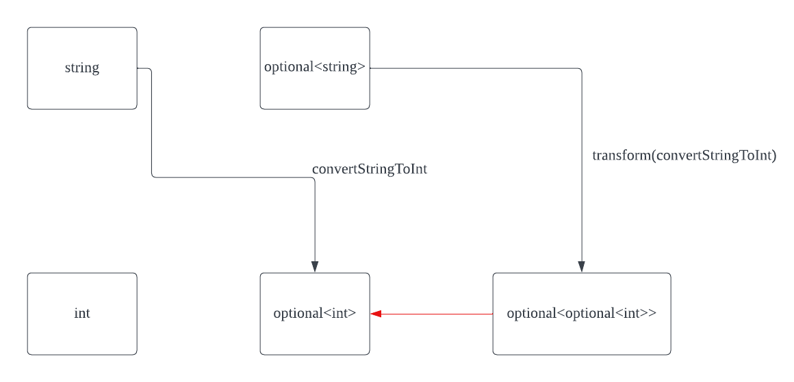

Slide 39
Join
01: template<typename T>
02: optional<T> join(const optional<optional<T>>& opt)
03: {
04: if(opt.has_value())
05: {
06: return opt.value();
07: }
08: return {};
09:}

Slide 40
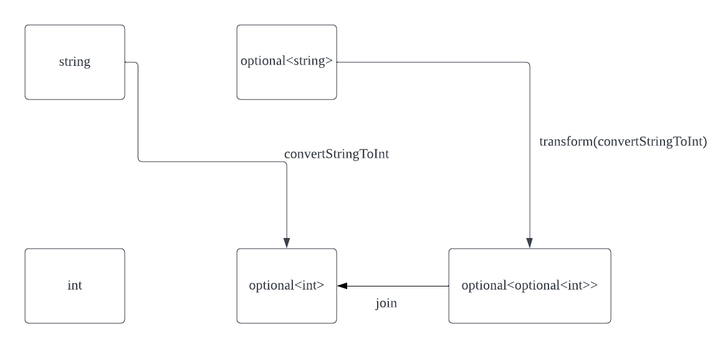

Slide 41
Fixing the example
01: optional<string> doubleNumberFunctor(const optional<string>& opt)
02: {
03: auto nestOpt = transform(convertStringToInt) // optional<optional<int>>
04:
05: return join(nestOpt) // optional<int>
06: .transform(doubleInt) // optional<int>
07: . .transform(convertIntToString); // optional<string>
08:}

Slide 42
Let’s introduce a new member function
01: template<typename A>
02: class optional {
03: // other functions...
04:
05: template <typename B>
06: optional<B> and_then(function<optional<B>(A)> f)
07: {
08: auto optionalOptional = this -> transform(f); // have optional<optional<B>>
09: return join(optionalOptional);
10:}
11:}

Slide 43
A nice pipeline again
01: optional<string> doubleNumberMonad(const optional<string>& opt)
02: {
03: return opt.and_then(convertStringToInt) // optional<int>
04: .transform(doubleInt) // optional<int>
05: . .transform(convertIntToString); // optional<string>
06:}

Slide 44
Introducing the monad
All the requirements of functor, plus one more operation
The operation is typically called monadic bind or mbind. In C++: and_then
Can be thought of as a transform, followed by a join
template<typename A, typename B>
Monad<B> and_then(Monad<A>, function<Monad<B>(A)>);

Slide 45
Another example: Vector
Functor/transform: 1 to 1. Input vector size == output vector size
Monad: 1 to any number. Output vector size can be anything

Slide 46
A new example - A C++ compiler
We have a function from filename to compile errors
vector<string> compileFile(const string& filename);
How can we turn a vector of files into a vector of compile errors?

Slide 47
Start with transform…
01: vector<string> compileFiles(const vector<string>& filenames);
02: {
03: return filenames
04: | ranges::transform(compileFile) // have vector<vector<string>...
05: // this feels familiar...
06:
07: };

Slide 48
Add a join…
01: vector<string> compileFiles(const vector<string>& filenames);
02: {
03: return filenames
04: | ranges::transform(compileFile)
05: | ranges::join
06: | ranges::to<vector>
07: };

Slide 49
Other use cases for vector monad
Filtering - represent your predicate as element -> vector (empty is false, non empty is true)
Simulations
Cartesian products

Slide 50
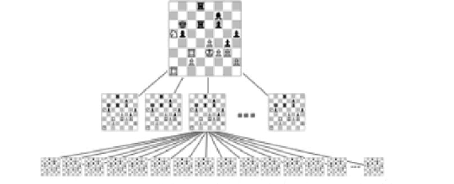
Simulation
World with a state and a function to create new states
e.g. chess

Slide 51
Quick code example
01: struct ChessState
02: {
03: enum class Player{Black, White};
04: enum class GameState{WhiteWin, BlackWin, Stalemate, Ongoing};
05:
06: BoardState boardState; // some representation of the board state
07: GameState gameState;
08: Player currentPlayer;
09:
10: ChessState(){...} // set up correct starting position
11: };
vector<ChessState> evolveBoard(const ChessState& state);

Slide 52
A quick chess simulator
01: vector<ChessState> evolveBoards(const vector<ChessState>& states);
02: {
03: return states
04: | ranges::transform(evolveBoard)
05: | ranges::join
06: | ranges::to<vector>
07: };
01: // Generate 50 turns
02:
03: vector<ChessState> states{initialBoardState};
04:
05: for(int i = 0; i < 50; ++i)
06: states = evolveBoards(states);

Slide 53
Cartesian products
Have two vectors, want to get the list of all pairs
e.g., {1,2} and {4,5} should produce {1,4}, {1,5}, {2,4}, {2,5}

Slide 54
Cartesian product with a monad
01: vector<pair<int, int>> cartesianProduct(const vector<int>& lhs, const vector<int>& rhs)
02: {
03: auto computePairs = [&rhs](int i) -> vector<pair<int, int>>
04: {
05: auto makePair = [i](int element) -> pair<int, int>
06: {return pair{i, element};};
07:
08: return rhs | ranges::views::transform(makePair) | ranges::to<vector>; // functor!
09: }
10:
11: // input: {1,2}, {3,4}
12:
13: return lhs
14: | ranges::views::transform(computePairs) // have {{{1,3}, {1,4}}, {{2,3}, {2,4}}}
15: | ranges::views::join // have {{1,3}, {1,4}, {2,3}, {2,4}}
16: | ranges::to<vector>

Slide 55
Common monad types
Maybe monad (optional monad)
List monad (vector monad)
IO Monad
Reader Monad
Writer Monad
State Monad

Slide 56
Beyond Theory
Notes:
Up till now the talk was theoretical…
In this next & final section, we are going to go through what’s available to us as C++ developers & look at a small case study
of building our own monadic library…

Slide 57
What’s available?
Notes:
Let’s start with going over what’s out there… Some of those things we already touched upon…

Slide 58
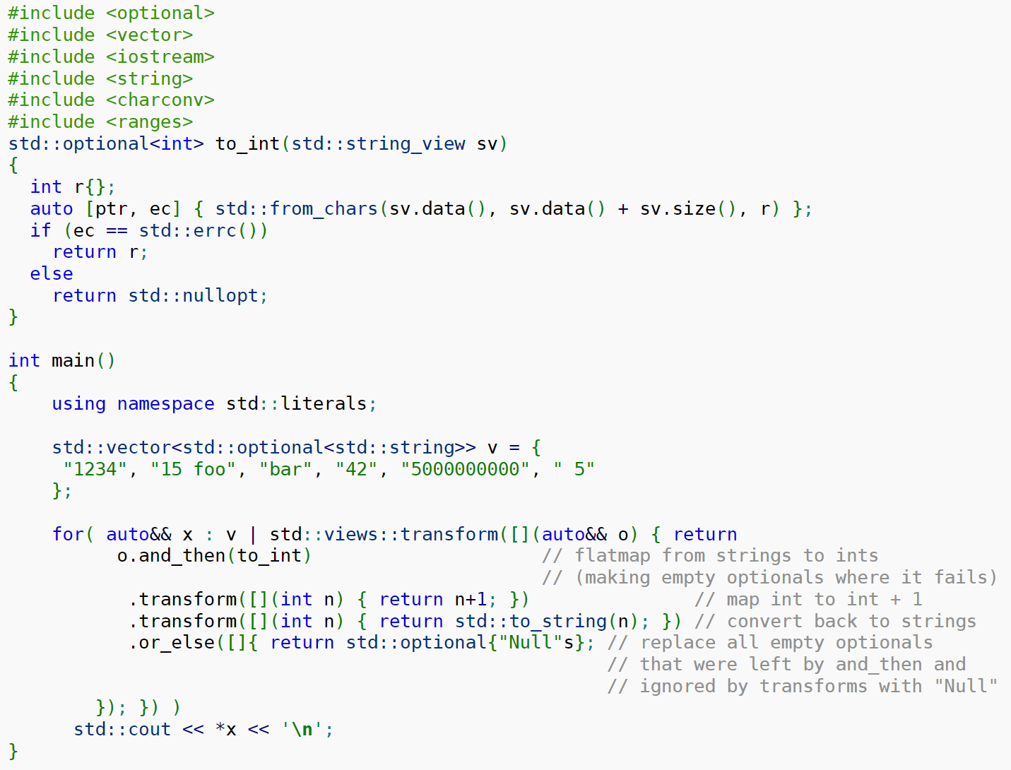
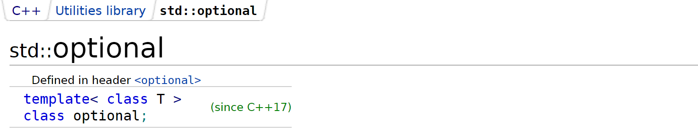
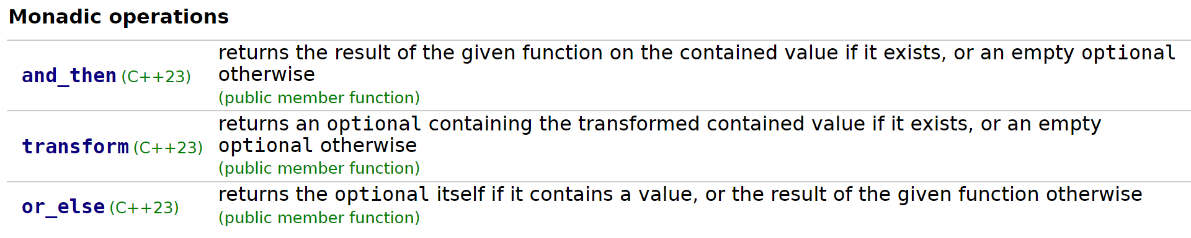
std::optional
Notes:
Starting with one of those – std::optional – a very important type in the stl… Semantics are quite simple - there’s either a value or no value…
Introduced in C++17. Unfortunately, though, we only get the monadic operations in C++23 – quite the lag between introducing the type * acknowledging
the usefulness of viewing optional as a monad…
For those we have - transform/and_then, already looked at. And also or_else, taking a lambda which gets called if the input optional is null…
This is how it looks - from C++ reference.. We can kinda notice the nice composition of those operation & this or_else in the end is like a catch_all,
ensures that we don’t need to check the end optional, so it’s always safe to dereference down there…
Overall std::optional is great & it’s becoming greater…

Slide 59
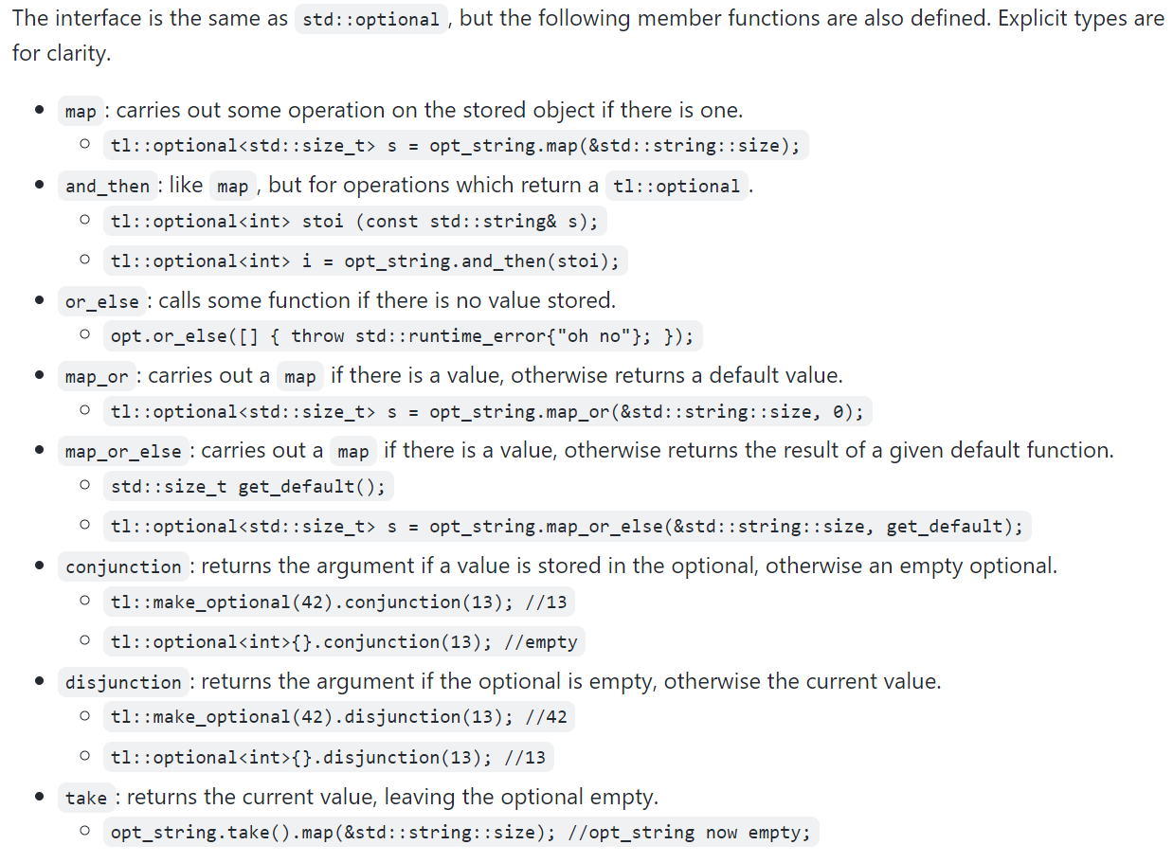
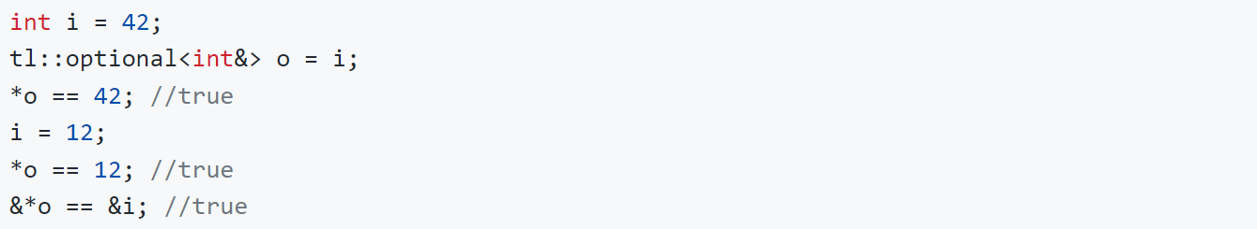
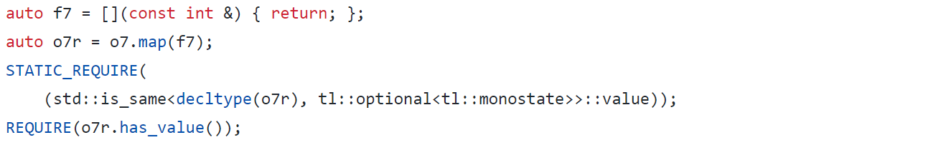
tl::optional
Notes:
An OS version of it is tl optional… Sy Brand built this library & it is the basis of monadic operations in std::optional.
An interesting thig is it allows us to store references within, which we cannot do with std::optional. ***Quite convenient,
as opposed to needing to create reference wrappers…***
Also, it allows us to return void from our lambdas. Useful because in some cases, we just wanna unwrap the optional we’re dealing with…
I’ve seen a lot of cases when reviewing PRs, where I wanna just do some logging, if the optional is set, for example… Not necessarily do
anything else with its value…
In addition to that, the API is quite rich… We have all the monadic operations from the standard, as well as some convenience ones,
like map_or, which would translate to transform_or. This is basically combining transform and or_else, without the need to pass a
separate lambda…

Slide 60
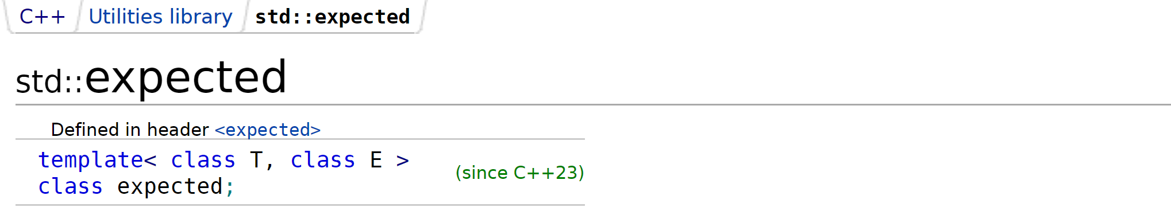
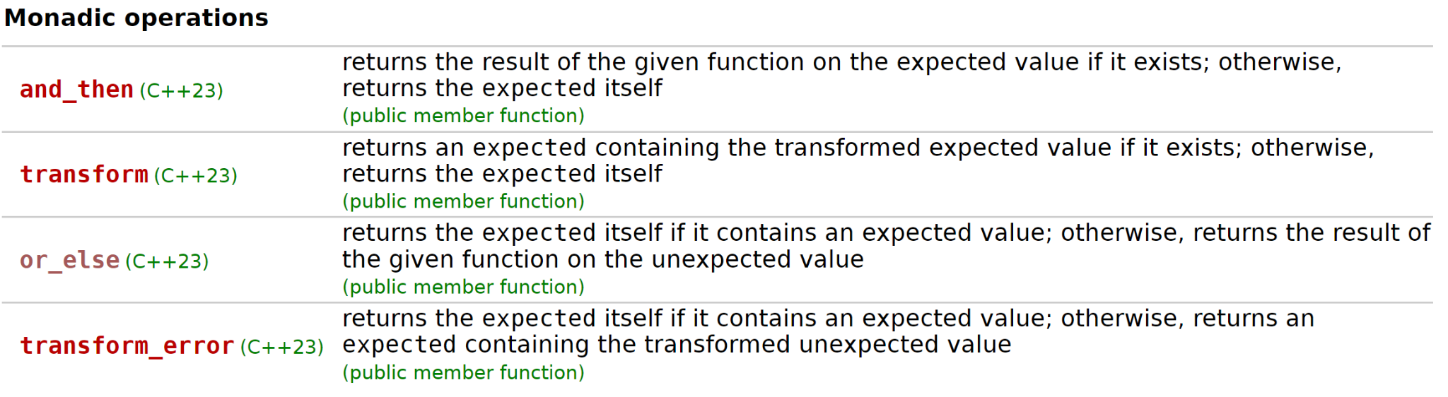
std::expected
01: #include <iostream>
02: #include <expected>
03: #include <stdexcept>
04: #include <string_view>
05:
06: enum class parse_error {
07: invalid_char,
08: overflow,
09: // ...
10: unknown
11: };
12:
13: std::expected<int, parse_error>
14: parse_number(const std::string& str) {
15: try {
16: return std::stoi(str);
17: } catch (const std::invalid_argument &error) {
18: return std::unexpected(parse_error::invalid_char);
19: } catch (const std::out_of_range &error) {
20: return std::unexpected(parse_error::overflow);
21: } catch (...) {
22: return std::unexpected(parse_error::unknown);
23: }
24: }
25:
26: int main() {
27: auto res = parse_number("123")
28: .transform([](auto val){ return val; })
29: .transform_error([](auto error) { /* do error handling */ return error; })
30: .or_else([] (auto /* error */) -> std::expected<int, parse_error>{ return -1; });
31: return 0;
32: }
Notes:
Another very popular one is std::expected… Very similar to std::optional, but embeds an exception component… The semantics are
- you either have a value, or exception… It’s coming into C++23..
And hurray hurray, monadic operations are coming as well…
A short example here, which I wrote (meaning it’s available with some compilers already). Parsing a number is the one we’re looking at…
Assume that can result in several diff errors & we want to propagate it to our callers by means other than throwing…
From there, we can call transform. After wards we have transform_error, which gets called if we have an error… Note here that the first
transform might end up modifying the type of std::expected, but transform_error would still work since the error type will be
preserved in the potentially new type…
We also have or_else as a catch all…

Slide 61
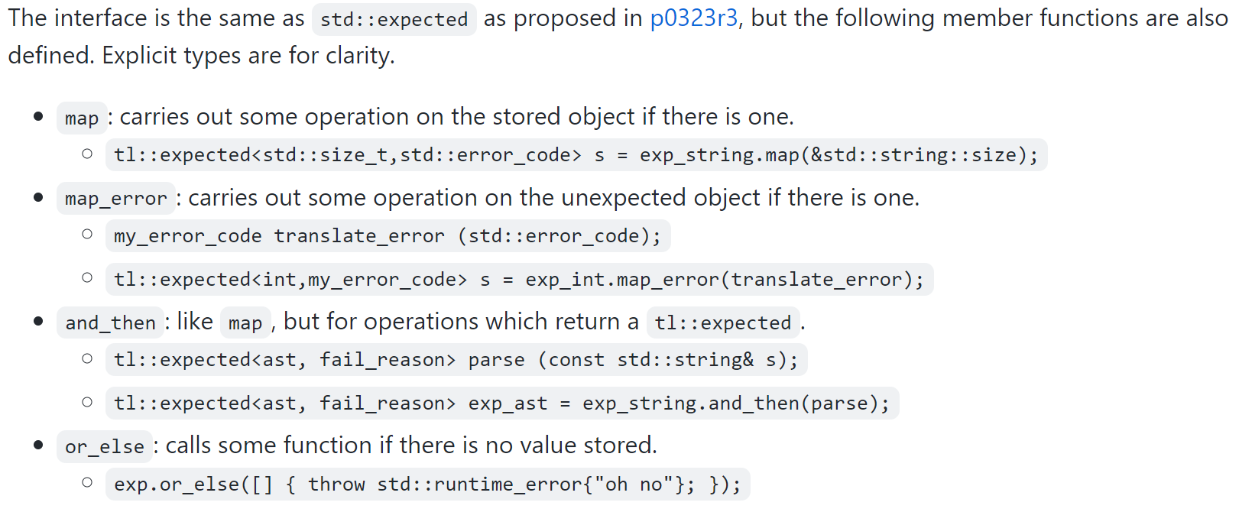
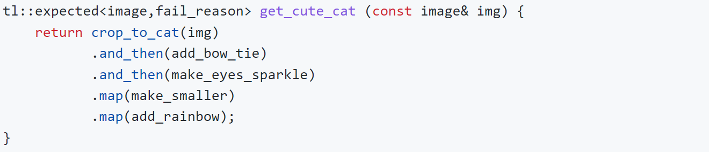
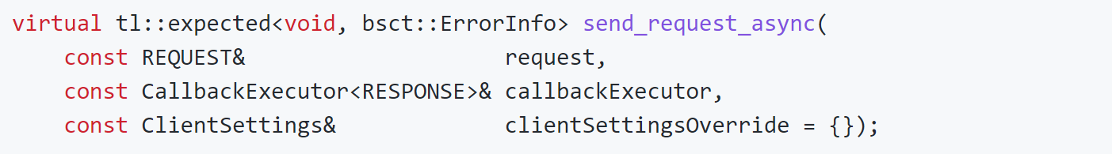
tl::expected
std::optional<bsct::ErrorInfo>
Notes:
Moving on, we also have tl::expected. Available pre-C++23 Same author here…
An example worth looking at is storing void as the expected type… Up till recently I thought that wasn’t possible in the standard version, but it is, which is great!
This is actually from a library I’m working on… We basically send an asynchronous request, submitting
the request itself might fail. But once you submit it, there’s
nothing to wait on, really or to block on => void is a good type for the return value…
Alternatively I could re-write this with an optional exception as return value, but it’s really weird to have the positive
case be exceptional one…
Similarly, it has richer API as compared to std::expected…

Slide 62
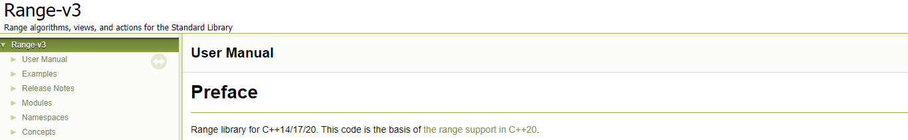
std::ranges
Notes:
Moving onto std:;ranges, those definitely need no intro… They camme in C++20 in the standard… However, I would
argue that iteration wasn’t complete… For example, ranges::to conversion comes in c++23 & this is very convenient.
Obviously those are based on ranges/v3 ← which is a feature complete library where little things are missing… Obviously,
we should be encouraged to use the standard one, but for cases where we haven’t migrated to C++20 yet, such as ours… We
definitely use ranges/v3 which works great…

Slide 63
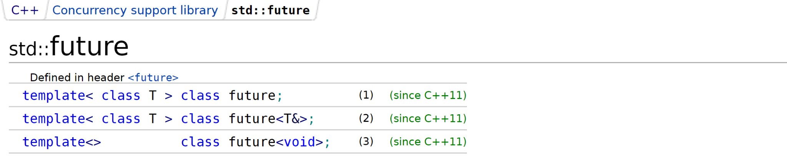
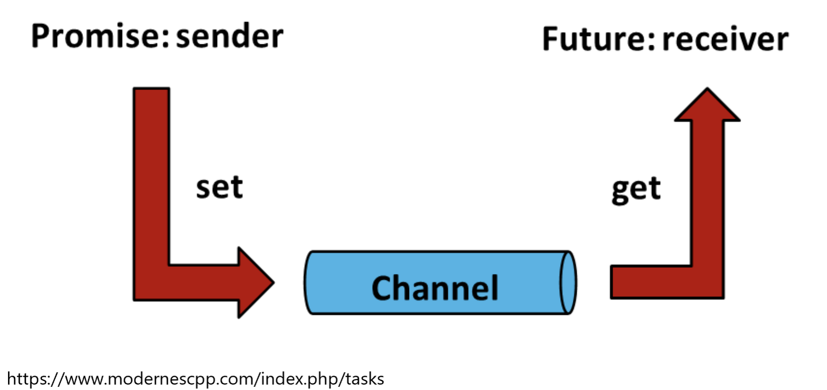
std::future
Notes:
Now moving onto something a bit more interesting… std::future, which we’ve had since c++11.. A type providing means
to access the result of async operation on a type T… A bit of background, most of you might be aware, but a future doesn’t
exist on its own… It’s part of the promise/future async abstraction…
You got a promise on the sender side; future is on the receiver side… All the shared state needed for sync is
encapsulated in this abstraction… Future on its own exposes a method to access the result, called get, which might block…

Slide 64
std::future
01: // sender/producer
02: std::future<int> async_algo() {
03: std::promise<int> p;
04: auto f = p.get_future();
05: std::thread t { [p = std::move(p)] () mutable {
06: int answer = // compute!
07: p.set_value(answer);
08: }};
09: t.detach();
10: return f;
11: }
Blocking
No composability - aka continuation
1: // receiver/consumer
2: int main() {
3: // get() blocks!
4: auto res = async_algo().get();
5: std::cout << "res = " << res << std::endl;
6: }
Notes:
Here we have a very simple use case – sender/producer side which has a promise & creates a future off it…
This is what’s returned, BUT there’s an async operation, represented by this std::thread that will produce our result…
And here we have how thigns look on the consumer side… A trivial example, this get here is going to block, until the promise
is fulfilled…
Now there are 2 fundamental issues with this piece here… One one side, we have get() blocking… Which isn’t really great
for fully async applications… On the other – we cannot achieve composability, which is aka as continuation in async programming…
Continuity is when we get the result from 1 async operation & then want to kick another one & another one & another one…
This is an ideal architecture of async operations – you don’t block until the very last of those chained async operations finishes up…
Now let’s see an API extension for future that can help with that…

Slide 65
std::future
std::future<T1> f1 = ...;
functor
T2 continuationA(T1);
auto f2 = f1.then(continuationA);
monad
std::future<T2> continuationB(T1);
auto f2 = f1.then(continuationB);
auto res = f1
.then(c1)
.then(c2)
// ...
.then(cn).get();
Notes:
Let’s assume we have a std::future<T1>
- We should be able to continue that future with a continuationA that looks like this one…
- Something able to transform the result within that future…
- And this is what we achieve with an imaginary `then` method of our future…
- Hopefully we can appreciate by now that we have the functor pattern over here…
- Another option, as I was mentioning a future’s result can immediately roll into another future...
- In that case, we have our continuation B which actually returns another future…
- And again, we have `then` method for the continuation…
- Now hopefully, we can see the monad peeking at us over here…
- Overall, async programming should really look something like this… We have the whole chain og individual ops & only in
the end we call get() - thus blocking just once…

Slide 66
std::future
Fix the std::future pattern
  I See a Monad in Your Future (link)
  Extensions for concurrency TS (link)
  Unified Futures Proposal (p1054R0)
std::future<T1> f1 = ...;
functor
T2 continuationA(T1);
auto f2 = f1.then(continuationA);
Where does then execute?
monad
Rolled into std::execution framework (P2300R6)
  Senders/Receivers
  Generic async algorithms
  Schedulers
std::future<T2> continuationB(T1);
auto f2 = f1.then(continuationB);
auto res = f1
.then(c1)
.then(c2)
// ...
.then(cn).get();
WIP :(
Notes:
While so far I been speaking hypothetically, there have actually been some attempts to fix the future pattern in the standard…
- Some dating back from the early modern C++ days – this article discusses something like this…
- And this was even the basis of a Technical Spec for extension of the concurrency API in C++...
- On top, there have been further proposals to fix future…
I guess unfortunately, this didn’t make it in the standard… One of the issues with this or more like a missing point is WHERE
does then execute, really… Is it in the consumer side or sender side – and why not either, really….
Overall, the work on improving the concurrency API has been rolled into std::execution framework… This is a very ambitious
research, the goal of which is to come up with the new async framework of the language – a feature as core as containers/algorithms/ranges/etc.
Here similarly we have senders/receivers as abstractions.
Also async algorithms (which is what this then is really)
And also the concept of schedulers – defining the where and how of the async execution…
Sounds really great, but the one bad part is, it’s still WIP, not going to make it into C++23; AND at the same time, we still have a broken
future pattern…

Slide 67
std::monad/std::functor
C++ Monadic Interface (p0650r0)
  Proposal from 2017 (never made it :()
  Generic type classes + customization points
Unifies functor/monad in the standard
1: std::optional<std::string> doubleNumbers(
2: const std::optional<std::string>& input)
3: {
4: return std::functor::map(
5: std::functor::map(
6: std::monad::bind(input, convertStringToInt),
7: doubleInt),
8: convertIntToString);
9: }
Interesting questions raised
  Are smart pointers (pointers) functors?
  Are std::array, std::vector functors?
  etc.
Boost.Hana achieves this via Functor / Monad (and a few other) concepts.
  hana::lazy/hana::optional/hana::tuple
Notes:
Last thing to mention is a proposal, which didn’t really make it to the standard & I believe research on it has terminated…. But
I think it’s worth mentioning since I really like the idea behind it…
So the paper was called C++ Monadic Interface & idea was to really consolidate & standardize monads/functors & to provide
customization points for various things that are considered monads/functors…
This is how our doubleNumbers example would look more or less with this proposal…
Here the composition is done w/o the help of the | operator overloading & it looks a bit less readable. BUT… I personally love
the idea of having a functor/monad as a thing in the standard…
Another great thing about this paper is it raised some interesting questions. For instance:
1) Are (smart) pointers functors
2) Are arrays/vectors functors, etc.
Interestingly, we don’t give Boost enough credit, but within the Boost.Hana library, there’s exactly this thing implemented… There’s
a Functor/Monad concepts with a few concrete types….

Slide 68
A Short Case Study
Notes:
At this point we will wrap up the walkthrough of what’s available to us…
I hope we managed to cover the important pieces - I know there are stuff we must’ve missed, but
I also want to spend a little time going over a case study of a small monadic library…

Slide 69
Revisiting optional(s) again
Monadic ops abstract away error-prone control flow
But… Is std::optional part of something more generic?
  raw pointers, std::shared_ptr, result of find?
  Those are all Maybe-like types…
Can we have generic monads on Maybe-like types?
  Ranges work on range-like types - i.e., begin(), end()
Notes:
To give the context for it… It is to do with optional in a way…
As we said monadic ops for optional encapsulate the control flow, which is typically annoying to look at, but at the same time tends to be quite error prone…
Question - is std::optional part of something more generic… Are there other code patterns/types that can benefit from what we saw today.
By that I mean things like pointers – both raw & smart; results of find, etc.
Those are all, I would argue maybe-like types or objects - there’s either a value or not (similar to optional)...
That said, can we have those same monad operations on Maybe-like types in the general case…
This is to kind of draw comparison with ranges, which is a bunch of algorithms on range-like objects…
So if I have a template type that has begin(), end() (+ a few other things) defined, we more or less can re-use ranges on it.
Can we have something like that for Maybe-like objects?

Slide 70
Revisiting optional(s) again
Monadic ops abstract away error-prone control flow
But… Is std::optional part of something more generic?
  raw pointers, std::shared_ptr, result of find?
  Those are all Maybe-like types…
Can we have generic monads on Maybe-like types?
  Ranges work on range-like types - i.e., begin(), end()
find()
T1*
shared_ptr<T1>
optional<T1>
MaybeLike<T1>
Adapter pattern
MaybeMonad
(T1 -> T2)
MaybeLike<T2>
?
optional<T2>
Notes:
Schematically, what I mean is… All those things (find, raw ptrs, smart ptrs, optional included) map together onto a MaybeLike construct…
Conceptually, we can think of this as something like adapter pattern
Then this MaybeLike adapter object, we can pass through our monadic operations…
And at the very end… We get a MaybeLike adapter object of type T2…
Now the big question is, what is the concrete thing that comes out here (this Maybe<T2>)... Typically, functors/monads are structure-preserving constructs…
Meaning we should expect the same thing to come - e.g. if we have an optional of something as input → we have optional of something as output…
However this raises a bunch of concerns – for instance – what should we do with raw pointers – do we keep creating raw pointers all along the chain of calls? We are likely going to end up with lots of memory leaks or at the very least, we’ll do something not super smart…
We need a simpler solution here – and what I claim it makes sense to do is… Just return optional<T2>...
So just to kinda word it out… We start with any of those above, we do our monadic ops & end with either a result or no result (std::optional)... Kinda makes sense to me (even tho we’re breaking the identity laws of both functors/monads)…
A few eyebrows might be raised due to the memory implications of std::optional, this is something we’ve found more useful than not…
Now let’s see how this is going to look in some code examples…

Slide 71
How does this look?
1: std::optional<std::string> doubleNumbers(
2: const std::optional<std::string>& input)
3: {
4: return input
5: | maybe::and_then(convertStringToInt)
6: | maybe::transform(doubleInt)
7: | maybe::transform(convertIntToString);
8: }
1: std::optional<std::string> doubleNumbers(
2: const std::unique_ptr<std::string>& input)
3: {
4: return input
5: | maybe::and_then(convertStringToInt)
6: | maybe::transform(doubleInt)
7: | maybe::transform(convertIntToString);
8: }
1: std::optional<std::string> doubleNumbers(
2: std::string* input)
3: {
4: return input
5: | maybe::and_then(convertStringToInt)
6: | maybe::transform(doubleInt)
7: | maybe::transform(convertIntToString);
8: }
1: std::optional<std::string> doubleNumbers(
2: const std::unordered_map<std::string, int>& inpMap,
3: const std::string& searchKey)
4: {
5: return maybe::find(inpMap, searchKey)
6: | maybe::transform(doubleInt)
7: | maybe::transform(convertIntToString);
8: }
Notes:
On the top left here we have our canonical by this point example to double numbers… A few things to point here:
- we have this maybe namespace – where our maybe monad lives
- we’ve chosen to overload the | operator cuz I think it’s cool & this is how the example looks with that solution
- here we have and_then and transform implemented pretty much as in the standard
Now let’s look at the other ones:
- we have one for raw pointers as input, the output still being std::optional
- one for smart pointers (same semantics)
- and one for find… this is an interesting one - we have maybe::find… we didn’t really implement our own algorithm,
we really just have a specialization point for associative containers and sequential containers… Sequential containers
use std::find – a linear search… Associative containers have find defined as a member method & it’s MUCH faster than
the linear search std::find does…
Semantics here are: if searchKey is found -> transform the value, etc.
Something we have internally & the reason was we didn’t really try re-inventing the wheel… The actual reason was… We’re kinda still at C++17, we got really into monads, but we didn’t want to wait till c++23… So a small side project ended up into this thing here…
Not a standard proposal by any means, just a small PoC, which we’ve found useful.
Now that’s fair enough… We’re going to see a vertical slice of the implementation – just how transform is implemented & the rest
can be viewed within a godbolt, I’ll place the link for…

Slide 72
Monad
01: // namespace maybe::detail
02:
03:
04:
05:
06:
07:
08:
09:
10:
11:
12: template <typename SpecificMonad>
13: struct Monad
14: {
15: template <typename Maybe>
16:
17: friend constexpr auto operator|(Maybe &&maybe, Monad&& monad)
18: {
19:
20: }
21: };
Notes:
So here, we’re in our maybe namespace… Start with building out the implementation components (hence in detail…)
We have our Monad struct, it has a type parameter SpecificMonad… This might give a bit of hint we’ll be using CRTP in here…
A bit below we have our pipe operator & we gonna define it here as well… 2 parameters as is typical:
- A maybe-like object on the left
- a monad on the right
And now the very first thing we need to do as good library developers is throw a type requirement…

Slide 73
Monad
01: // namespace maybe::detail
02:
03:
04:
05:
06:
07:
08:
09:
10:
11:
12: template <typename SpecificMonad>
13: struct Monad
14: {
15: template <typename Maybe>
16: requires MaybeLike<Maybe>
17: friend constexpr auto operator|(Maybe &&maybe, Monad&& monad)
18: {
19:
20: }
21: };
Notes:
We want maybe to be maybe-like… Otherwise, if we pass something like an integer, we’d like to see a nice compiler error…
So what is this maybe like – well it’s a concept that looks like this

Slide 74
Monad
01: // namespace maybe::detail
02:
03: template <typename T>
04: concept NotVoid = !std::same_as<T, void>;
05:
06: template <typename M>
07: concept MaybeLike = requires (M obj) {
08: {bool(obj)};
09: {*obj} -> NotVoid;
10: };
11:
12: template <typename SpecificMonad>
13: struct Monad
14: {
15: template <typename Maybe>
16: requires MaybeLike<Maybe>
17: friend constexpr auto operator|(Maybe &&maybe, Monad&& monad)
18: {
19:
20: }
21: };
Notes:
2 things required:
- we want our object to be bool convertible, so we can use it in condition expression
- we want to have the dereference operator defined & ideally we want its return type to be non-void…
Now with this in place, let’s see the implementation of the | operator

Slide 75
Monad
01: // namespace maybe::detail
02:
03: template <typename T>
04: concept NotVoid = !std::same_as<T, void>;
05:
06: template <typename M>
07: concept MaybeLike = requires (M obj) {
08: {bool(obj)};
09: {*obj} -> NotVoid;
10: };
11:
12: template <typename SpecificMonad>
13: struct Monad
14: {
15: template <typename Maybe>
16: requires MaybeLike<Maybe>
17: friend constexpr auto operator|(Maybe &&maybe, Monad&& monad)
18: {
19: return std::invoke(static_cast<SpecificMonad&&>(monad), std::forward<Maybe>(maybe));
20: }
21: };
Notes:
What we’re going to do is invoke our monad & pass the maybe type to it…

Slide 76
Monad
01: // namespace maybe::detail
02:
03: template <typename T>
04: concept NotVoid = !std::same_as<T, void>;
05:
06: template <typename M>
07: concept MaybeLike = requires (M obj) {
08: {bool(obj)};
09: {*obj} -> NotVoid;
10: };
11:
12: template <typename SpecificMonad>
13: struct Monad
14: {
15: template <typename Maybe>
16: requires MaybeLike<Maybe>
17: friend constexpr auto operator|(Maybe &&maybe, Monad&& monad)
18: {
19: return std::invoke(static_cast<SpecificMonad&&>(monad), std::forward<Maybe>(maybe));
20: }
21: };
CRTP: each monad defines its own () method
Notes:
So this is where the static cast from CRTP kicks in & obviously
each specific monad is going to need to implement the () operator for this call…
I guess the next thing here is to show how a specific monad looks like, which should hopefully clarify any questions like wtf is happening….

Slide 77
TransformMonad (or fmap)
01: // namespace maybe::detail
02:
03: template <typename Callable>
04: struct TransformMonad : public Monad<TransformMonad<Callable>>
05: {
06:
07:
08: template <typename Maybe>
09: constexpr auto operator()(Maybe&& maybe) const
10: {
11:
12:
13:
14:
15:
16:
17:
18:
19: }
20: };
Notes:
Let’s implement our transform monad here… Again we call it a monad, but we really have our functor here…
Basically to make CRTP work, we need to extend our generic monad & pass ourselves to it…
And over here is where we have our () operator, which we invoke from Monad and just as a reminder that’s how it looked…

Slide 78
TransformMonad (or fmap)
friend constexpr auto operator|(Maybe &&maybe, Monad&& monad)
{
return std::invoke(static_cast<SpecificMonad&&>(monad), std::forward<Maybe>(maybe));
}
01: // namespace maybe::detail
02:
03: template <typename Callable>
04: struct TransformMonad : public Monad<TransformMonad<Callable>>
05: {
06:
07:
08: template <typename Maybe>
09: constexpr auto operator()(Maybe&& maybe) const
10: {
11:
12:
13:
14:
15:
16:
17:
18:
19: }
20: };

Slide 79
TransformMonad (or fmap)
01: // namespace maybe::detail
02:
03: template <typename Callable>
04: struct TransformMonad : public Monad<TransformMonad<Callable>>
05: {
06: Callable d_callable;
07:
08: template <typename Maybe>
09: constexpr auto operator()(Maybe&& maybe) const
10: {
11:
12:
13:
14:
15:
16:
17:
18:
19: }
20: };
Notes:
We have our callable, which is the lambda (or function) users are gonna be passing…
(next slide is reference)

Slide 80
TransformMonad (or fmap)
01: // namespace maybe::detail
02:
03: template <typename Callable>
04: struct TransformMonad : public Monad<TransformMonad<Callable>>
05: {
06: Callable d_callable;
07:
08: template <typename Maybe>
09: constexpr auto operator()(Maybe&& maybe) const
10: {
11:
12:
13:
14:
15:
16:
17:
18:
19: }
20: };
Stored by reference (promise)
Notes:
And this is actually going to be retained by reference (as much as it doesn’t look like it here)
But take that as a promise…
Generally, we don’t want our library to retain anything – making it as pure as possible.
Next thing is…

Slide 81
TransformMonad (or fmap)
01: // namespace maybe::detail
02:
03: template <typename Callable>
04: struct TransformMonad : public Monad<TransformMonad<Callable>>
05: {
06: Callable d_callable;
07:
08: template <typename Maybe>
09: constexpr auto operator()(Maybe&& maybe) const
10: {
11: using MaybeInnerType = decltype(*std::declval<Maybe>());
12: using FuncReturnType = std::invoke_result_t<Callable, MaybeInnerType>;
13: using MonadReturnType = std::optional<FuncReturnType>;
14:
15:
16:
17:
18:
19: }
20: };
Notes:
A few type aliases in our () operator….

Slide 82
TransformMonad (or fmap)
01: // namespace maybe::detail
02:
03: template <typename Callable>
04: struct TransformMonad : public Monad<TransformMonad<Callable>>
05: {
06: Callable d_callable;
07:
08: template <typename Maybe>
09: constexpr auto operator()(Maybe&& maybe) const
10: {
11: using MaybeInnerType = decltype(*std::declval<Maybe>());
12: using FuncReturnType = std::invoke_result_t<Callable, MaybeInnerType>;
13: using MonadReturnType = std::optional<FuncReturnType>;
14:
15:
16:
17:
18:
19: }
20: };
i.e. T1
Notes:
First one here is our T1 & we obtain it via this type expression…

Slide 83
TransformMonad (or fmap)
01: // namespace maybe::detail
02:
03: template <typename Callable>
04: struct TransformMonad : public Monad<TransformMonad<Callable>>
05: {
06: Callable d_callable;
07:
08: template <typename Maybe>
09: constexpr auto operator()(Maybe&& maybe) const
10: {
11: using MaybeInnerType = decltype(*std::declval<Maybe>());
12: using FuncReturnType = std::invoke_result_t<Callable, MaybeInnerType>;
13: using MonadReturnType = std::optional<FuncReturnType>;
14:
15:
16:
17:
18:
19: }
20: };
i.e. T2
Notes:
Next one is the return type of our lambda, which is T2

Slide 84
TransformMonad (or fmap)
01: // namespace maybe::detail
02:
03: template <typename Callable>
04: struct TransformMonad : public Monad<TransformMonad<Callable>>
05: {
06: Callable d_callable;
07:
08: template <typename Maybe>
09: constexpr auto operator()(Maybe&& maybe) const
10: {
11: using MaybeInnerType = decltype(*std::declval<Maybe>());
12: using FuncReturnType = std::invoke_result_t<Callable, MaybeInnerType>;
13: using MonadReturnType = std::optional<FuncReturnType>;
14:
15:
16:
17:
18:
19: }
20: };
i.e. optional<T2>
Notes:
And finally, the monad’s return type, which is std::optional<T2>...
We were saying std::optional is our sink template – where we’re gonna be storing the result…

Slide 85
TransformMonad (or fmap)
01: // namespace maybe::detail
02:
03: template <typename Callable>
04: struct TransformMonad : public Monad<TransformMonad<Callable>>
05: {
06: Callable d_callable;
07:
08: template <typename Maybe>
09: constexpr auto operator()(Maybe&& maybe) const
10: {
11: using MaybeInnerType = decltype(*std::declval<Maybe>());
12: using FuncReturnType = std::invoke_result_t<Callable, MaybeInnerType>;
13: using MonadReturnType = std::optional<FuncReturnType>;
14: if (maybe)
15: {
16: return MonadReturnType{std::invoke(d_callable, *std::forward<Maybe>(maybe))};
17: }
18: return MonadReturnType{};
19: }
20: };
1: std::optional<std::string> doubleNumbers(
2: const std::optional<std::string>& input)
3: {
4: return input
5: | maybe::and_then(convertStringToInt)
6: | maybe::transform(doubleInt)
7: | maybe::transform(convertIntToString);
8: }
Notes:
Lastly, we have our business logic which we’re familiar with at this point…
If maybe, then we call our callable, passing down the input T1…
Otherwise, we return an empty T2…
And this is our TransformMonad implemented, really… A little bit naive, some more concepts needed to prevent against bad compile-time experience… But
good enough for illustrative purposes…
Now we just need a bit of scaffolding to make the nice syntax from the examples work…

Slide 86
MonadCreator
01: // namespace maybe::detail
02:
03: template <template <typename> class SpecificMonad>
04: struct MonadCreator
05: {
06: template <typename Callable>
07: constexpr auto operator()(Callable&& c) const
08: {
09: return SpecificMonad<Callable&&>{{}, std::forward<Callable>(c)};
10: }
11: };
1: std::optional<std::string> doubleNumbers(
2: const std::optional<std::string>& input)
3: {
4: return input
5: | maybe::and_then(convertStringToInt)
6: | maybe::transform(doubleInt)
7: | maybe::transform(convertIntToString);
8: }
Notes:
Firstly, we have a MonadCreator component, Still in detail…
We’re not gonna be asking of our users to know of any of these…
This guy just has a () operator, taking our callable...
So, when we call transform or and_then, we’ll be calling this method here…

Slide 87
MonadCreator
01: // namespace maybe::detail
02:
03: template <template <typename> class SpecificMonad>
04: struct MonadCreator
05: {
06: template <typename Callable>
07: constexpr auto operator()(Callable&& c) const
08: {
09: return SpecificMonad<Callable&&>{{}, std::forward<Callable>(c)};
10: }
11: };
Notes:
And here is where we initialize & return our SpecificMonad… Hence the MonadCreator name

Slide 88
MonadCreator
01: // namespace maybe::detail
02:
03: template <template <typename> class SpecificMonad>
04: struct MonadCreator
05: {
06: template <typename Callable>
07: constexpr auto operator()(Callable&& c) const
08: {
09: return SpecificMonad<Callable&&>{{}, std::forward<Callable>(c)};
10: }
11: };
Stored by reference (promise kept!)
Notes:
And as I promised, we store Callable here by reference…

Slide 89
maybe::transform
01: // namespace maybe
02:
03: constexpr static auto transform =
04: detail::MonadCreator<detail::TransformMonad>();
05:
06:
07:
08:
09:
10:
Notes:
The last bit is where we really define the public API… Our transform is just an instantiation of the MonadCreator, parametrized with the transofmr monad…

Slide 90
maybe::transform
01: // namespace maybe
02:
03: constexpr static auto transform =
04: detail::MonadCreator<detail::TransformMonad>();
05:
06:
07:
08:
09:
10:
Exposed to clients
Notes:
And this is what we’re going to expose to our clients…
Pretty much it, a few levels of hierarchy, but let’s try to run through an example & see what’s happening…

Slide 91
maybe::transform
01: // namespace maybe
02:
03: constexpr static auto transform =
04: detail::MonadCreator<detail::TransformMonad>();
05:
06:
07:
08:
09:
10:
Exposed to clients
inputOpt | maybe::transform([](auto && el) {}) …
Notes:
If we have something like this, what’s the sequence of things that happens…
Well we have the pipe operator over here… We need to first resolve its 2 arguments…
The inputOpt is kinda good to go…
What about the the maybe::transform…

Slide 92
maybe::transform
01: // namespace maybe
02:
03: constexpr static auto transform =
04: detail::MonadCreator<detail::TransformMonad>();
05:
06:
07:
08:
09:
10:
Exposed to clients
inputOpt | maybe::transform([](auto && el) {}) …
MonadCreator<TransformMonad>::opreator(Callback c)
Notes:
As we saw, this ends up calling the () operator of MonadCreator…
Once this executes…

Slide 93
maybe::transform
01: // namespace maybe
02:
03: constexpr static auto transform =
04: detail::MonadCreator<detail::TransformMonad>();
05:
06:
07:
08:
09:
10:
Exposed to clients
inputOpt | maybe::transform([](auto && el) {}) …
TransformMonad
Notes:
We’re left with a new TransformMonad in the end…

Slide 94
maybe::transform
01: // namespace maybe
02:
03: constexpr static auto transform =
04: detail::MonadCreator<detail::TransformMonad>();
05:
06:
07:
08:
09:
10:
Exposed to clients
inputOpt | maybe::transform([](auto && el) {}) …
TransformMonad
Monad<TransformMonad>::operator|
Notes:
At this point, we have the 2 inputs to our | operator ready…
One is inputOpt & the other is our TransformMonad…
The overload resolution should be able to pick the right | overload.

Slide 95
maybe::transform
01: // namespace maybe
02:
03: constexpr static auto transform =
04: detail::MonadCreator<detail::TransformMonad>();
05:
06:
07:
08:
09:
10:
Exposed to clients
inputOpt | maybe::transform([](auto && el) {}) …
TransformMonad
Monad<TransformMonad>::operator|
TransformMonad::operator()
Notes:
The | of monad ends up calling the () operator of TransformMonad & this is triggers the functor’s logic….
At the end of the execution of the first | in our potentially long chain of calls, we will have our new optional produced in the end…

Slide 96
maybe::transform
01: // namespace maybe
02:
03: constexpr static auto transform =
04: detail::MonadCreator<detail::TransformMonad>();
05:
06:
07:
08:
09:
10:
Exposed to clients
Notes:
To wrap up… Just as we had transform defined…

Slide 97
maybe::transform
01: // namespace maybe
02:
03: constexpr static auto transform =
04: detail::MonadCreator<detail::TransformMonad>();
05:
06: constexpr static auto and_then =
07: detail::MonadCreator<detail::AndThenMonad>();
08:
09: constexpr static auto or_else =
10: detail::MonadCreator<detail::OrElseMonad>();
Exposed to clients
Notes:
We end up defining our other monads… Here we have and_then and or_else… This is our full API we expose to clients…

Slide 98
The complete thing - link
Defines & implements the rest
  AndThenMonad
  OrElseMonad
Provides adapter for find()
  Including specializations for associative & sequential containers
Also adapter for std::future… But it’s less than ideal as it blocks on the receiver side…
Notes:
Now this link over here is what has the full impl & some examples…
If you’ve found that interesting, feel free to take a look. But basically
- impl of AndThenMonad and OrElseMonad
- an adapter to find(), which includes specialization for associative and sequential containers… Because if we have associative containers, we dont want to use std::find, but rather make use of the improved performance…
- lastly, I played around with adapter for std::future… std::future is similarly maybe-like, but we do run into the issues we discussed before – we block on the receiver side, so it’s less than ideal

Slide 99
Thank you!
https://TechAtBloomberg.com/cplusplus
https://www.bloomberg.com/careers
Contact us: gkoyrushki@bloomberg.net
afisher92@bloomberg.net
Notes:
Add grants

Slide 100
Appendix A.1: Optional Functor Laws
Adopted to C++ from http://learnyouahaskell.com/functors-applicative-functors-and-monoids
01: int val = 1;
02: std::optional<int> myOpt {val};
03:
04: // LAW 1: Idenitity Preservation
05: auto id = [](int el) { return el; };
06: assert(
07: myOpt.transform(id) IS_EQUIV myOpt
08: );
09:
10: // LAW 2: Composition Preservation
11: auto f = [](int el) { return el * 2; };
12: auto g = [](int el) { return el - 2; };
13: assert(
14: myOpt.transform(f).transform(g) IS_EQIV
15: myOpt.transform([](int el) { return g(f(el)); })
16: );

Slide 101
Appendix A.2: Optional Monad Laws
Adopted to C++ from http://learnyouahaskell.com/a-fistful-of-monads
01: int val = 1;
02: std::optional<int> myOpt {val};
03:
04: // LAW 1: Left Identity Preservation
05: auto mul2 = [](int el) { return std::optional<int>{el * 2}; };
06: assert(
07: myOpt.and_then(mul2) IS_EQUIV mul2(val)
08: );
09:
10: // LAW 2: Right Identity Preservation
11: auto id = [](int el) { return std::optional<int>{el}; }; // identity method
12: assert(
13: myOpt.and_then(id) IS_EQUIV myOpt;
14: );
15:
16: // LAW 3: Associativity Preservation
17: auto f = [](int el) { return std::optional<int>{el * 2}; };
18: auto g = [](int el) { return std::optional<int>{el - 2}; };
19: assert(
20: myOpt.and_then(f).and_then(g) IS_EQIV
21: myOpt.and_then([](int el){ return f(el).and_then(g); })
22: );

