Slide 1


Slide 2
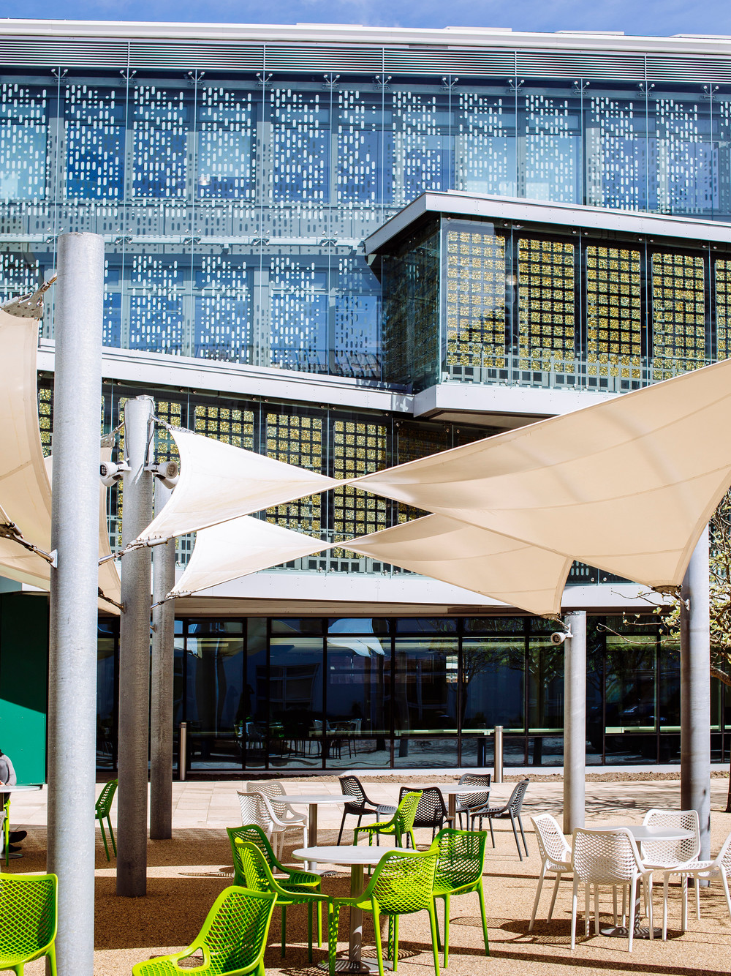
Jack Barnard
Lindsay Ezeagu
Gurvir Dhillon
Joe McNeil
Jack Simms

Slide 3
What do you want in a graduate?
Application Programming
Web Programming
Usability Engineering
Data Structures and Algorithms
Software Engineering Theory and Practice
Architecture and Operating Systems
Databases
Networks
Complex Problem Solving
Individual Project
https://www.port.ac.uk/study/courses/undergraduate/bsc-hons-software-engineering

Slide 4
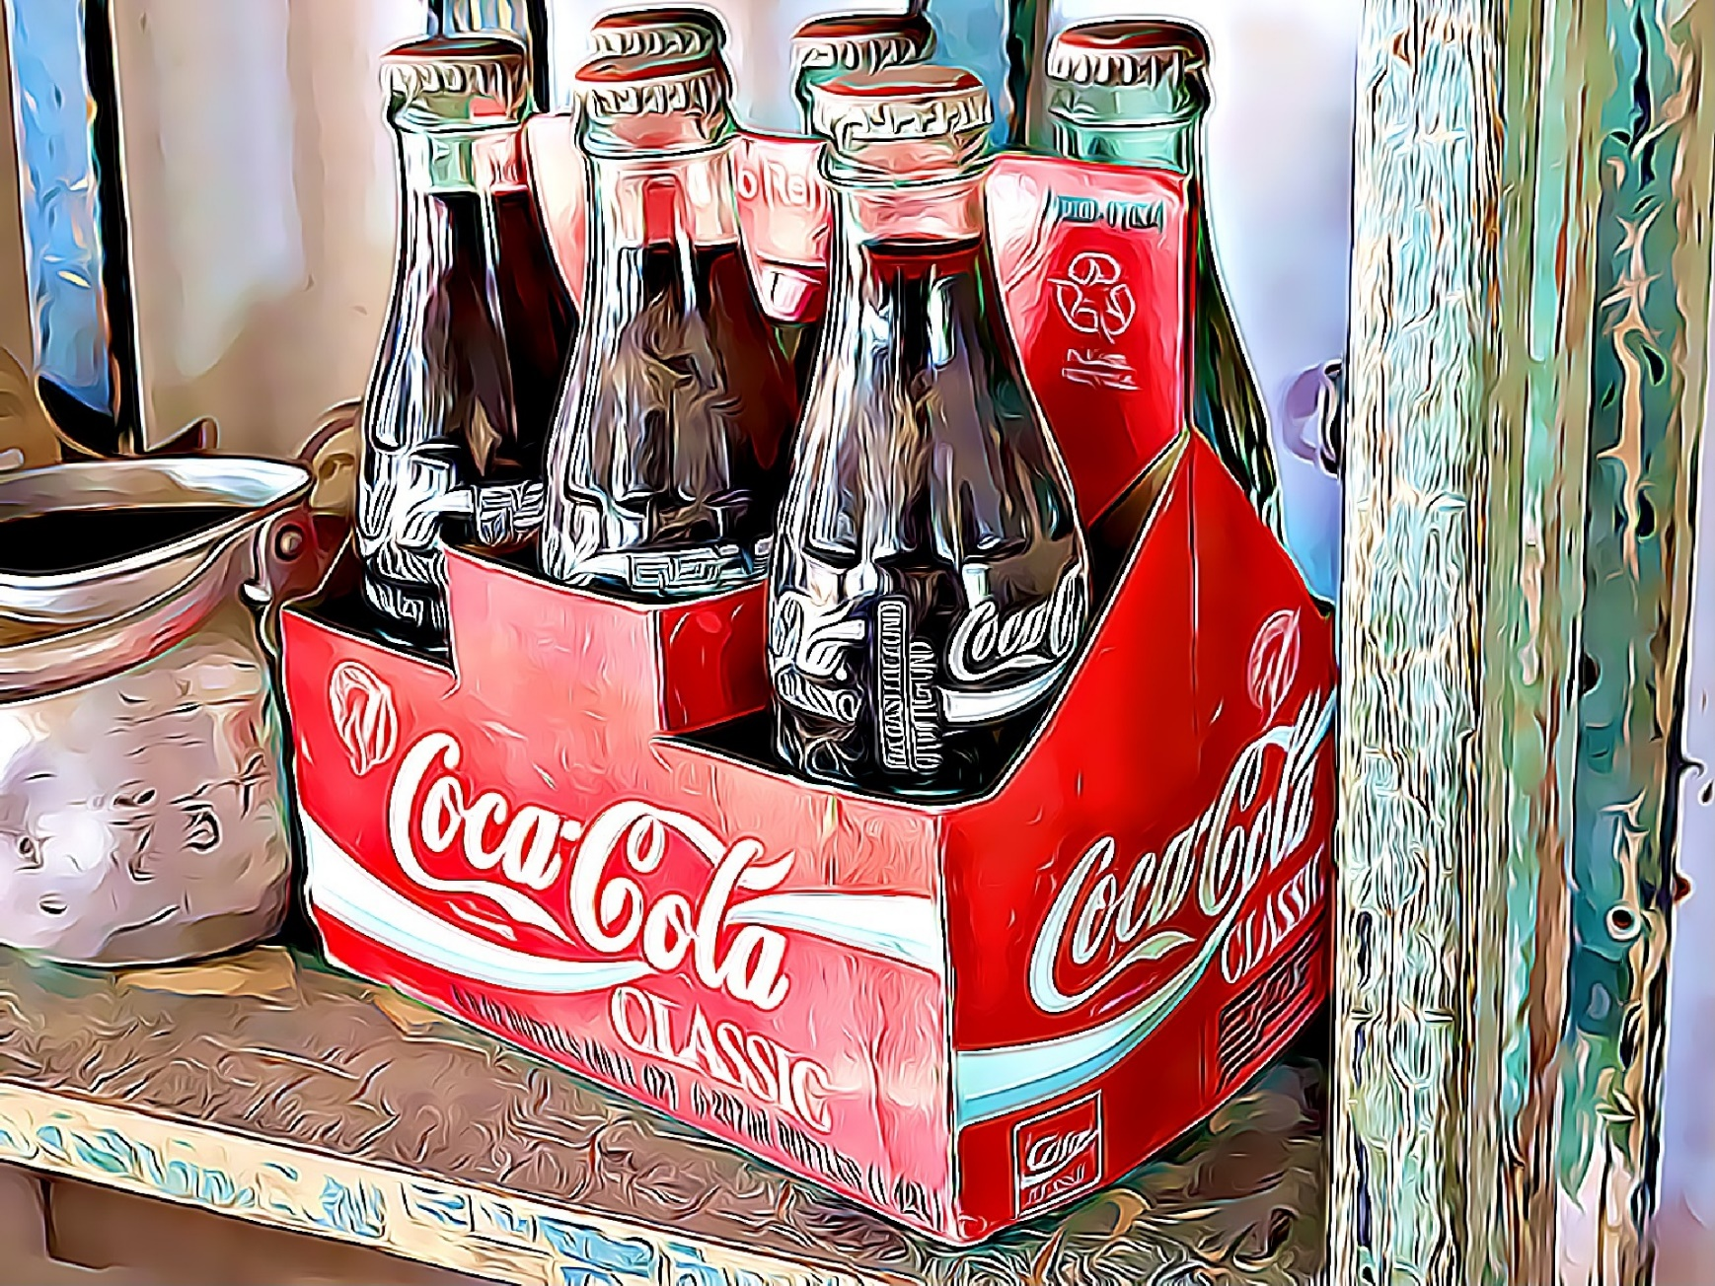
Software Engineering Culture

Slide 5
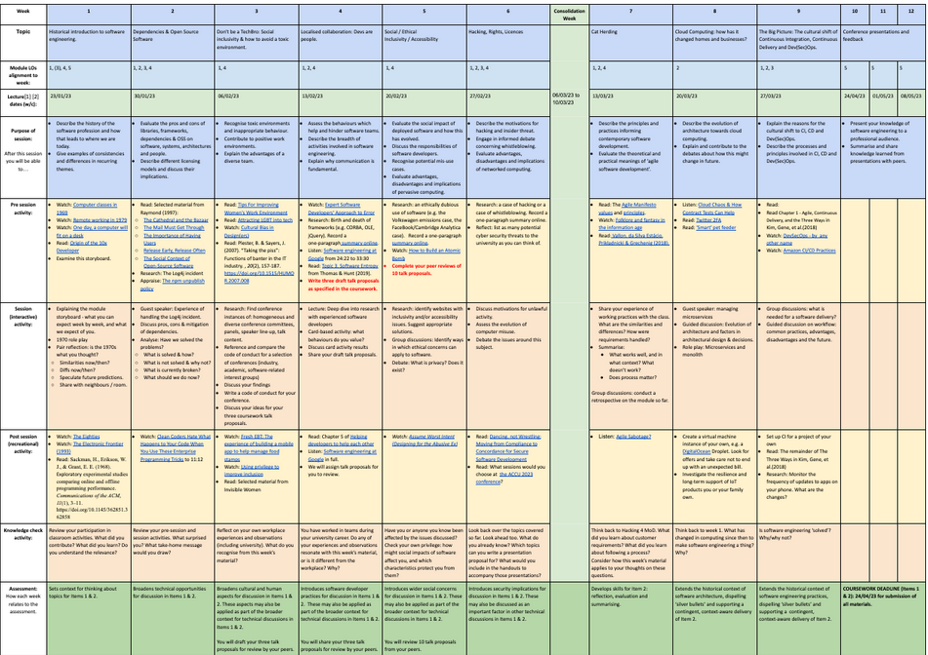

Slide 6
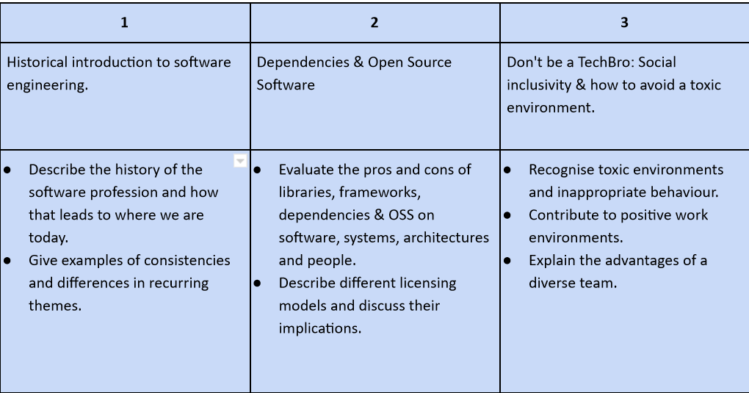

Slide 7
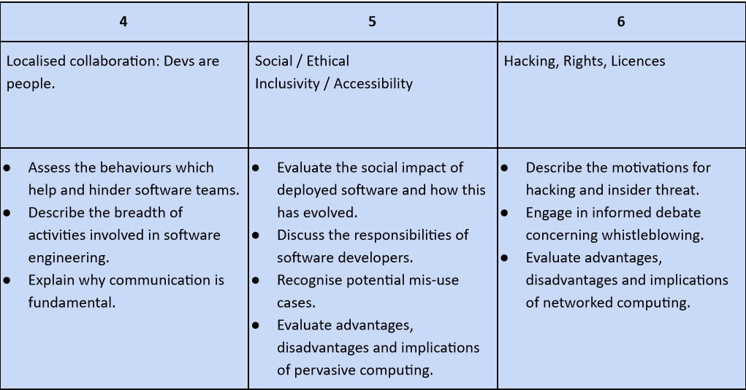

Slide 8
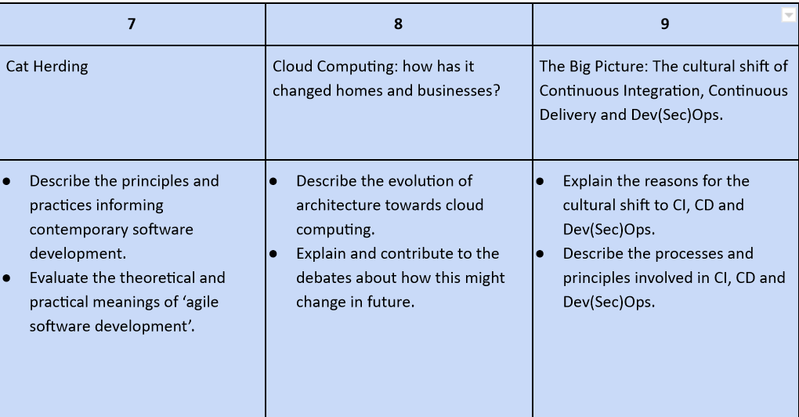

Slide 9
The “Conference” assignment
A speaker bio
3 proposals
Peer review
Slides
Handout
Presentation
  In person
  or
  Video

Slide 10
Are we on the right track?
gail.ollis@port.ac.uk

Slide 11
Jack Barnard
Lindsay Ezeagu
Gurvir Dhillon
Joe McNeil
Jack Simms

